Slide 1
Ten Years of the NJLA CUS/ACRL-NJ Technology Innovation Award
Mary Mallery, Ph.D., Montclair State University
NJLA 2012 Conference College and University Section Luncheon
Atlantic City, NJ

Slide 2
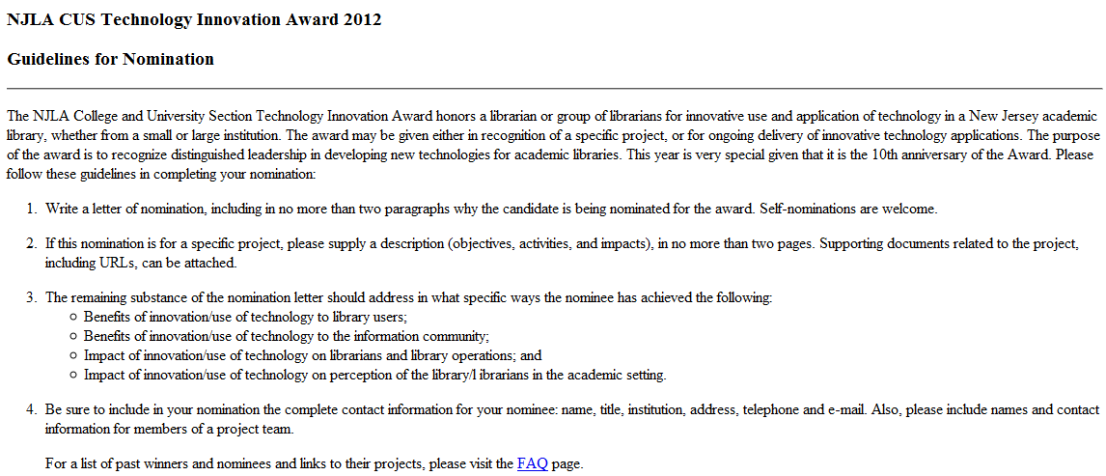

Slide 3
Reflections from Past Winners
(2002) Sr. Anita Talar (Project Director), Beth Bloom, Marta Deyrup, and Xue-Ming Bao, Seton Hall University, for “Information Literacy in the Wired University” project.
2012: Beth Bloom, Marta Deyrup, and Paul Fisher have been awarded a prestigious Google research grant of $15,000 to track undergraduate students' information-seeking behavior at Seton Hall University. This builds on an earlier CDI grant that Bloom and Deyrup received from the TLTC last year

Slide 4
(2003) Edward Corrado, System Administrator, Rider University Libraries, for his groundbreaking work in using Open Source Software (OSS) in library applications.
2012 Edward Corrado, Director of Library Technology, SUNY Binghamton University Libraries

Slide 5
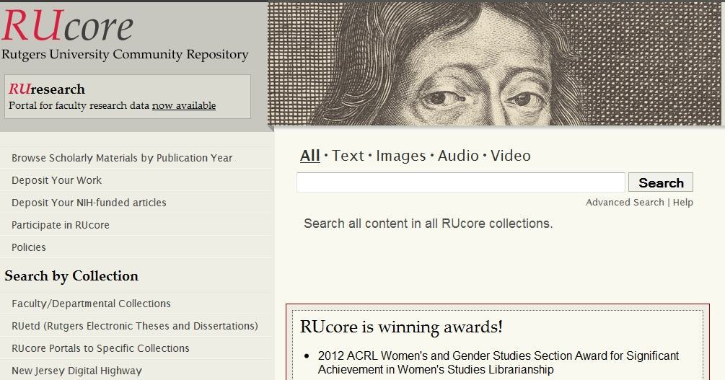
(2004) Ronald Jantz and theFEDORA Implementation Team, Rutgers University Libraries for "FEDORA: A Framework for Creating a Digital Library Repository"project
*2012: Ronald Jantz, Digital Library Architect, Scholarly Communication Center, Rutgers U. Libraries.

Slide 6
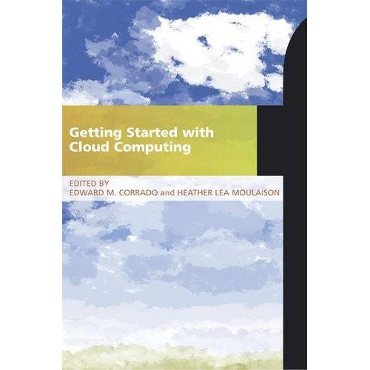
*(2006) Edward Corrado, Heather Moulaison, and Eric Thul, The College of New Jersey, for "Integrating RSS Feeds of New Library Acquisitions into a Course Management System"project.
2012 Co-editors of LITA Guide to:

Slide 7
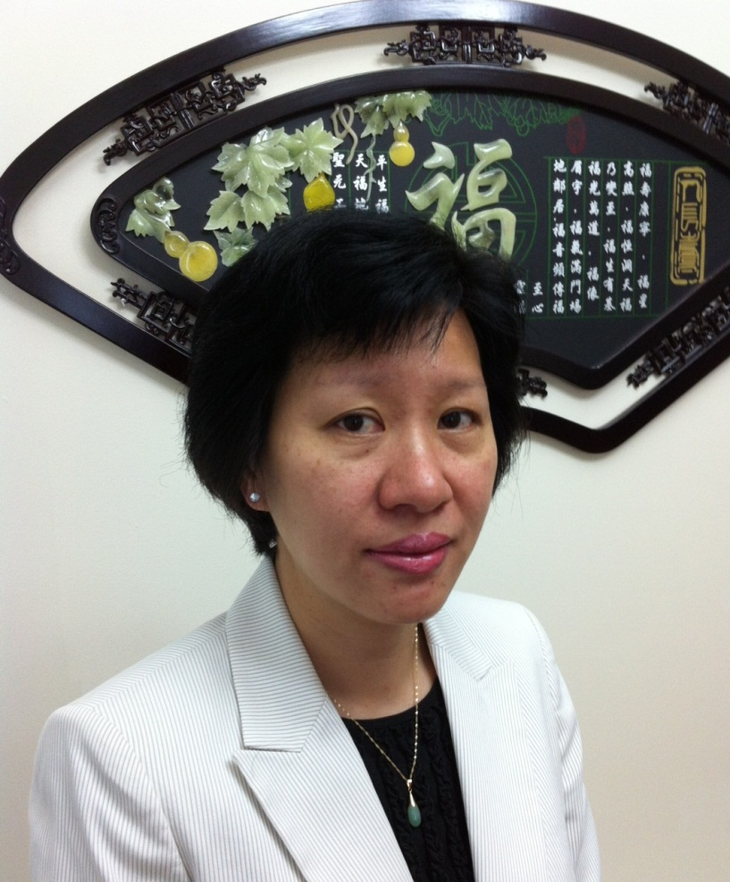
Courtesy of abowman.com
*(2008) the team of Choong Hoong Liew, Web Designer; and Mei Ling Lo, Math/Computer Science Librarian, at Rutgers University for the "Rutgers Library Toolbar."

Slide 8
*(2011) Technology Innovation Award winner was the NJVid Commercial Video Collection Project Team, a multi-institutional statewide effort led by:
Sandra Miller, Co-Principal Investigator, NJVid IMLS Grant (William Paterson Univ.);
Grace Agnew, Co-Principal Investigator, NJVid IMLS Grant (Rutgers U.);
Sujay Daniel, NJVid Manager, NJEdge Senior Information System Architect; and
Jane Hutchison, Chair, VALE Digital Media Committee (William Paterson University)

Slide 9
Help us discover new Technology Innovation Award winners! Nominate your innovators!
Mary Mallery, Ph.D.
mallerym@mail.montclair.edu

