Slide 1
Yo !

Slide 2
Yo !
Yes!

Slide 3
Yo !
Yes!
talking about tech

Slide 4
Yo !
Yes!
talking about tech
with thanks to

Slide 5
talking about tech
Yo !
Yes!
with thanks to

Slide 10
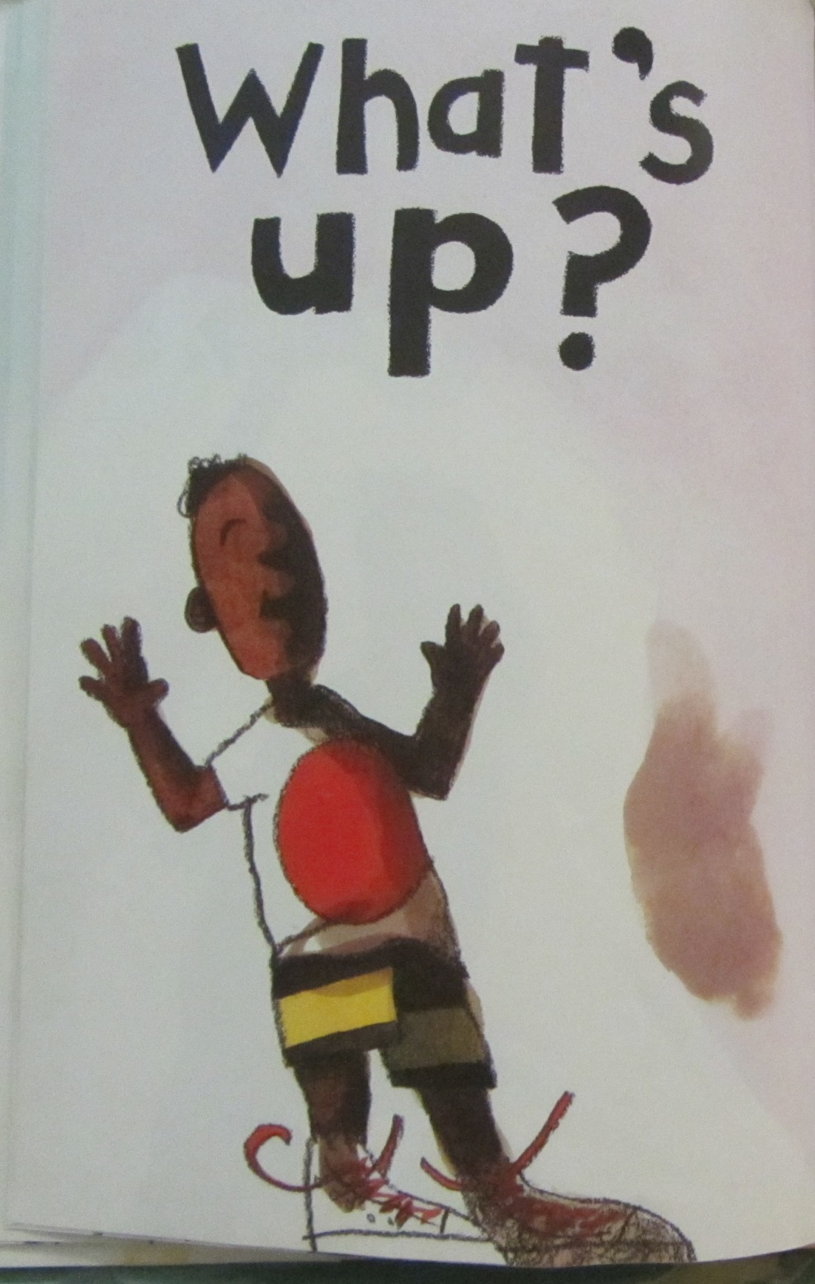

Slide 13
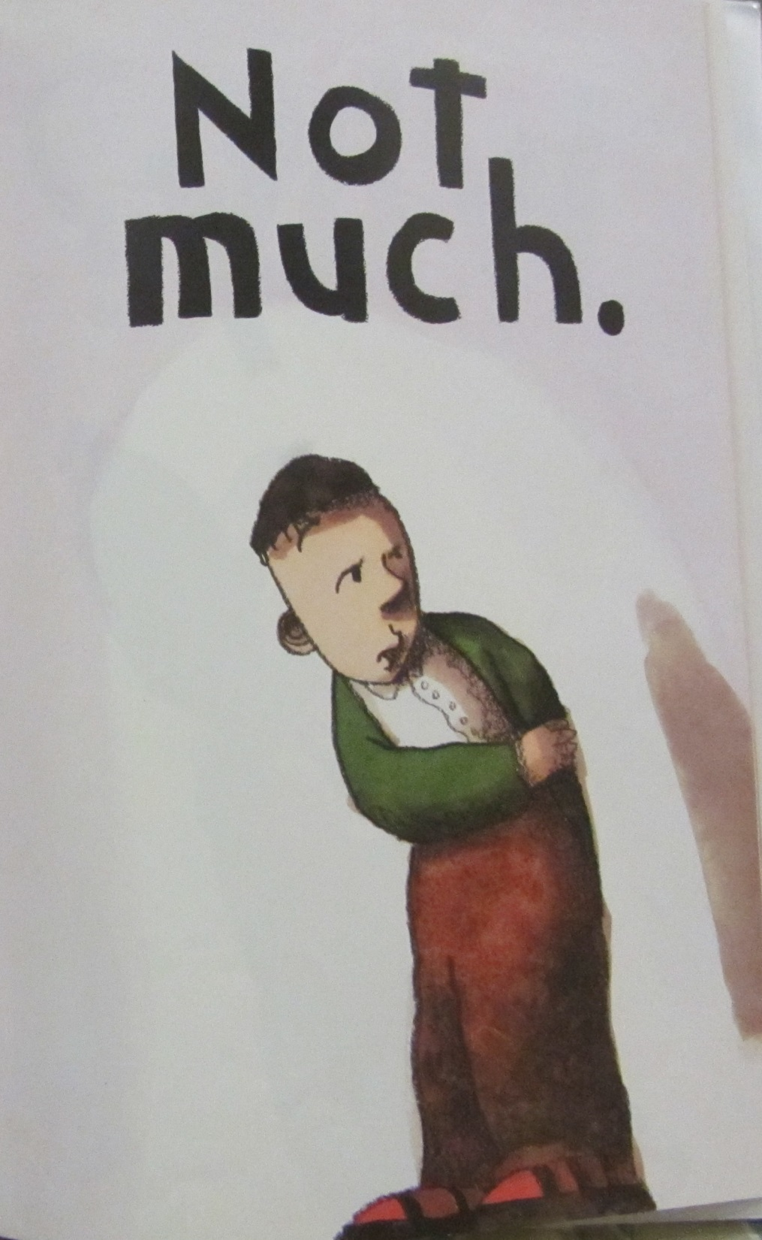

Slide 15
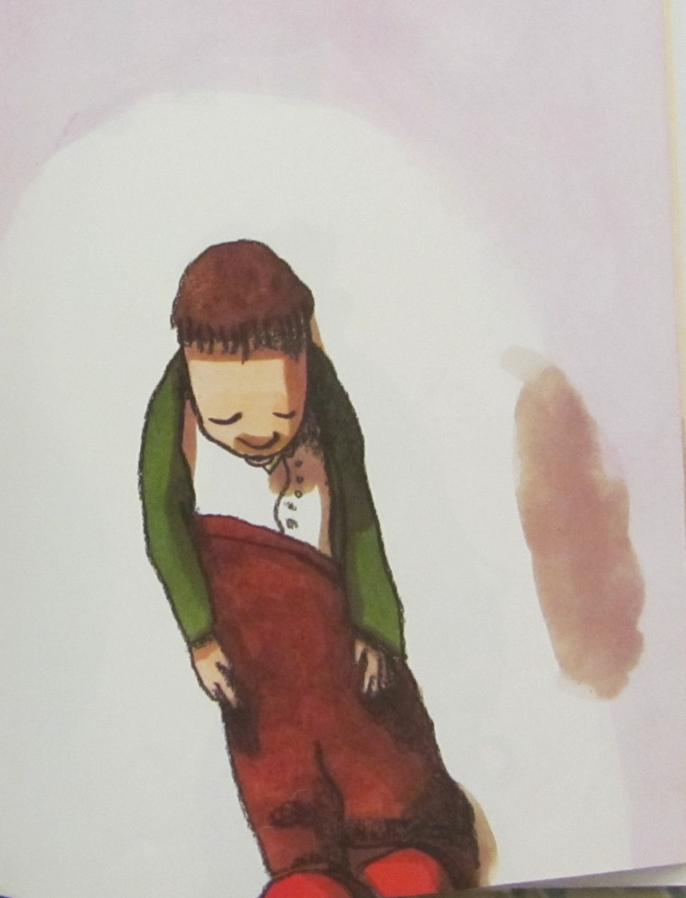

Slide 17
What methods of communication?

Slide 20
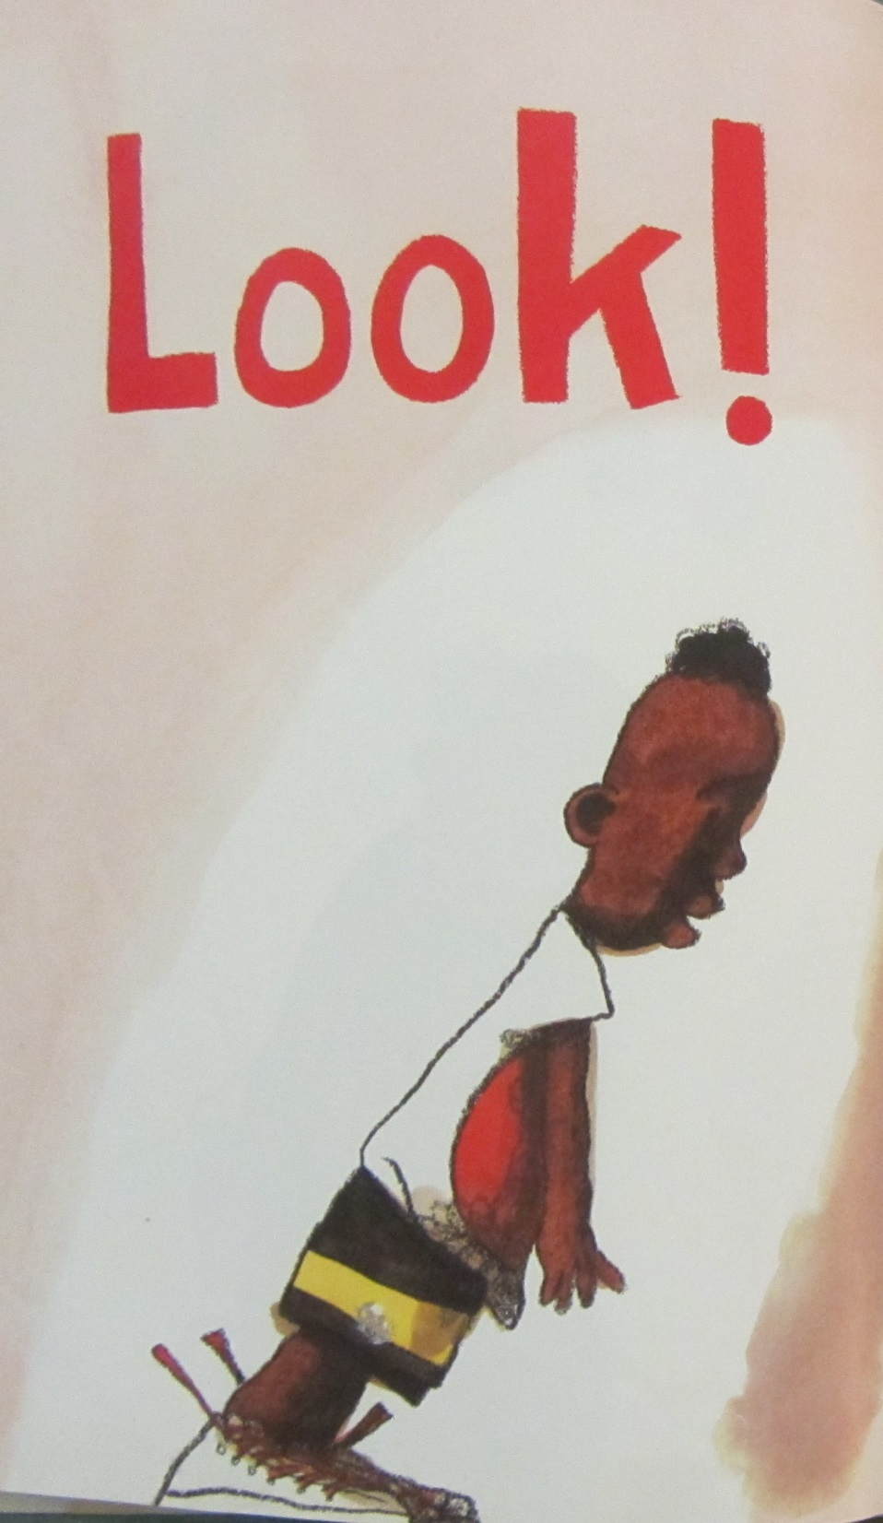

Slide 21
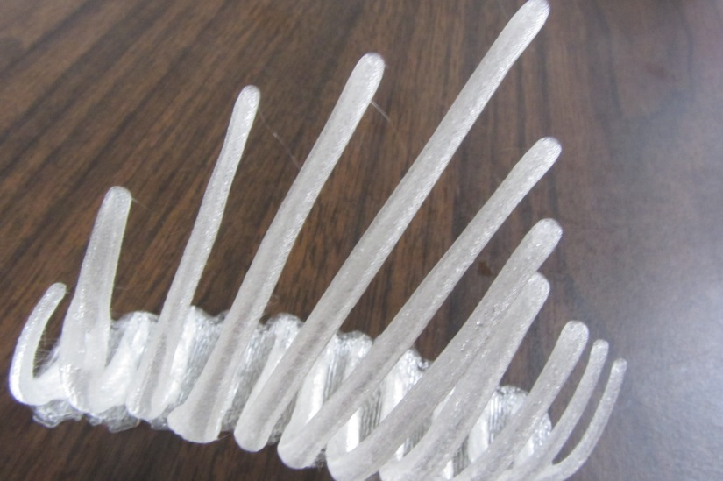

Slide 22
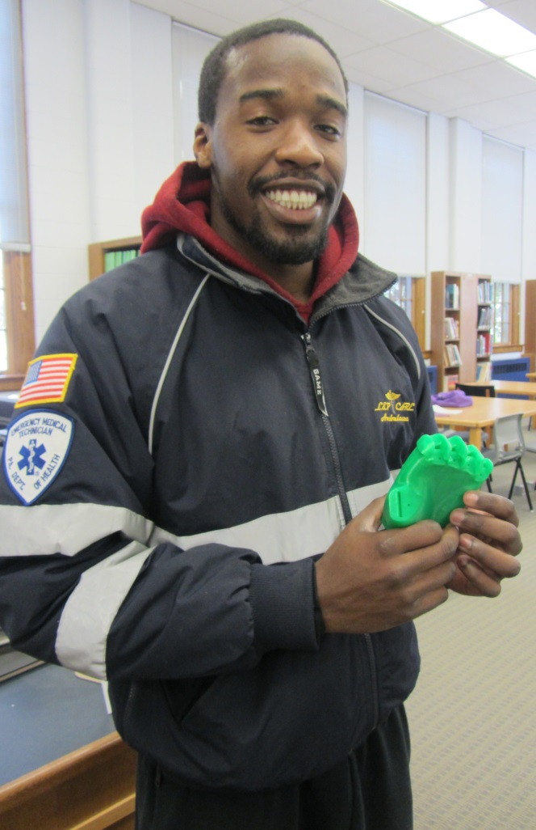

Slide 23
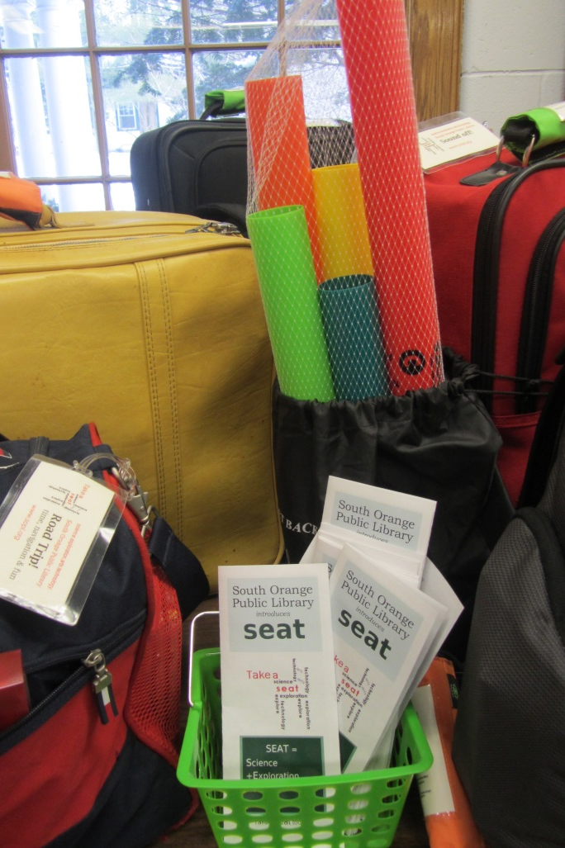

Slide 25
Bring it out of the building…

Slide 26
Work together!

Slide 27
Work together!
e.g. NJMakersDay…

Slide 28
Go big!

Slide 29
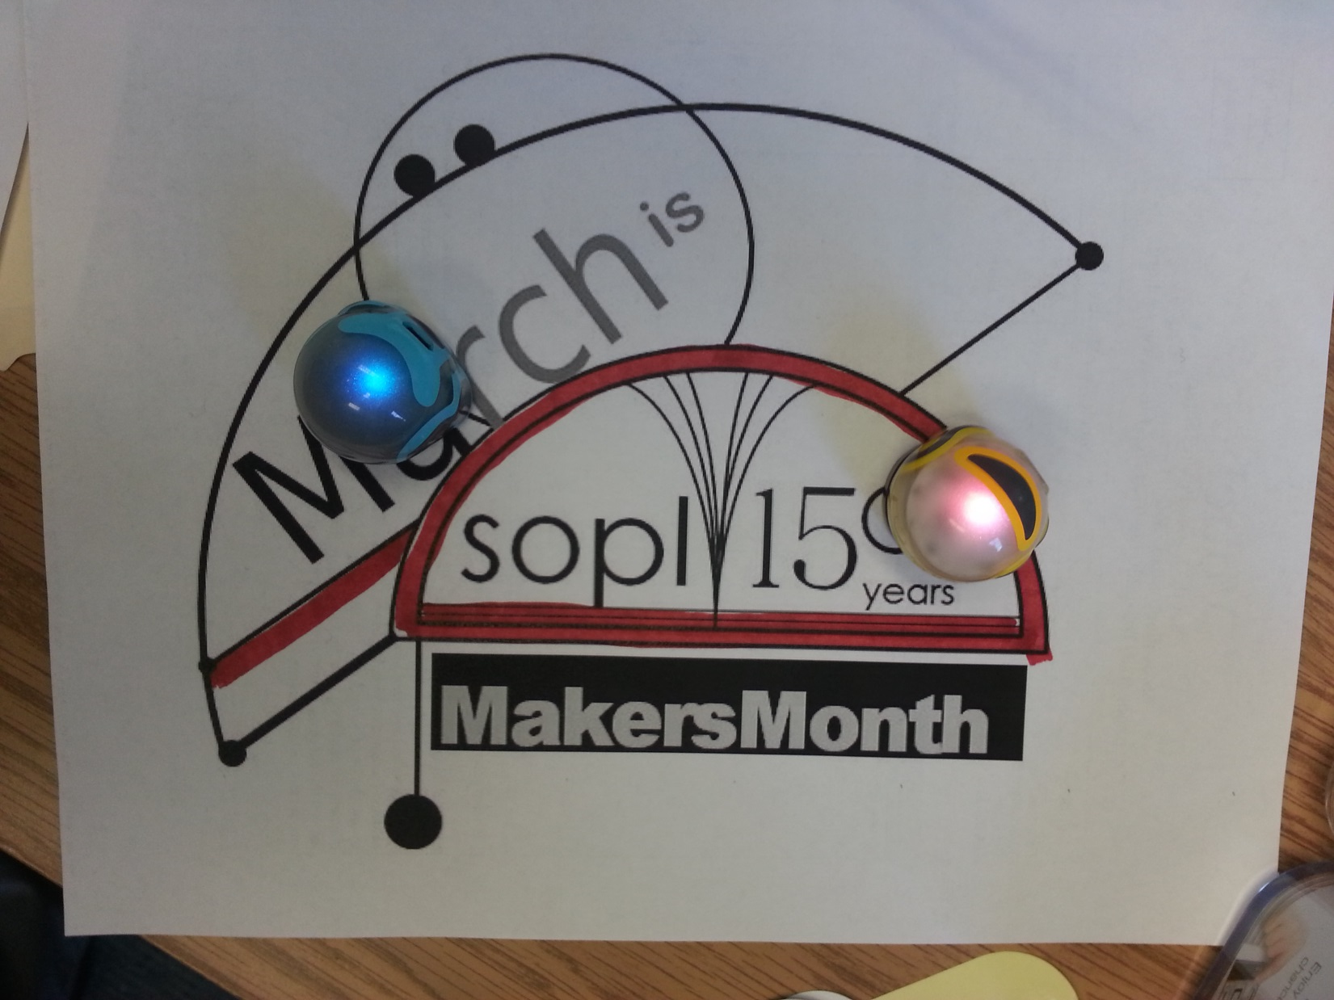

Slide 35
Keisha Miller
kmiller@sopl.org
Melissa Kopecky
mkopecky@sopl.org

