Slide 1
Free Stock Photos
Cynthia M. Lambert
#NJLA2015
Lightening Lunch

Slide 2
Every Hero Has a Story
What’s Yours?
Photo Source: US Governement (http://www.usa.gov/Topics/Graphics.shtml)

Slide 3
Great Vacation Reads: June 23, 7:00pm
What books will you bring?
Photo Source: Death to Stock Photo
Notes:
This service sends out a zip file filled with photos on a specific topic each month. The idea is you will build a database of high quality images over time.

Slide 4
Photo Source: Unsplash
Notes:
10 free photos every 10 days—you can also search the website for specific photos. I used an image from Upsplash and Pablo from Buffer.com to overlay the words—very fast and easy to use, but size can be a problem.

Slide 5
Summer Reading: Are you Ready?
Kindle Basics: June 2, 10:00am
Photo Source: Unsplash
Notes:
I found this photo by searching the Upsplash webpage for books and then for ereaders. This is the first time I am using a high-quality Kindle photo that I didn’t take myself of lift off the web hoping I got the rights properly. I’m thrilled to find this source.

Slide 6
What’s on your bedside table?
Best Books of 2014
December 14, 3:00 pm
Photo Source: Unsplash

Slide 7
Escape the Ordinary
Adult Summer Reading
June 22 to August 24
Sign Up Today!
Photo Source: Unsplash

Slide 8
Get Ready for Summer Reading…
20 Books in 30 Minutes
May 30, 2015
7:00pm in the program room
Photo Source: Death to Stock Photo
Notes:
This came from the

Slide 9
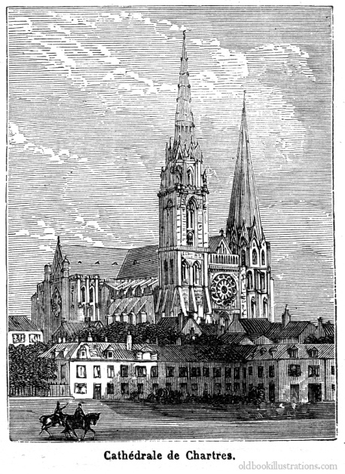
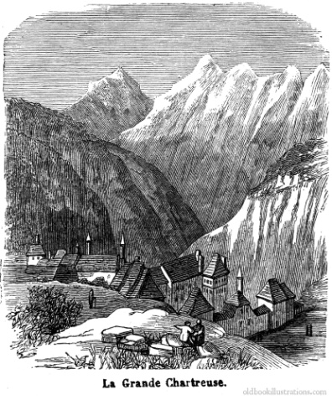
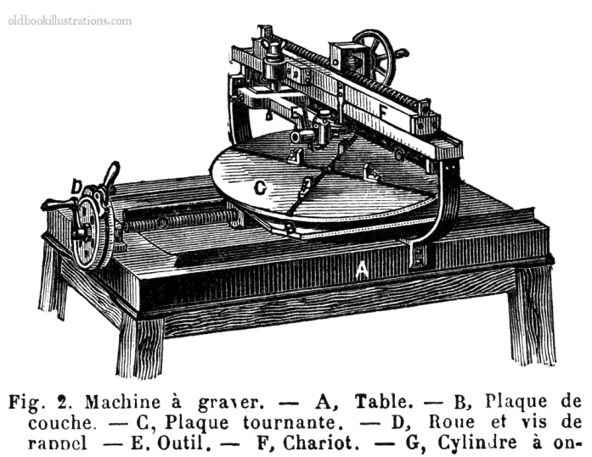
And now for something completely different….
Image Source: Old Book Resolutions

Slide 10
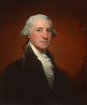
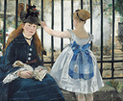
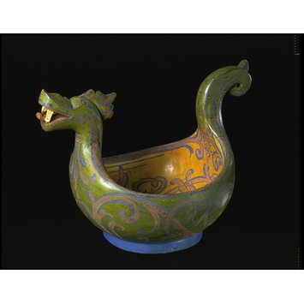
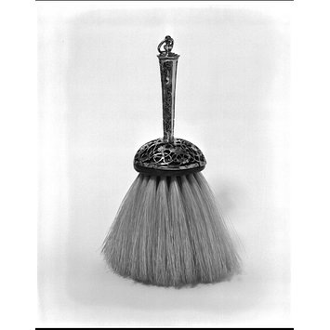
Art, Portraits, Historic Objects….
National Gallery of Art
Metropolitan Museum of Art
The Getty Museum
British Museum
Victoria & Albert Museum

