Slide 1
What’s new in newsletters
Presented by Megan McCarthy & Kate Vasilik
2015 NJLA Conference
April 22, 2015

Slide 2
WHY ENEWSLETTERS…Isn’t email dead?
Alive and well.
Personalized news source.
Compliments social media.
Notes:
MailChimp sends 400 million emails a day
A Quartz survey of 940 global executives get their news and info primarily from e-news
Source: Carr, David. 29, June 2014. “For Email a Death Greatly Exaggerated.” Retrieved from <http://www.nytimes.com/2014/06/30/business/media/for-email-a-death-greatly-exaggerated.html?_r=1>

Slide 3
Enhance your brand

Slide 4
Publicize events

Slide 5
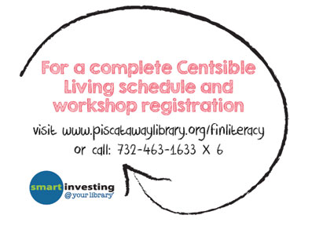
Market services & collections

Slide 6
Connect With specific audiences

Slide 7
Special announcements

Slide 8
Reader’s advisory

Slide 9
fundraising
Letter regarding your Annual Appeal
Publicize fundraising events
Include donate button
Articles about opportunities such as leaving a legacy

Slide 10
Personal service

Slide 11
Ok, so what do I write?
Be engaging.
Be brief.
Be positive.

Slide 12
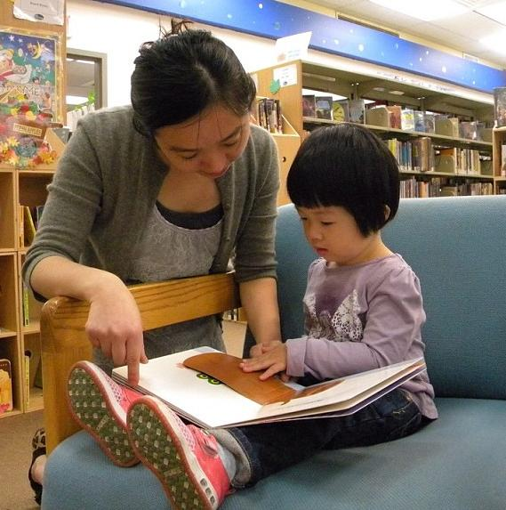
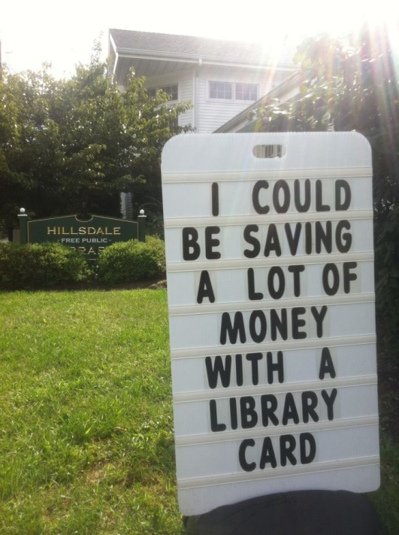
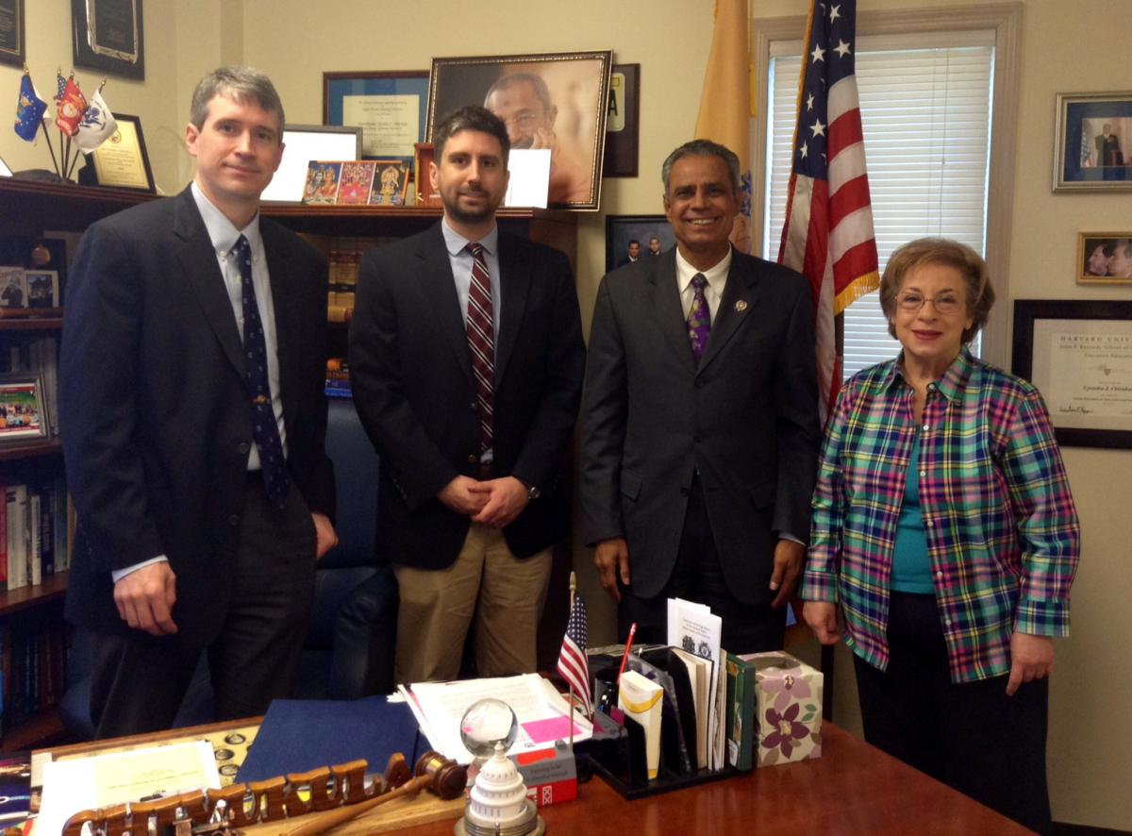
audience
Township and city officials
Board of Trustees
Advocates, voters, and lawmakers
Direct your content to its intended audience/potential audience
Topic-specific v. general library services

Slide 13
contributors
Establish your voice
Gather content from staff
Use vetted volunteers
Take advantage of talent, interest, and knowledge

Slide 14
WRITING TIPS
Study your inbox
Think hard about your subject line
Call to Action
More education, less promotion
Keep it concise
Use a casual tone
…PROOFREAD!
Notes:
Sources:
Soskey, G. 20 Aug 2013. “The Go-to Guide to Creating Email Newsletters People Actually Read” Retrieved from <http://blog.hubspot.com/marketing/guide-creating-email-newsletters-ht>
Nonprofit Tech For Good. 28 Sept 2014. “10 e-Newsletter Best Practices for Nonprofits.” Retrieved from <http://www.nptechforgood.com/2014/09/28/10-e-newsletter-best-practices-for-nonprofits/>

Slide 15
LAYOUT
Easier than ever with ready-made templates (WYSIWYG)
Think mobile
Make text easy to read
Appeal to skimmers
Always include logo, contact info (branding!)
Preview and TEST!
Notes:
Appeal to skimmers
Hyperlinked table of contents
Headlines, bold words, blurbs

Slide 16
graphics
Use them!
Keep ’em small
Don’t overwhelm
(keep layout to about 30% graphics)
Free art sources:
FreeImages www.freeimages.com
PicJumbo http://picjumbo.com/
morgueFILE http://morguefile.com

Slide 17
SUBSCRIBING & OTHER CONSIDERATIONS
Make your subscription sign-up page informative
Make unsubscribing obvious and easy
Identify the sender clearly
Include text only option, link to pdf, etc.
Alt image text

Slide 18
How do I send it?
Newsletter services.
Open source platforms.
Small mailing lists.

Slide 19
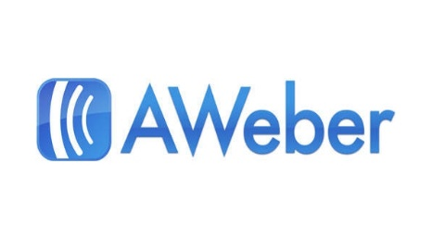
Newsletter SERVICES
Email templates
Previewing and testing options
Contact management
Email delivery
Social media sharing tools
Analytics

Slide 20
Newsletter SERVICES
-Constant Contact www.constantcontact.com
-MailChimp www.mailchimp.com
-Flashissue (Gmail) www.flashissue.com
-Vertical Response www.verticalresponse.com
-Campaigner www.campaigner.com
-AWeber www.aweber.com
Also:
-NextReads https://www.ebscohost.com/novelist/our-products/libraryaware-nextreads-newsletters
Notes:
-Many offer discounts and resources for non-profits like libraries

Slide 21
Constant contact
Large template selection, easy to customize
Good customer service
Social media sharing tools
Pricing for Constant Contact Unlimited:
500 subscribers $15/month
2,500 subscribers $55/month
5,000 subscribers $85/month

Slide 22
Tinyletter & mailchimp
FREE! (MailChimp for under 2,000 subscribers, limited features)
Unlimited image storage
MailChimp App
Pricing for MailChimp Unlimited:
500 subscribers $10/month
2,500 subscribers $30/month
5,000 subscribers $50/month

Slide 23
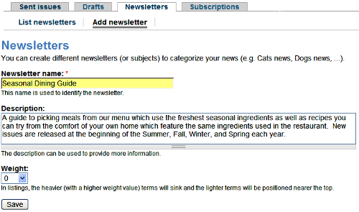
Open source platforms
Drupal, WordPress, Joomla all have newsletter plug-ins/modules
Free!
Initial template design involved, but then easily copied and updated
Easy to import contacts
Notes:
Some newsletter services also have plug ins

Slide 24
CREATe YOUR OWN
Great for schools, stakeholders and officials, and other small or closed groups
Free HTML email templates using Microsoft Publisher and Outlook
Send as a PDF file

Slide 25
logistics
How often?
When to send?
Delivery issues and SPAM
Notes:
Send emails in small batches
Beware of BCC lists

Slide 26
Now what?
Get the word out.
Measure your outcomes.

Slide 27
Promote!
Everywhere you do outreach
Everywhere you are online
Every time you interact with your community, anywhere!
Notes:
Print copies, have around library
Button on each page of web site
Signage, bookmarks, the usual
Social media – create visuals

Slide 28
Analytics
Compare to industry standards
Track your own progress
Get to know your subscribers to better serve them
Notes:
Measure “opens” and “clicks”
Bounces and Unsubscribes
A/B Testing

Slide 29
You did it! Now do it again next month.
Megan McCarthy
meganbezdek@gmail.com
Kate Vasilik
kvasilik@piscatawaylibrary.org

