Slide 1
Weeding Watchdog
Karen Andriolo, Bernards Township Library
Lynn Hoffman, Somerset County Library System of NJ
Karen Vaias, Bernards Township Library
Notes:
Welcome!
Today we will be talking about how to weed well and how to develop weeding policies that support your choices in a way that is understandable to staff and the public.
Who here is from a public library?... Academic library?... Media Center?... Other?
Fist to five– How much weeding have you done?
Has anyone had pushback from items they weeded from a collection?

Slide 2
Why Weed?
Space
Currency
Accuracy
Redundancy
Notes:
We weed so our libraries don’t explode.
We weed to keep our collections current, relevant and attractive.
We weed to eliminate duplicates and older editions
If we don’t weed, our collections start to look like something out of Hoarders

Slide 3
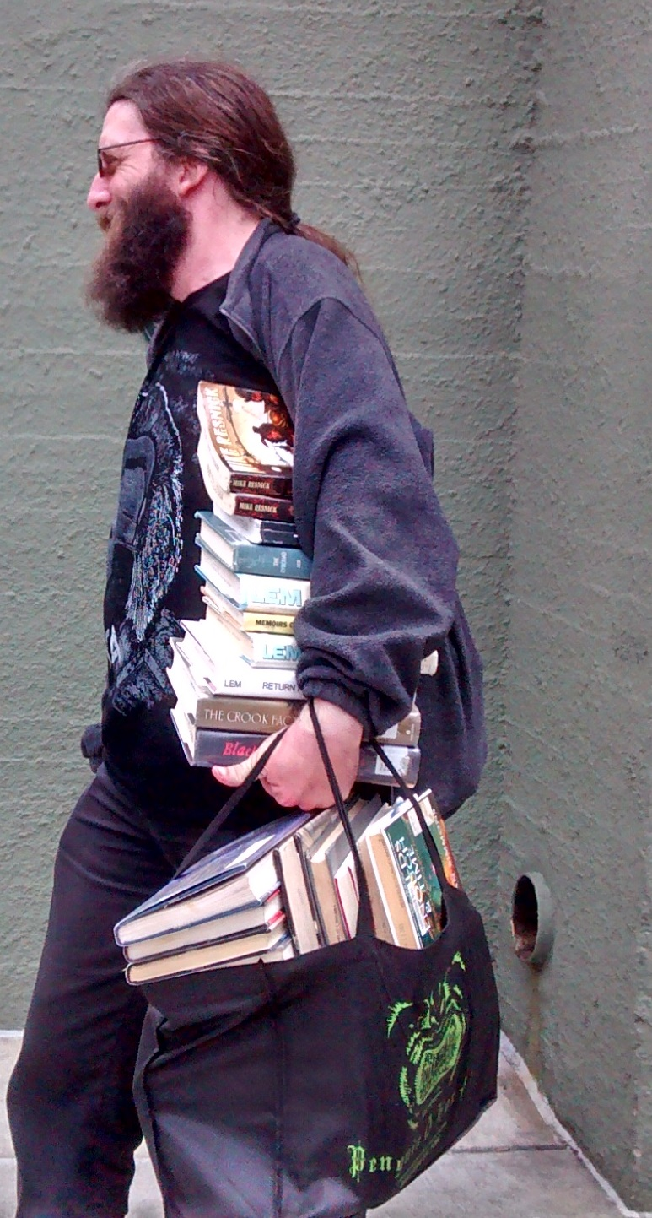
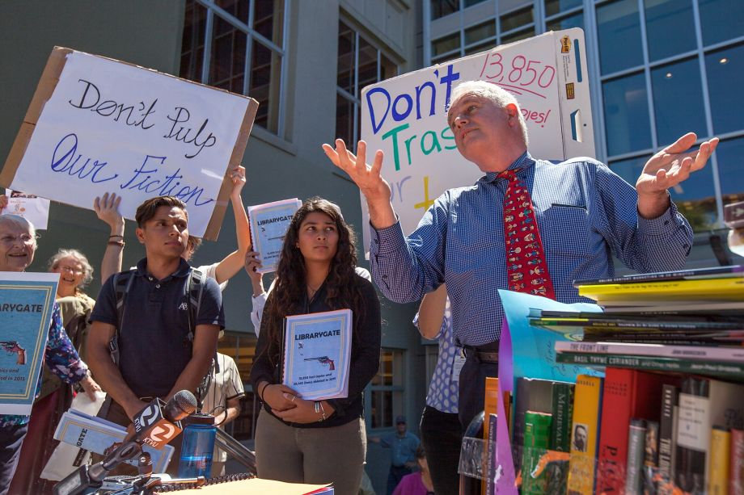
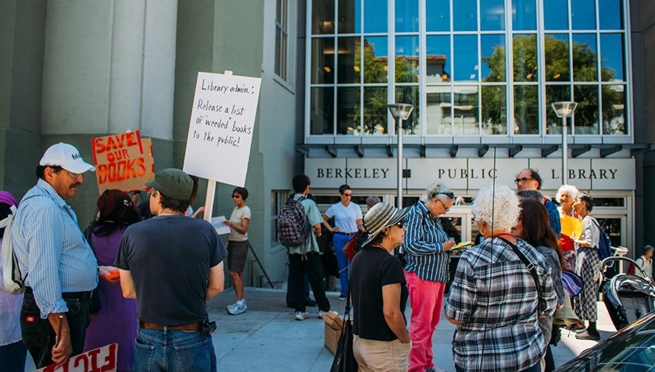
Berkeley Public Library

Slide 4
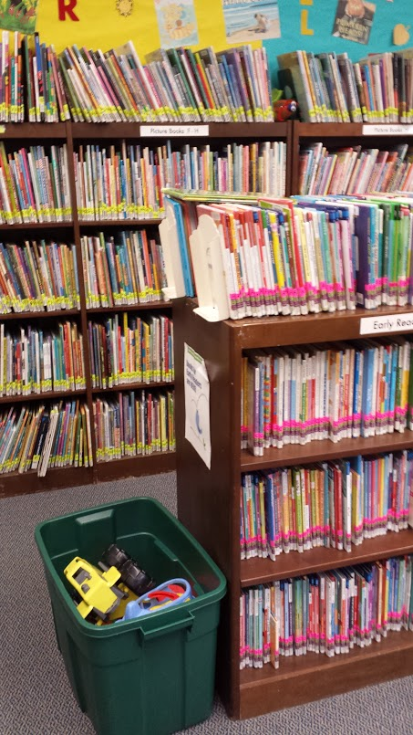
Picture Books - Fall 2015
3.9% of branch Picture Books checked out
0.83 collection turnover
Notes:
10/27/2015 - 3.9% of Picture Books checked out (would hope to see more like 20%)
11/25/2015 - Picture Book turnover: 0.83 (compared to 2.19 system-wide)

Slide 5
With thousands upon thousands of our tax-funded materials being deleted from the 10 branches of the Somerset County Library System daily, and without public input, we need to ask ourselves what is the purpose of our County Library System.
Notes:
Letter to the Editor - 1/26/2016

Slide 6
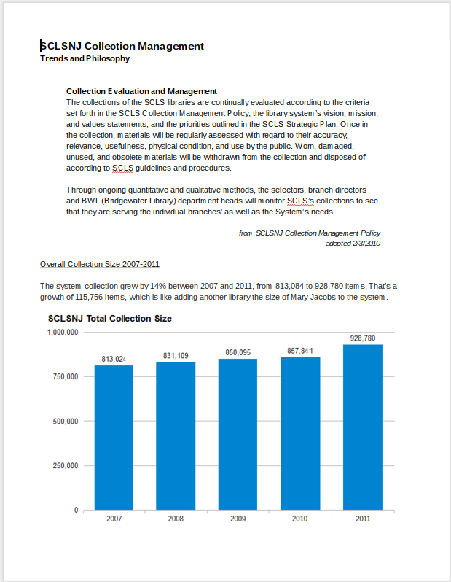
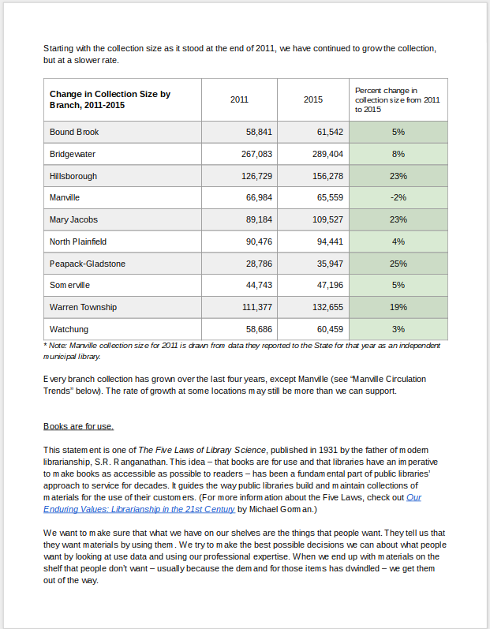
Notes:
Presentation at Commission meeting - February 3; made available to the public

Slide 7
“We all know that one of the things Hitler did was to destroy the books. There are pictures of the books being tossed into a bonfire. The bonfire in North Plainfield was a dumpster.
I want North Plainfield to pull out of the Somerset County Library System until such time as they remove all the people involved in this situation, pay us reparations for our books and provide an agreement where they will never, ever do this again.”
Notes:
Letter to the Editor - 3/25/2016

Slide 8
Good Weeding: a few tips
Know your community
Handle and review the items you plan to weed
Use weeding lists
Consider replacing items in poor condition
Ask yourself:
Would this circulate in a different part of the collection?
Is this the last copy in my area, system and/or state?
Use one of the well know weeding tools
Notes:
Know your community: This is true for all aspects of Collection Development. NYT Bestsellers/Duck Dynasty
Know your staff: make sure they understand what’s going on. Get them “on board” if possible.
Know your stuff: What’s in your collection?
Use weeding lists to identify things that haven’t circulated recently and/or are out of date.
Handle anything you are considering for discard. Is it in poor condition? It may need to be replaced.
Could I put this somewhere else?
Is this the last copy?
Use CREW or another established weeding method to shape your policy
Use publications such as
Fiction Core Collection Catalog (Serial), H.W. Wilson Company.
Public Library Core Collection, Nonfiction (Serial), H.W. Wilson Company.

Slide 9
Policies at the local level
Vision/Mission Statements
Collection Development Policy
Weeding Policy
Notes:
Bernards Township
VISION
To cultivate an inviting community destination, where curiosity can spark discovery.
MISSION
Bernards Township Library’s mission is to inform, enrich and connect our community.
Discarding Materials Policy:
Material no longer deemed useful by the Library staff will be withdrawn from the collection. The continuous process of weeding is essential to the maintenance of the library and the fulfillment of its responsibilities.
One or more of the following conditions justify discarding:
A worn, shabby, damaged or duplicate copy
Outdated nonfiction that has no historical value
Superseded editions
One-time popular fiction no longer in high demand and not included in standard lists.

Slide 10
The big difference in policy at the system or consortium level is that not every branch or member has to be weeded in the same way:
“Through ongoing quantitative and qualitative methods, Collection Development Department and Branch staff will monitor collections to see that they are serving the needs of individual branches and the Somerset County Library System.”
Medium Library
Broad collection, local interests
Large Library
Large resource collection, deeper holdings
Small Library
Popular materials

Slide 11
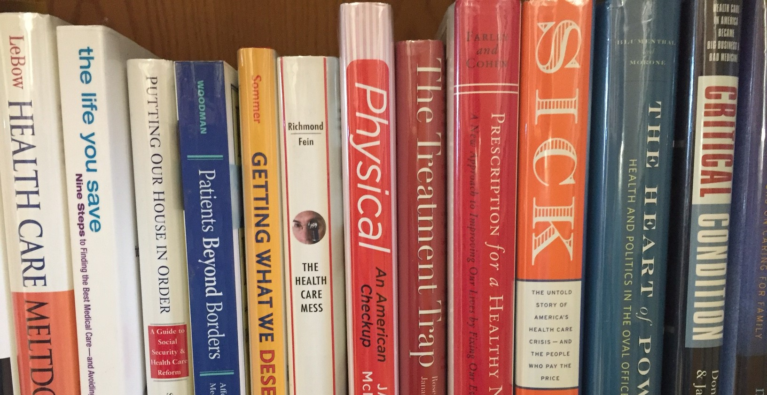
CREW
Continuous Review, Evaluation and Weeding

Slide 12
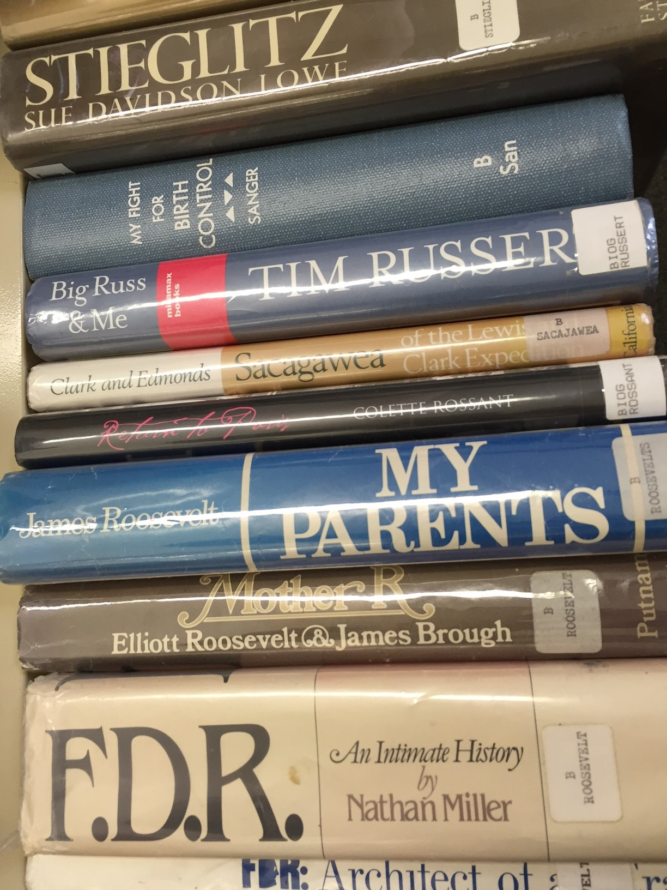
MUSTIE
Misleading
Ugly
Superceded
Trivial
Irrelevant
Elsewhere

Slide 13
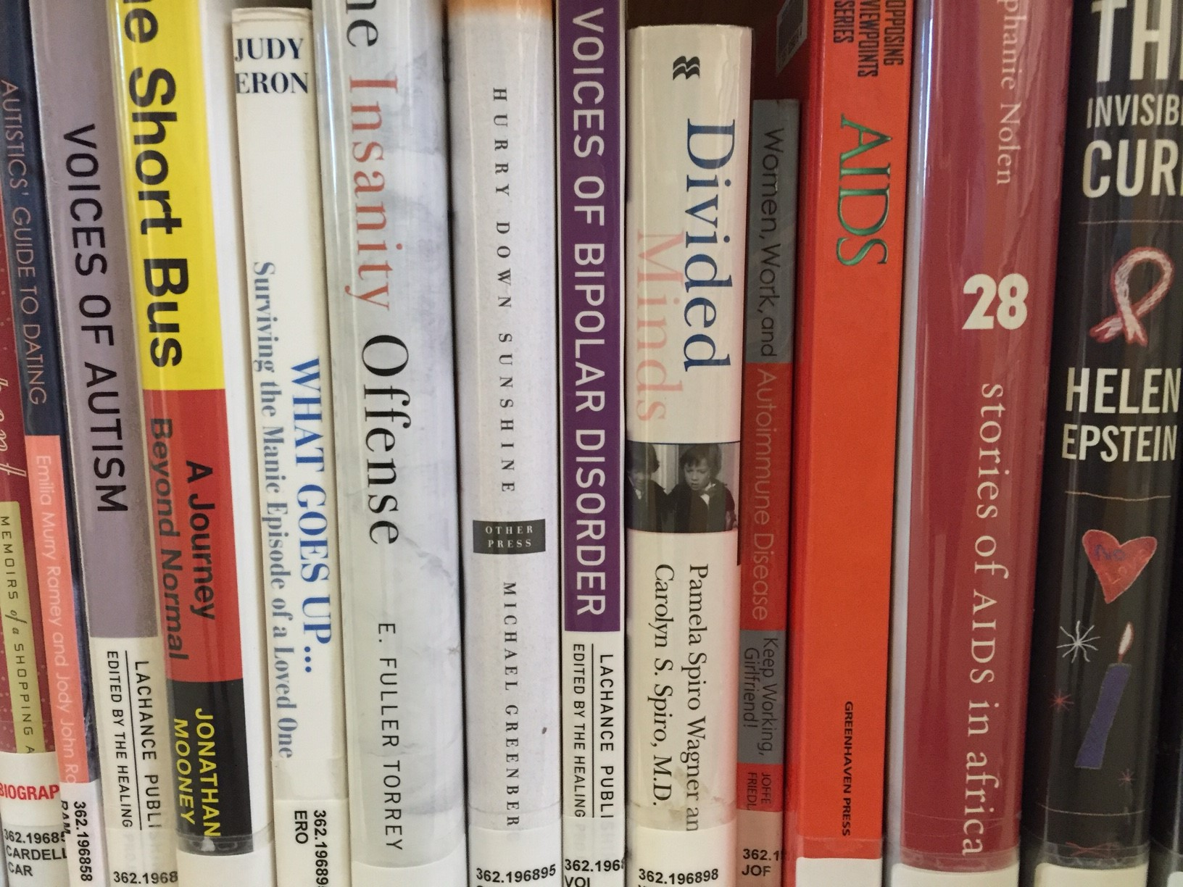
Collection Performance
Turnover rate
Relative use

Slide 14
Criteria for Various Collections
Adult
Reference/Local History
eResources
Teen
Children
Notes:
Adult:
Fiction- Does it go out?
Is it part of a series that mostly circs well?
Is it a classic? Core Fiction Collection or other resources
Non-Fiction- Does it go out?
Is it superseded?
Is it still considered true? (diets/medical/psychology/price guides)
Does it represent non-historical, out-dated thinking? Sexist, racist, etc.
Is there other coverage on this topic?
Reference - All the above plus
Is it worth the shelf space?
Should it circulate?
Do we have as an eBook?
Local History –All of above plus
Scope of collection?
Special or one-of-a-kind publication?
How many copies are needed?
Is this information duplicated elsewhere (municipal records, for example)
eResources-
It doesn’t take up shelf space, but can still create clutter.
Look for superseded or outdated materials

Slide 15
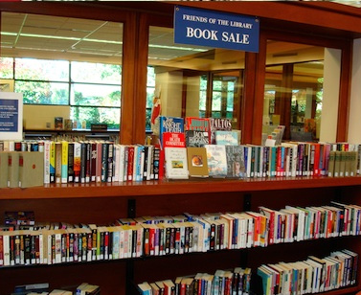
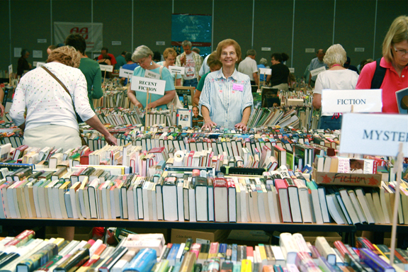
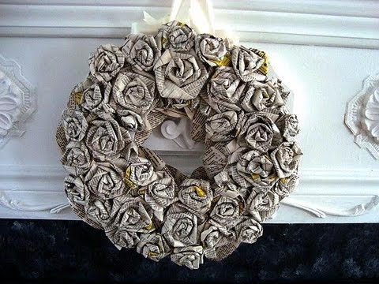
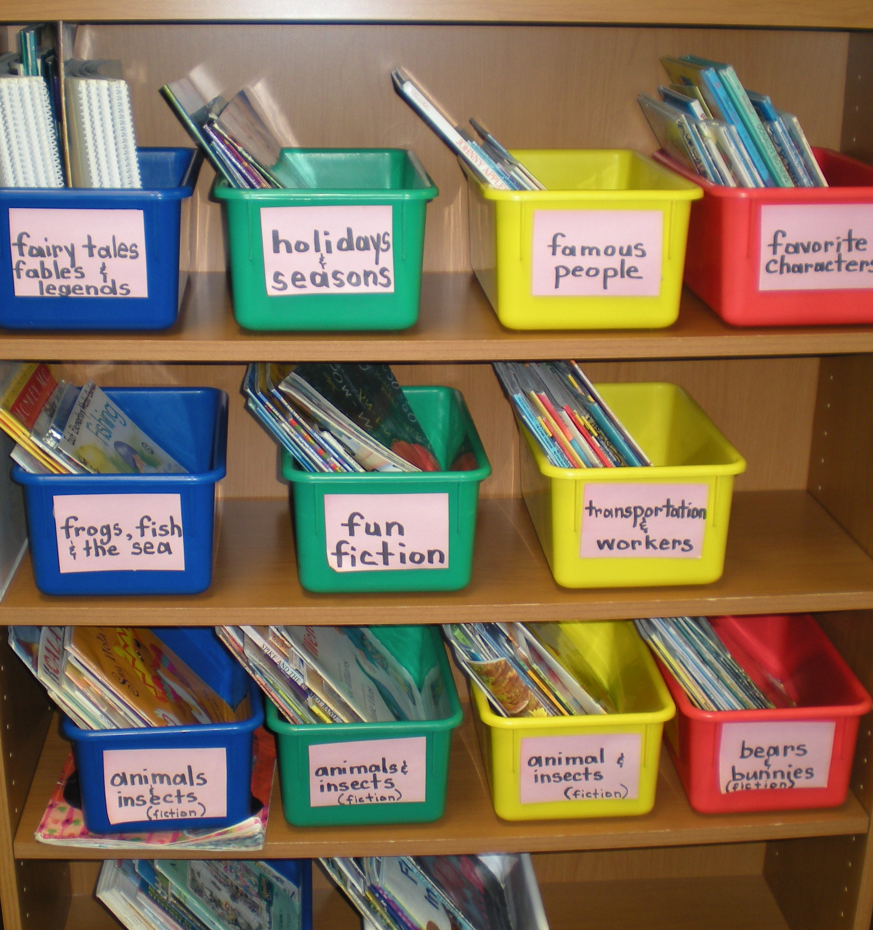
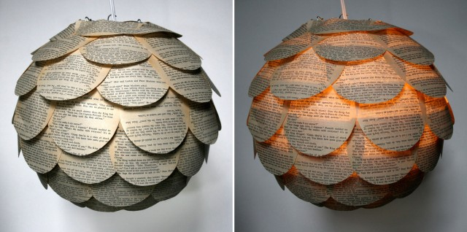
Disposal of items
Forums

Slide 16
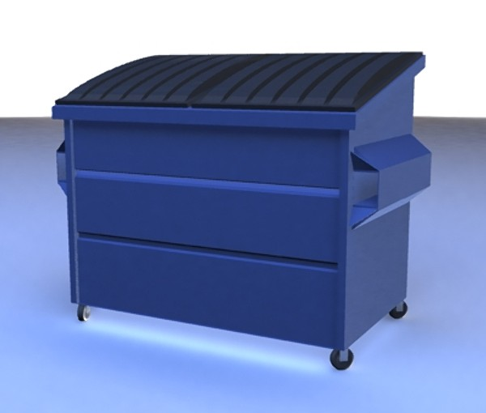
The last resort…

Slide 17
Agree on terminology.
Make sure everyone – all staff, volunteers, Friends – hears the same story about deselection.
Know your basic numbers, especially annual items added.
Know who your spokesperson is.
Get a sense of your community’s comfort level.
Notes:
Agree on terminology. “Weeding” may have connotations that are tough to overcome; can you call it “deselection” or something else?
Make sure everyone – all staff, volunteers, Friends – hears the same story about deselection. You don’t want anyone in a position where a neighbor strikes up a conversation about all the books that are being thrown away and the staff member or volunteer chimes in, “Yeah, it’s a real shame, isn’t it?”
Know your basic numbers, especially annual items added. For SCLSNJ, saying that we added 80,000 items last year system-wide helps put it in perspective.
Know who your spokesperson is. Make sure there’s one person everyone knows about where questions can be directed. Staff should feel comfortable with the basics, but should have someone to refer question to if things start to get more tricky.
Get a sense of your community’s comfort level. I’ve worked in one community where deselection was never an issue – the community’s pride in the amount of new material the budget allowed us to purchase far outweighed any concern.

Slide 18
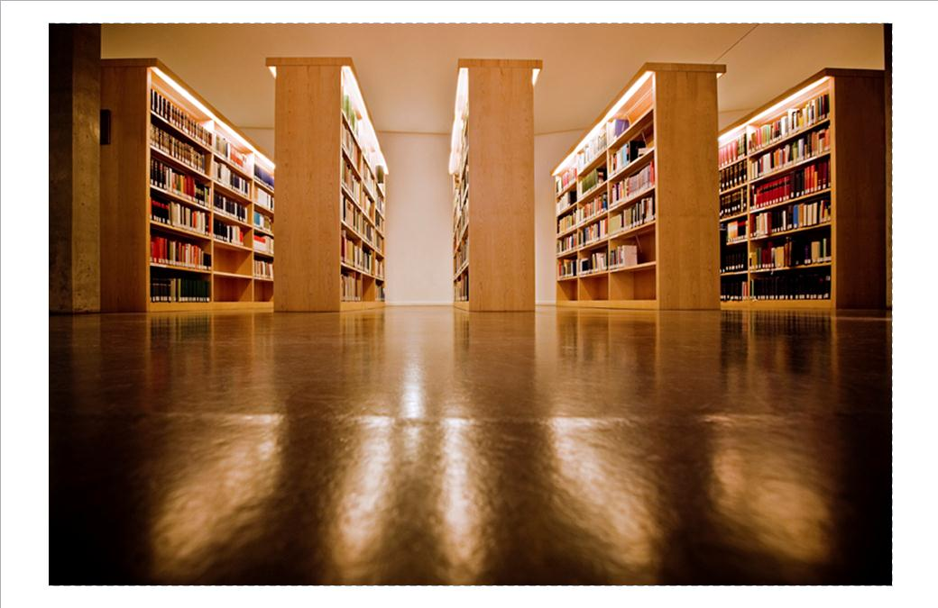
Questions?
Notes:
Resource list!

Slide 19
Karen Andriolo kandriolo@bernards.org Lynn Hoffman lhoffman@sclibnj.org Karen Vaias kvaias@bernards.org
Notes:
In 2015 @ BTL:
Added 12,507 items (total collection 127,090); 11,814 discarded.

