Slide 1
TRAINING TIPS & TRICKS: Templates & Strategies for training new staff
Deborah Blackwell, Ocean County Library
John P. Irwin, Seton Hall University
Joan M. Serpico, Rider University Libraries
Emily Witkowski, Maplewood Memorial Library

Slide 2
ONBOARDING IS…
The process of helping new hires adjust to social and performance aspects of their new jobs quickly and smoothly
The set-up of the new hires successful contribution to the organization’s mission
The beginning of an engaged employee

Slide 3
THE FOUR C’S
Compliance
Connection
Clarification
Culture

Slide 4
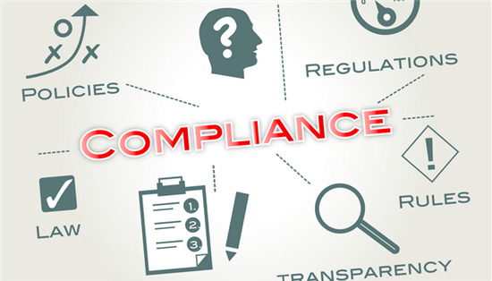
1. COMPLIANCE
Includes teaching employees basic legal and policy-related rules and regulations
Source: Helios HR/

Slide 5
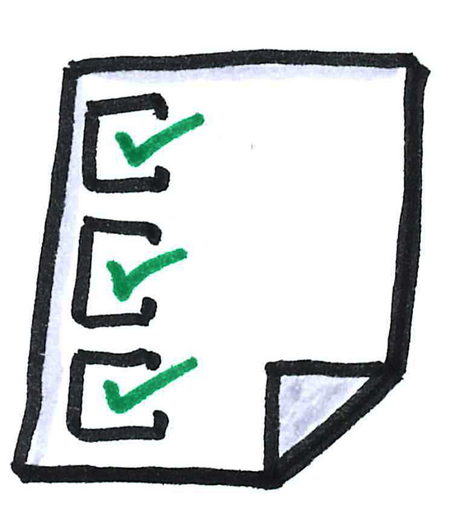
UNDER COMPLIANCE
Caution: don’t overwhelm them with paperwork…
What key policies and procedures does the new hire need to be aware of the first day of work to avoid mistakes?
Certification/Documentation
Federal Law
State Law
Accounting/Payroll

Slide 6
POLICY
Training and staff development
Travel reimbursement
Performance review
Personnel records
Sexual harassment
Staff obligations
Benefits
Holidays
Discipline/Remedial action
Workweek

Slide 7
FEDERAL
Federal Family Leave (FMLA)
Workers Compensation
Unemployment

Slide 8
STATE LAW
New Jersey Family Leave (NJFLA)
Child Labor Laws
Disability
Civil Service

Slide 9
2. CONNECTION
The vital interpersonal relationships and information networks that the employees must establish (Social Integration)
Source: Stockmonkeys.com

Slide 10
BEFORE EMPLOYEE ARRIVES
Update systems with new employee information
Notify staff
Prepare the workspace
Contact new hire with start information
Source: Workpulse

Slide 11
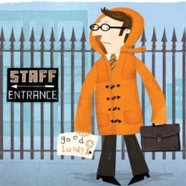
ON THE FIRST DAY…
Meet new hire and introduce to staff
Explain training process and next steps
Complete personnel paperwork
Provide hire with job description, mission and vision statement, etc.
Source: Graduate Recruitment Bureau, UK

Slide 12
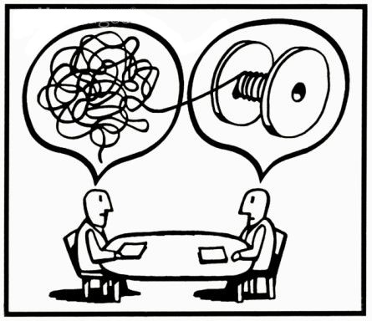
3. CLARIFICATION
Ensuring that employees understand their new jobs and all related expectations. Explaining how standards and competencies are aligned with the vision and goals of the organization

Slide 13
CUSTOMER SERVICE
Emphasizing on Communication and Teamwork
Face to face interactions with patrons
Phone calls
Emails
Text
Helping each other
Positive attitudes

Slide 14
MANAGEMENT
Managing Staff, Students and Volunteers
Making sure schedules are set
Making sure each individual knows their time at service desk
Understanding the organizational chart
Each new hire needs to know supervisor responsibilities
Means of recognizing staff and stakeholders

Slide 15
COMPETENCIES
Computer software
Navigating the Catalog and Databases
Material
Cleaning
Organizing
Shelving
Statistical information
Notes:
No matter who you are, if someone comes in with a directional/library question they know where to direct this person to.
Core competencies within their role of the organization.

Slide 16
OPENING, CLOSING, AND SAFETY
Make sure new hire knows their role in opening and closing procedures
Locks
Alarms
Lights
Etc.

Slide 17
4. CULTURE
Provides employees with a sense of organizational norms – both formal and informal.

Slide 18
YOUR LIBRARY IS UNIQUE…
… so make sure your new hire knows your library’s
Reputation – what is your library known for?
Assumptions, values and customer service expectations
Policies on food and drink, cell phone use, sleeping, loud talking
Internet filtering policy and rationale

Slide 19
YOUR LIBRARY IS UNIQUE…
… so make sure your new hire knows about
Schedules
Professional development
Maintaining the library

Slide 20
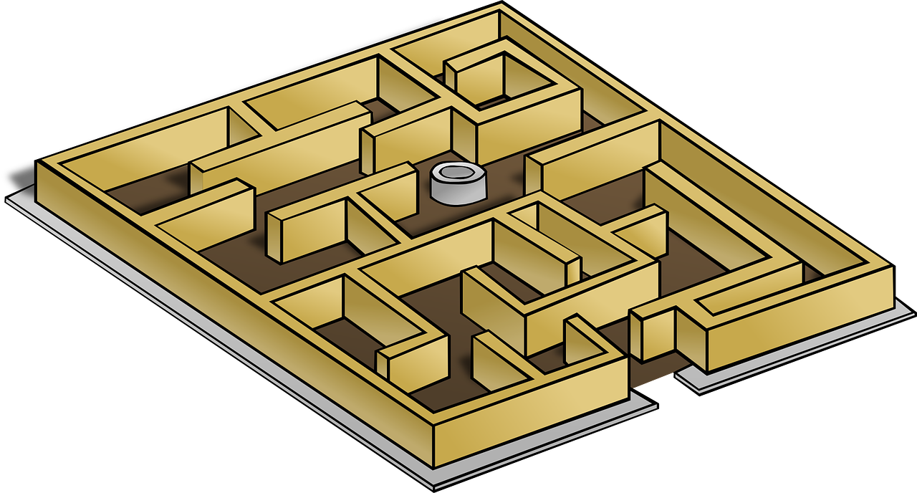
YOUR LIBRARY IS UNIQUE…
… so make sure your new hire knows about
Handling challenging situations

Slide 21
YOUR LIBRARY IS UNIQUE…
… so make sure your new hire knows about
The library’s organizational style
Career pathways

Slide 22
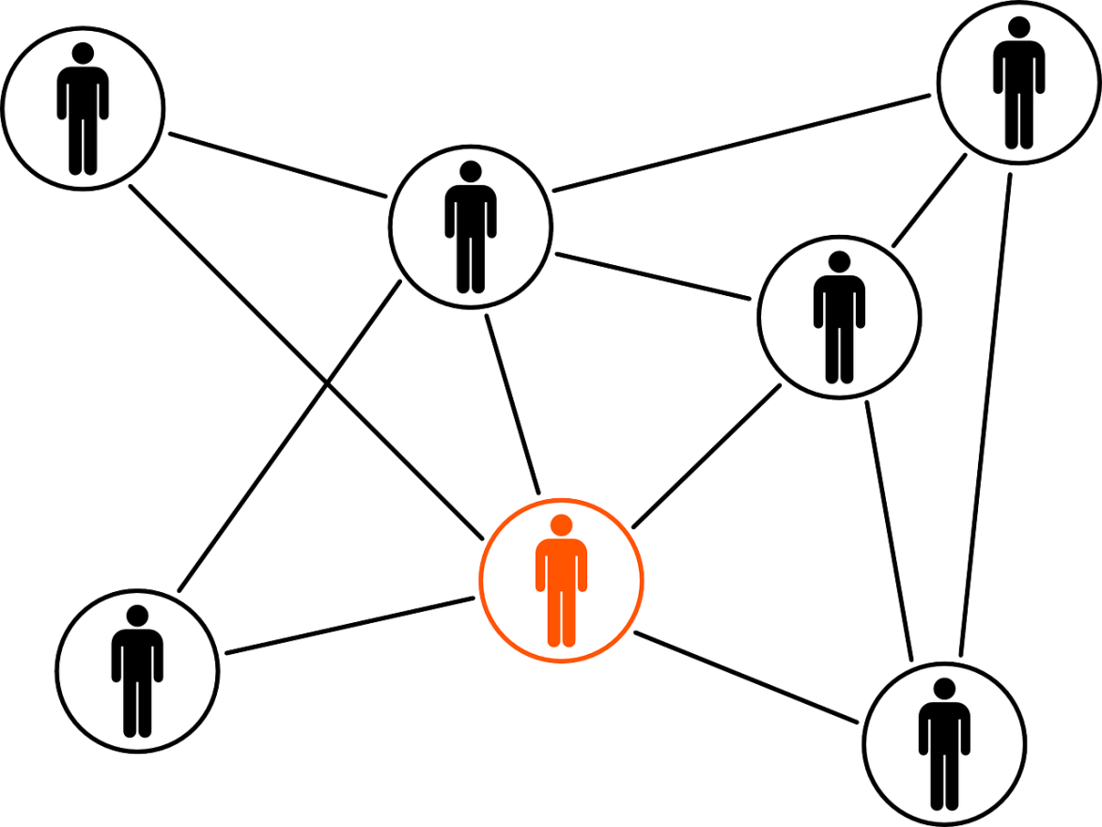
YOUR LIBRARY IS UNIQUE…
… so make sure your new hire knows
They are welcome and important to the library

Slide 23
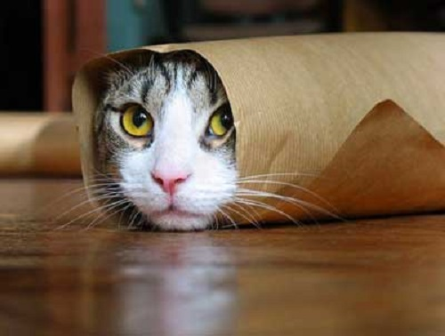
WRAPPING UP
Source: The Marketing Bit

Slide 24
Thank you!
Deborah Blackwell, Ocean County Library
dblackwell@theoceancountylibrary.org
John P. Irwin, Seton Hall University
john.irwin@shu.edu
Joan M. Serpico, Rider University Libraries
jserpico@rider.edu
Emily Witkowski, Maplewood Memorial Library
emily.witkowski@maplewood.bccls.org
@emily_witkowski

