Slide 1
Notes:
Poll Title: What is your comfort level with web development tools? (HTML, CSS, JavaScript, etc.) https://www.polleverywhere.com/multiple_choice_polls/9kngwX0vh2Z5RPk

Slide 2
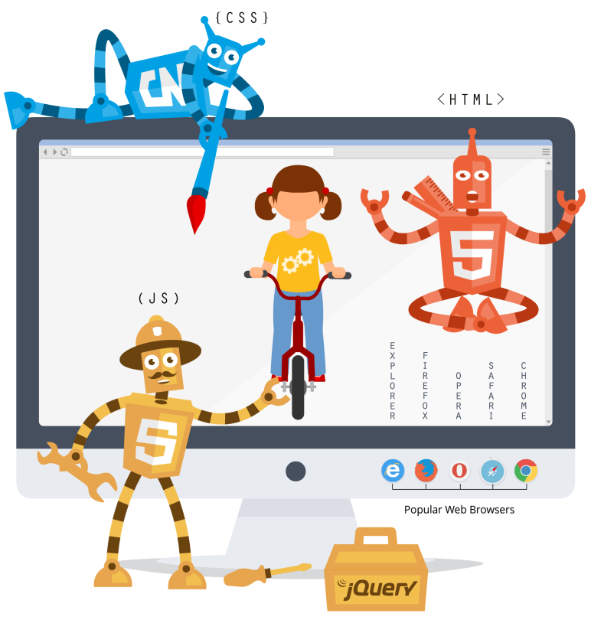
Technology: Speak Confidently
Alyssa M. Valenti, MS, MLS
Raritan Valley Community College
©Pixels4Kids.net 2014

Slide 3
How do I get started?
You’ll need:
A text editor
A curious mind
A desire for solving puzzles
Great ‘Google’ skills!

Slide 4
Outside of the scope, but I MIGHT mention it
HTTP / HTTPS
APIs
Servers
App development
Networking
Data transfer
CSS selectors (classes & ids)
PHP / Perl / Python / Ruby / Java / Swift

Slide 5
Outside of the scope, but I probably WON’T mention it
Making your own website
Linux
WAMP / LAMP / MAMP / XAMPP
SQL
OOP
Hard Computer Science (C, C++, C#, Cobol, Fortran, etc.)
Anything else I’ve forgotten or simply don’t know about!

Slide 6
The first website
http://info.cern.ch/hypertext/WWW/TheProject.html

Slide 7
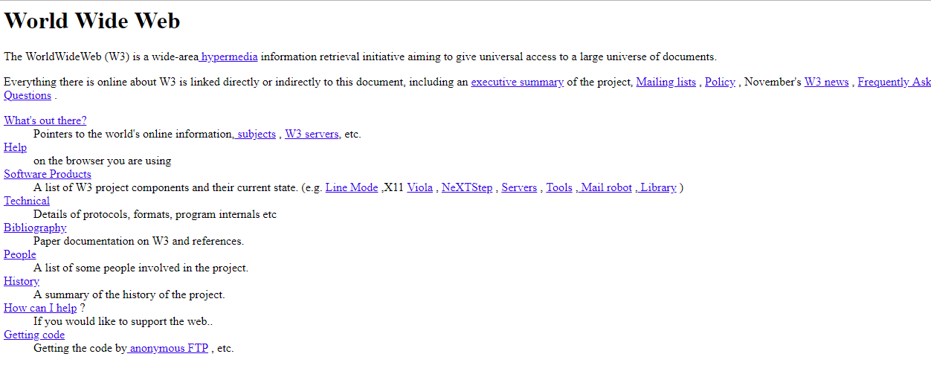

Slide 8
Hypertext Markup Language
Gives your webpage structure
Made up of elements
Elements are represented by tags

Slide 9
A very basic webpage:
<!DOCTYPE html>
<html>
<head> <title>Page Title</title> </head>
<body> <h1>My First Heading</h1> <p>My first paragraph.</p> </body>
</html>
The declaration
Root element
<head> element contains meta information about the document
Title of the document
Body = visible page content
<h1> defines a large heading
<p> defines a paragraph

Slide 10
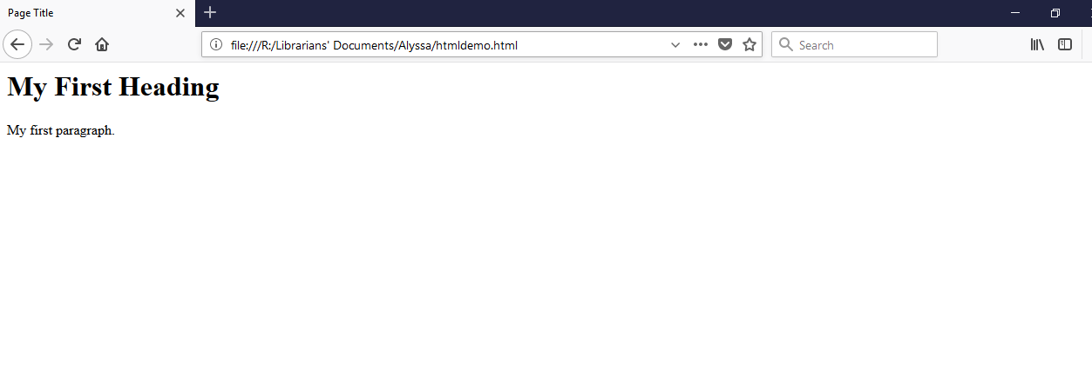
Title of the document
<h1> defines a large heading
<p> defines a paragraph

Slide 11
Cascading Stylesheets
Gives your HTML document style
Tells your browser how to
display HTML elements
CSS is made up of properties
Properties have values

Slide 12
A very basic webpage:
<!DOCTYPE html>
<html>
<head> <title>Page Title</title> </head>
<body> <h1>My First Heading</h1> <p>My first paragraph.</p> </body>
</html>

Slide 13
Some CSS for a very basic webpage:
h1 {
color: green;
font-family: Courier new;
}
p {
color: blue;
font-family: Arial;
}
HTML element
property
value
property
value
HTML element
property
value
property
value
{
{
{
{

Slide 14
<h1> is now green in Courier New font
<p> is now blue in Arial font

Slide 15
JavaScript
The programming languages of HTML and the Web.
Programs the behavior of web pages
Includes functions, variables, methods, and events
JS is relatively easy to learn – jQuery (a JS library) is easier!

Slide 16
A very basic webpage:
<!DOCTYPE html>
<html>
<head> <title>Page Title</title> </head>
<body> <h1>My First Heading</h1> <p>My first paragraph.</p> <button>Click me for an alert!</button> </body>
</html>

Slide 18
A very basic webpage:
…
<body> <h1>My First Heading</h1> <p>My first paragraph.</p> <button onclick=“myFunction()”>Click me for an alert!</button> </body>
<script>
function myFunction() {
alert(“Here is your alert!”);
}
</script>
</html>
Include your function with an event
Declare your function with a method (ours is an alert)
*Functions may contain parameters (in parentheses, ours does not)

Slide 19
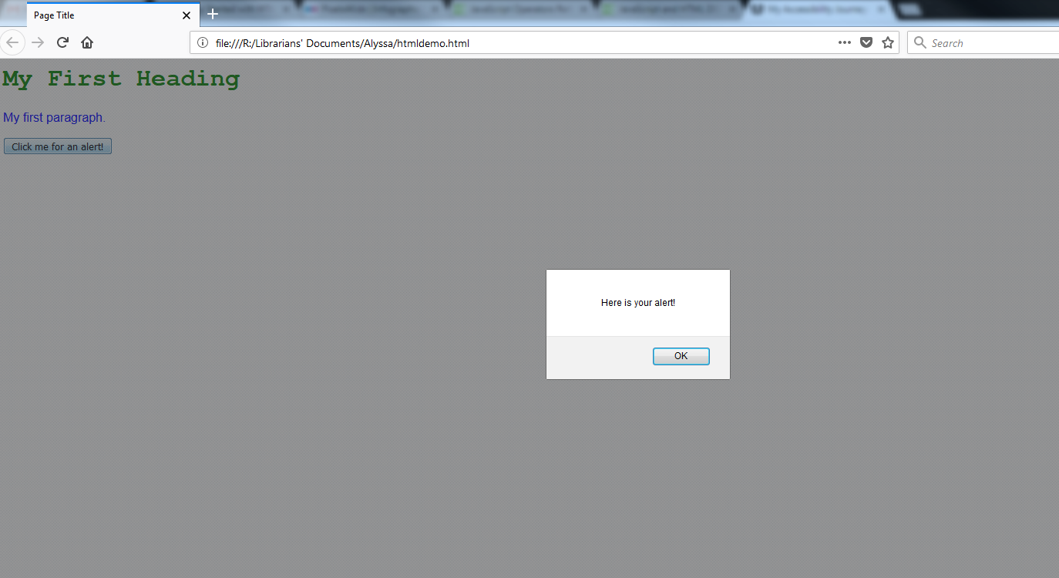

Slide 20
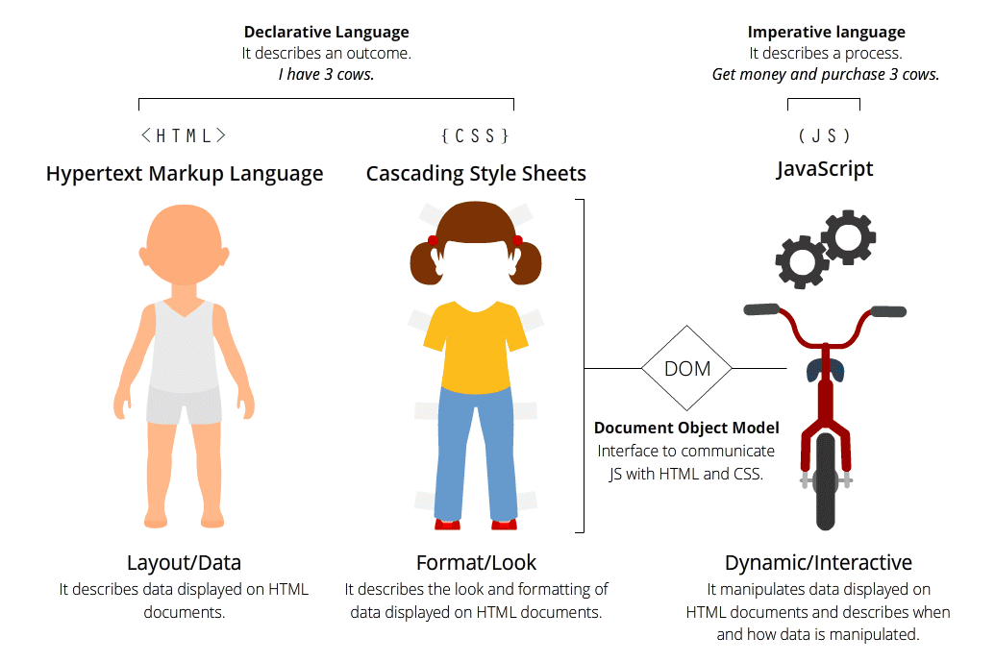
©Pixels4Kids.net 2014

Slide 21
Accessibility
For the web to be truly accessible, everyone who makes websites needs to care about accessibility (Matuzovic, 2018)
Accessibility is NOT about disability.
If your site takes ten seconds to load on a mobile connection, it’s not accessible.
If your site is only optimized for one browser, it’s not accessible.
If the content on your site is difficult to understand, your site isn’t accessible.

Slide 22
WYSIWYG: WTF?!
The REAL title of this presentation

Slide 23
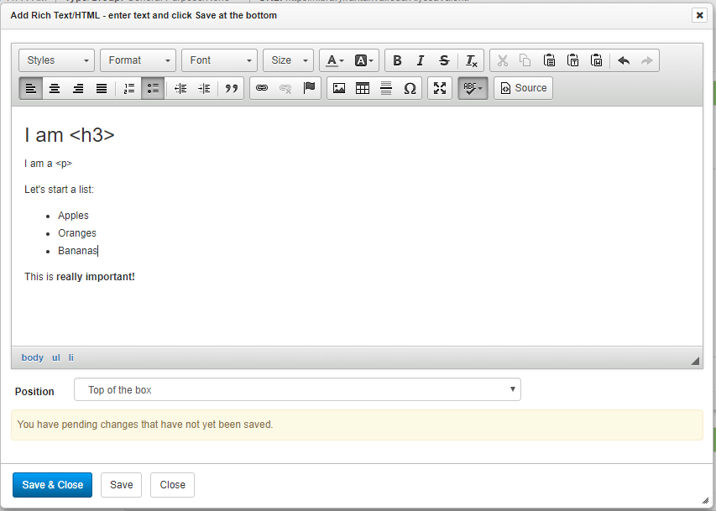
Use the power!

Slide 24
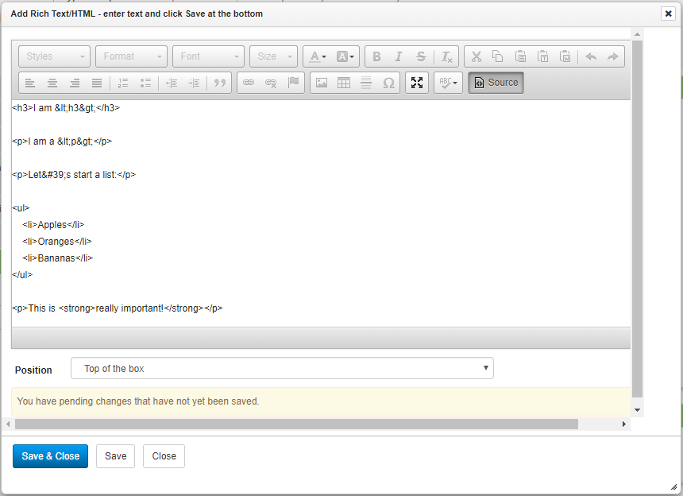

Slide 25
Use the power!

Slide 26
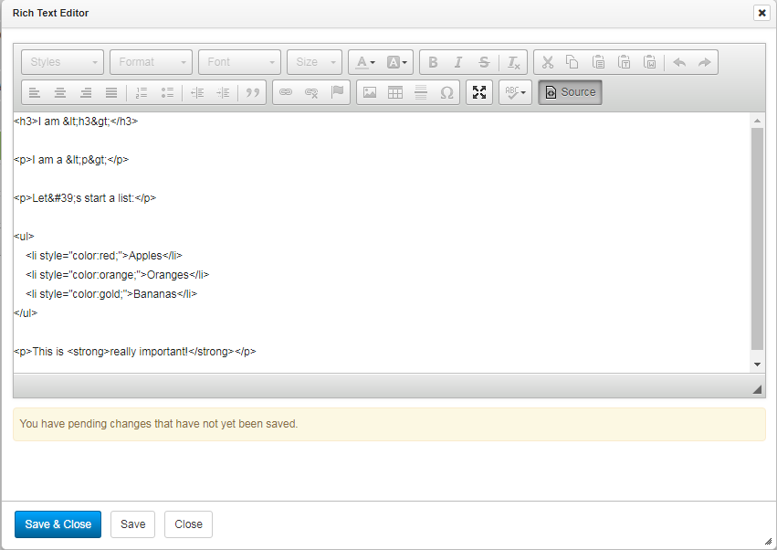

Slide 27
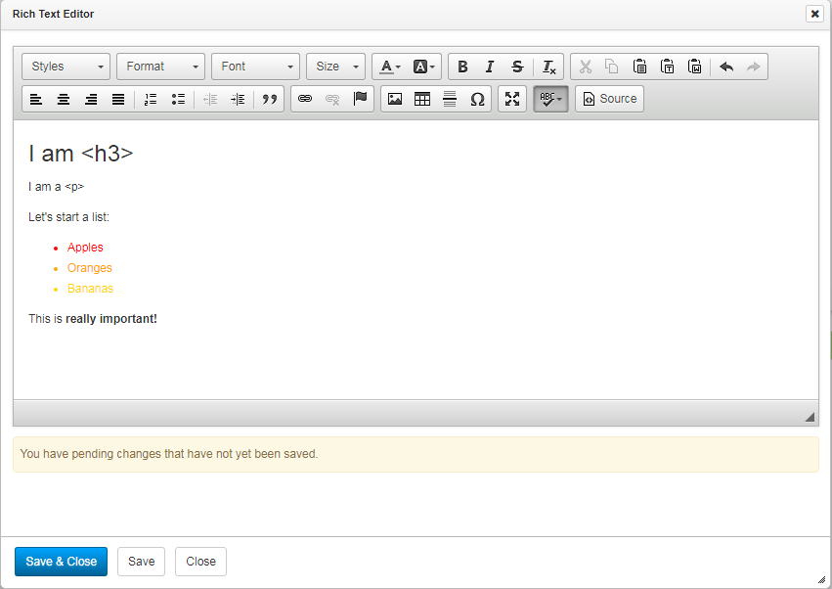

Slide 28
A solid knowledge of HTML solves a lot of problems
Notes:
It’s impressive to see how JavaScript and the way we use it has changed in recent years.
It has become incredibly powerful and more important than ever for web development.
At the same time, it seems HTML has become less important. There is an ongoing discussion about CSS in JavaScript and whether it’s
more efficient and cleaner than normal CSS from a development perspective. What we should talk about instead is the excessive
use of <div>and <span> elements at the expense of other elements. It makes a huge difference whether we use a link or a <div> with an onclick handler.
There’s also a difference between links and buttons when it comes to accessibility. Form items need <label> elements, and a sound document outline is essential.
Those are just a few examples of absolute basics that some of us forgot or never learned. Semantic HTML is one of the cornerstones of accessible web development.
Even if we write everything in JavaScript, HTML is what is finally rendered in the user’s browser.

Slide 29
Where else does this come in handy?
Widgets
Embed codes (sizing)
When you copy and paste from somewhere and you discover more than what you copied & pasted! Ads?! Weird links?!
Source Code
Inspect element
Overriding custom settings (sometimes. Don’t be evil.)

Slide 30
Where can I learn more?
There are SO, SO, SO many more places you can learn more!
W3Schools
Codecademy.com
Lynda.com
CodeSchool
Treehouse
AListApart blog
O’Reilly books

Slide 31
References & Resources
Hische, J. & Maschmeyer, R. Don’t fear the Internet: Basic HTML and CSS for non-web designers. Don’t Fear the Internet. Retrieved from http://www.dontfeartheinternet.com/
Pol-Mir, J. 2014. Getting started with HTML, CSS, JavaScript, and the awesome jQuery. Pixels4Kids. Retrieved from https://pixels4kids.net/2014/11/20/html-css-javascript-and-the-awesome-jquery/ AND Infographic: http://dl.esc4.net/pixels4kids/infographics/Html_CSS_JavaScript_and_the_Awesome_jQuery/index.html
Matuzovic, M. 2018. My accessibility journey: What I’ve learned so far. A List Apart. Retrieved from http://alistapart.com/article/my-accessibility-journey-what-ive-learned-so-far
StackOverflow. N.d. Stack Overflow: Where developers learn, share, and build careers. Retrieved from www.stackoverflow.com
W3Schools.com. N.d. w3Schools.com: The world’s largest web developer site. Retrieved from https://www.w3schools.com/

Slide 32
Thank you!
Alyssa M. Valenti, MS, MLS
alyssa.valenti@raritanval.edu
Raritan Valley Community College

