Slide 1
Six Years after RDA: Projects, Initiatives, Trends, and Directions
New Jersey Library Association Annual Conference
May 17, 2016
Sharon Q. Yang, Rider University
Yan Yi Lee, Wagner College

Slide 2
Overview
RDA-six years later, where are we now?
BIBFRAME Tools
BIBFRAME Implementation and Testing
Goals for future cataloging and bibliographic data
Challenges

Slide 3
RDA - Six Years Later, Where Are We Now?
RDA released in 2010 – 6 Years
RDA Implementation Started in 2013 – 4 Years
Switch to RDA
- LC and other US National Libraries
- Large Academic Libraries in US
- Other libraries in US

Slide 4
RDA in Other Countries
Internationalization - A major goal of the RDA standard
RDA Implementation - UK, Canada, Australia, Germany
Translations of RDA
- French, German (2013)
- Chinese (2014)
- Italian (2015)
- Finnish (2015)
- Spanish (2015)

Slide 5
Transition From AACR To RDA
Cataloging in Hybrid Environment
Multi-standards
- RDA
- AACR2
- Pre-AACR2
Hybrid Records in OCLC
- Adding 336/337/338 fields
- Spelling out abbreviations

Slide 6
Convert Legacy Data to RDA
RDA Conversion
- RDAExpress
- MARCIVE
- RDA Helper (MARCedit, free tool)
RDA Enrichment
- Backstage Library Works

Slide 7
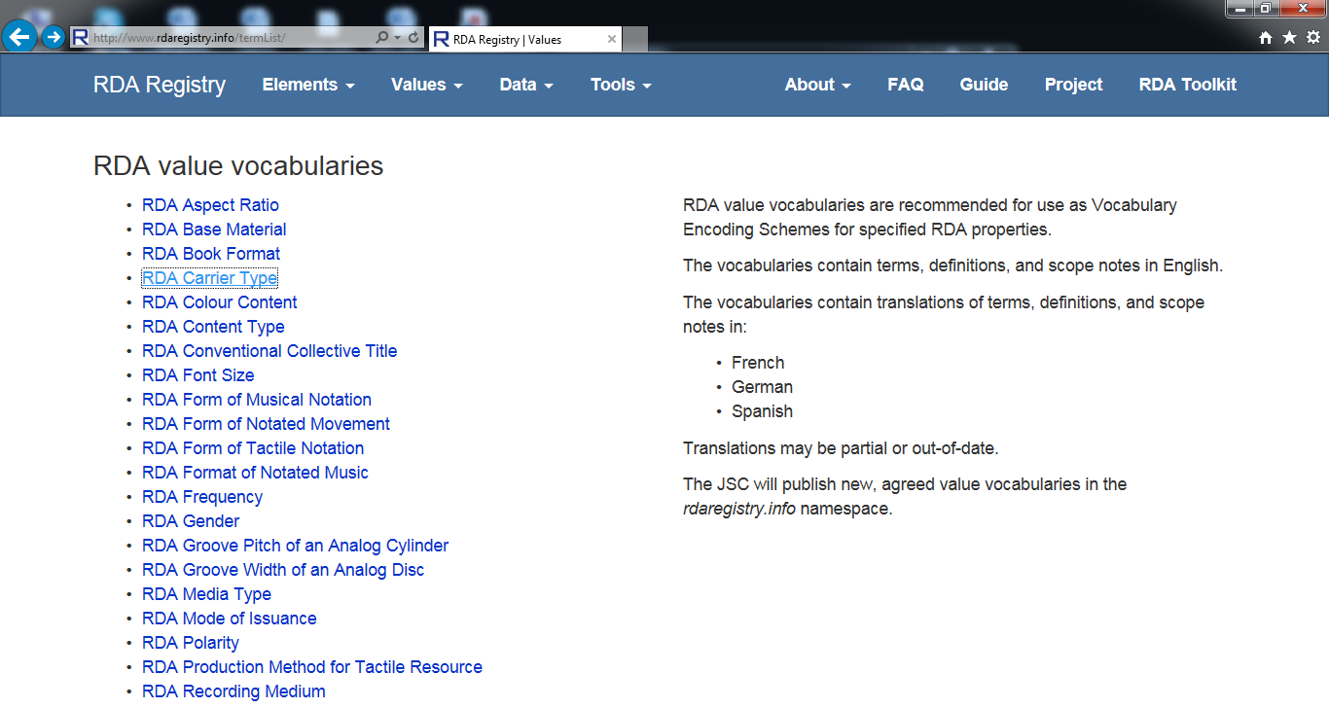
RDA Vocabulary

Slide 8
RDA Vocabulary
RDA elements and relationship designators have been published in the Open Metadata Registry (OMR) http://rdvocab.info in 2008
New namespace for RDA elements is http://rdaregister.info
Basic elements for linked data and semantic Web applications
RDA elements will be part of the BIBFRAME vocabulary

Slide 9
BIBFRAME
Not only for libraries
Data elements-atomistic elements, each of which contains one type of information
Recombinant data-assemble the data in any way a community wants (think about legos).
Data are reusable.
Image-https://en.wikipedia.org/wiki/History_of_Lego

Slide 10
BIBFRAME TOOLS
Cataloging
BIBFRAME Editor 1.0 – 2013 (demo)
BIBFRAME Editor 2.0 - April 2016 (download)
BIBFRAME Profile Editor (demo and download)
Storage
Fuseki, an open source triplestore
Display/Search
BIBFRAME Catalog (demo & download)
Metaproxy-Xquery (download)
Metaproxy-SPARQL (download)
Transformation tools
Comparison service (demo & download)
Transformation service (demo & download)
From BIBFRAME to MARC (to be developed)
Notes:
BIBFRAME 2.0 was released in April 2016. The BIBFRAME demo, transformation tools are not 2.0 yet.
This software is designed to enable the configuration of profiles based on the profile specification BIBFRAME Profiles: Introduction and Specification . The resulting RDF profile may be used to create templates in BIBFRAME editors.
BIBFRAME Catalog is a proof of concept software, open source, will be uploaded to github
Fuseki Fuseki is a SPARQL server. It provides REST-style SPARQL HTTP Update, SPARQL Query, and SPARQL Update using the SPARQL protocol over HTTP.
BIBFRAME Catalog is contracted to Aaron Schmidt and Jeremy Nelsen of Influx Library User Experience and under development. Proof of concept catalog

Slide 11
BIBFRAME Editor 2.0
https://www.loc.gov/bibframe/docs/bibframe2-model.html
Notes:
Work. The highest level of abstraction, a Work, in the BIBFRAME context, reflects the conceptual essence of the cataloged resource: authors, languages, and what it is about (subjects).
Instance. A Work may have one or more individual, material embodiments, for example, a particular published form. These are Instances of the Work. An Instance reflects information such as its publisher, place and date of publication, and format.
Item. An item is an actual copy (physical or electronic) of an Instance. It reflects information such as its location (physical or virtual), shelf mark, and barcode.
BIBFRAME 2.0 further defines additional key concepts that have relationships to the core classes:
Agents: Agents are people, organizations, jurisdictions, etc., associated with a Work or Instance through roles such as author, editor, artist, photographer, composer, illustrator, etc.
Subjects: A Work might be “about” one or more concepts. Such a concept is said to be a “subject” of the Work. Concepts that may be subjects include topics, places, temporal expressions, events, works, instances, items, agents, etc.
Events: Occurrences, the recording of which may be the content of a Work.
he BIBFRAME vocabulary consists of RDF classes and properties. Classes include the three core classes listed above as well as various additional classes, many of which are subclasses of the core classes. Properties describe characteristics of the resource being described as well as relationships among resources. For example: one Work might be a “translation of” another Work; an Instance may be an “instance of” a particular BIBFRAME Work. Other properties describe attributes of Works and Instances. For example: the BIBFRAME property “subject” expresses an important attribute of a Work (what the Work is about), and the property “extent” (e.g. number) expresses an attribute of an Instance.

Slide 12
BIBFRAME Editor 1.0 vs. 2.0
BIBFRAME 1.0
BIBFRAME 2.0
Creative Work
Instance
Authority
Annotation
Work
Instance
Item
Agents, subjects, and events
Notes:
BIBFRAME 1.0
Creative work-A resource reflecting a conceptual essence of the cataloging item
Instance-A resource reflecting an individual, material embodiment of the work
Authority-A resource reflecting key authority concepts that have defined relationships reflected in the Work and Instance. Examples of Authority Resources include People, Places, Topics, Organizations, etc.
Annotation-A resource that decorates other BIBFRAME resources with additional information (Library Holdings information, cover art and reviews)] (http://www.loc.gov/bibframe/pdf/marcld-report-11-21-2012.pdf
BIBFRAME 2.0
Work. The highest level of abstraction, a Work, in the BIBFRAME context, reflects the conceptual essence of the cataloged resource: authors, languages, and what it is about (subjects). Instance. A Work may have one or more individual, material embodiments, for example, a particular published form. These are Instances of the Work. An Instance reflects information such as its publisher, place and date of publication, and format. Item. An item is an actual copy (physical or electronic) of an Instance. It reflects information such as its location (physical or virtual), shelf mark, and barcode.
Agents: Agents are people, organizations, jurisdictions, etc., associated with a Work or Instance through roles such as author, editor, artist, photographer, composer, illustrator, etc. Subjects: A Work might be “about” one or more concepts. Such a concept is said to be a “subject” of the Work. Concepts that may be subjects include topics, places, temporal expressions, events, works, instances, items, agents, etc. Events: Occurrences, the recording of which may be the content of a Work.
he BIBFRAME vocabulary consists of RDF classes and properties. Classes include the three core classes listed above as well as various additional classes, many of which are subclasses of the core classes. Properties describe characteristics of the resource being described as well as relationships among resources. For example: one Work might be a “translation of” another Work; an Instance may be an “instance of” a particular BIBFRAME Work. Other properties describe attributes of Works and Instances. For example: the BIBFRAME property “subject” expresses an important attribute of a Work (what the Work is about), and the property “extent” (e.g. number) expresses an attribute of an Instance.

Slide 13
BIBFRAME Editor 1.0

Slide 14
BIBFRAME Data Storage
BIBFRAME produces RDF triples
Fuseki/Apache's Jena Fuseki Server
Triplestore (store RDF triples)
Open source
For Storing/Querying RDF data
Serving RDF data over HTTP
URI URI /Property URI/Value
Subject
Predicate
Object

Slide 15
BIBFRAME Catalog-BIBCat
Display & search BIBFRAME data
LC contracted with Influx Library User Experience
Demo at http://bibcat.org-Proof of the concept working demo
Download at https://github.com/jermnelson/bibframe-catalog
Front end is BIBFRAME
Backend is Fuseki triplestore
Notes:
Search
Bible
Mark twain

Slide 16
BIBFRAME Catalog at http://bibcat.org

Slide 17
BIBFRAME Searching
LC contracted Index Data
Metaproxy-Xquery-convert existing MARCXML records to BIBFRAME records - on the fly - as part of retrieval
Metaproxy-SPARQL-converts SRU/Z39.50 queries to SPARQL in order to search triplestore backends
Source-http://www.loc.gov/bibframe/tools/

Slide 18
BIBFRAME Transformation Tools
Comparison Service -compare an individual record from MARCXML with BIBFRAME record
Transformation service-batch convert MARCXML to BIBFRAME
BIBFRAME to MARC conversion tool-to be developed
Source-http://www.loc.gov/bibframe/tools/
Notes:
Comparison service-
Transformation service-Submit your own MARC Bibliographic records (as MARC/XML) and view them as BIBFRAME resources in Exhibit. The resulting data are also available for download.

Slide 19
Download BIBFRAME Tools?
Applications for a Linux server, not for Windows. IT?

Slide 20
BIBFRAME - Implementation and Testing
BIBFRAME Implementation Testbed
- Monitor implementation progress
- Discover errors, shortcomings
BIBFRAME Implementation Register
- List BIBFRAME implementations

Slide 21
BIBFRAME Implementation Register
Projects or applications - existing, developing, and planned
Any organization implementing a BIBFRAME project or application can be listed
Library of Congress, The National Library of Medicine
German National Library, Library of Alexandria
US Academic Libraries

Slide 22
Comparison Service-A BIBRAME Tool
A Test Project of BIBFRAME by LC, registered in 2014, available for use
Compare a MARCXML record with its BIBFRAME representation
Demonstration site http://bibframe.org/tools/transform/start
Input Bibliographic Identifier (MARC Tag 001)
View a before and after presentation of a MARC record from the LC's database as BIBFRAME resources

Slide 23
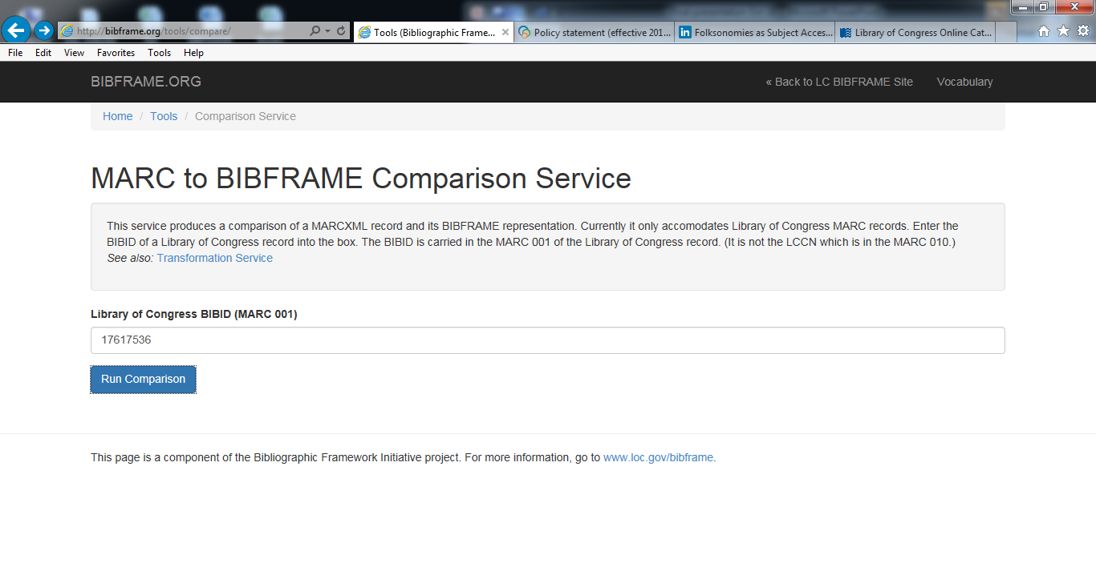
Comparison Service - Continued

Slide 24
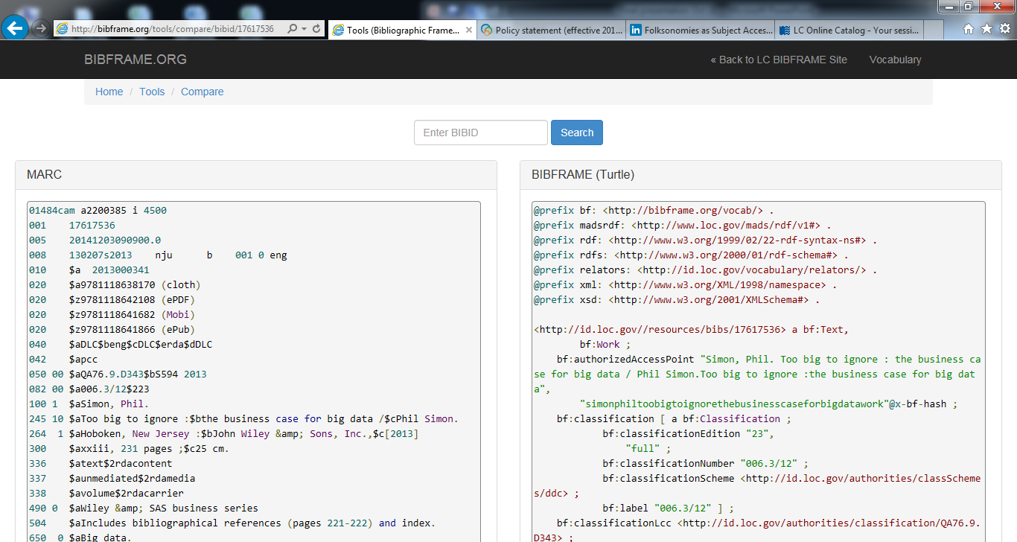
LC BIBID (MARC 001): 17617536

Slide 25
Transformation Service
Another Test BIBFRAME Project of LC, registered in 2014, available for use
Use LC’s MARC2BIBFRAME to convert MARC records
Demonstration site http://bibframe.org/tools/transform/start
Input MARCXML file (Convert MARC to MARCXML in MarcEdit, or export MARCXML file from Sierra, OCLC)
Input URL (Permanent Link of MARCXML)

Slide 26
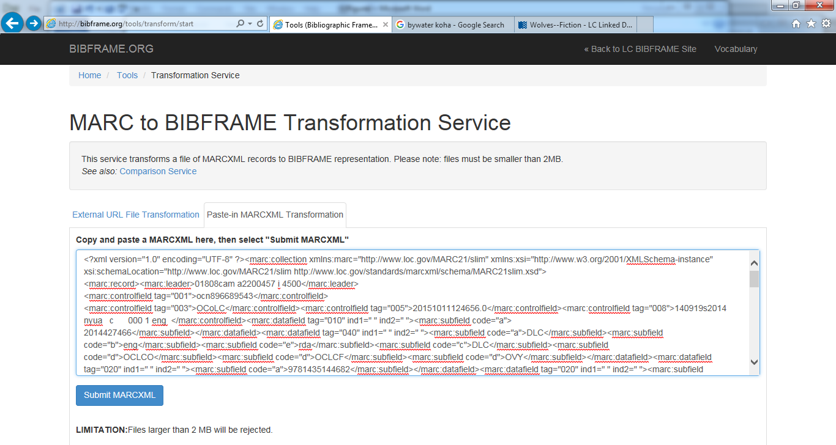
Example: The Call of the Wild by Jack London

Slide 27
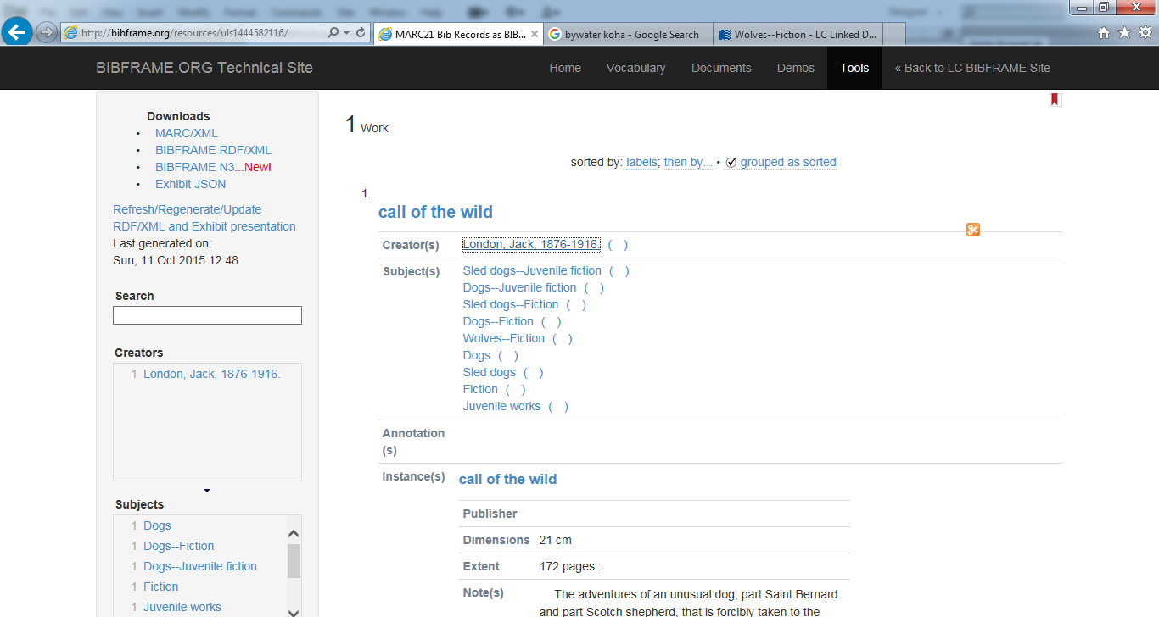
Example: The Call of the Wild by Jack London

Slide 28
Subject in RDF
<?xml version="1.0" encoding="utf-8"?>
<rdf:RDF
xmlns:bf="http://bibframe.org/vocab/"
xmlns:rdf="http://www.w3.org/1999/02/22-rdf-syntax-ns#"
>
<bf:Topic rdf:about="http://bibframe.org/resources/uls1444582116/ocn896689543topic17">
<bf:label>Wolves--Fiction</bf:label>
<bf:authorizedAccessPoint>Wolves--Fiction</bf:authorizedAccessPoint>
<bf:hasAuthority rdf:resource="http://id.loc.gov/authorities/subjects/sh2010118666"/>
</bf:Topic>
</rdf:RDF>

Slide 29
Creator’s Name in RDF
<?xml version="1.0" encoding="utf-8"?>
<rdf:RDF
xmlns:bf="http://bibframe.org/vocab/"
xmlns:rdf="http://www.w3.org/1999/02/22-rdf-syntax-ns#"
>
<bf:Person rdf:about="http://bibframe.org/resources/uls1444582116/ocn896689543person7">
<bf:authorizedAccessPoint>London, Jack, 1876-1916.</bf:authorizedAccessPoint>
<bf:hasAuthority rdf:resource="http://id.loc.gov/authorities/names/n78086415"/>
<bf:label>London, Jack, 1876-1916.</bf:label>
</bf:Person>
</rdf:RDF>

Slide 30
BIBFRAME Implementation Projects
Columbia University Libraries - Test the BIBFRAME vocabulary and data model by converting MARC and MODS records; assess available BIBFRAME tools and test the BIBFRAME Editor for the creation of new BIBFRAME descriptions
German National Library - BIBFRAME prototype in DNB OPAC
Library of Alexandria - Test BIBFRAME vocabulary, data model, and tools. Contribute to the creation of new Arabic BIBFRAME records, and conversion tool development for the Arabic Language

Slide 31
BIBFRAME Implementation Projects - continued
University of Illinois - examine aspects of the BF model related to ebooks
- Convert their 300,000 ebooks from MARC to BIBFRAME
- Develop an interface for users to search for those ebooks
- UIUC Bibframe search interface http://sif.library.illinois.edu/bibframe/search.php?
- Example Record http://sif.library.illinois.edu/bibframe/html/7578470.html

Slide 32
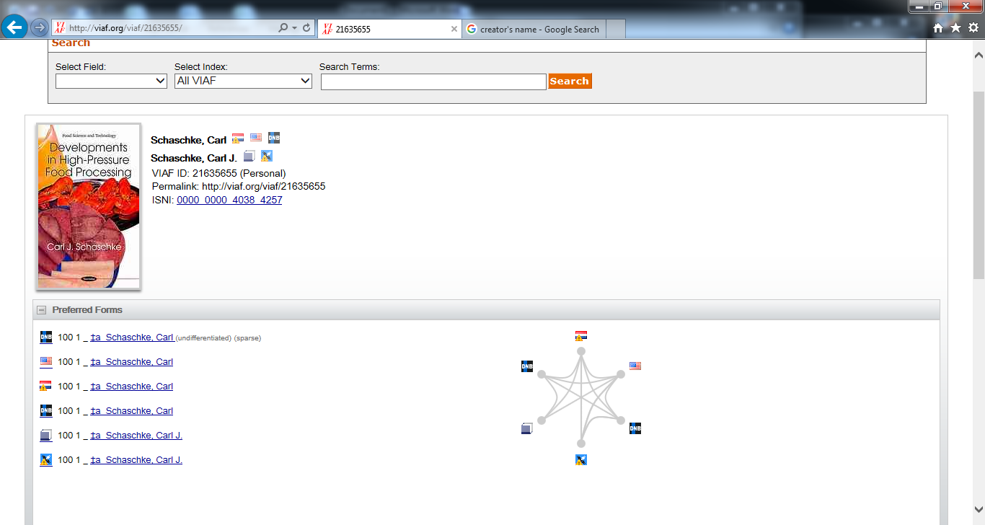
Example Record

Slide 33
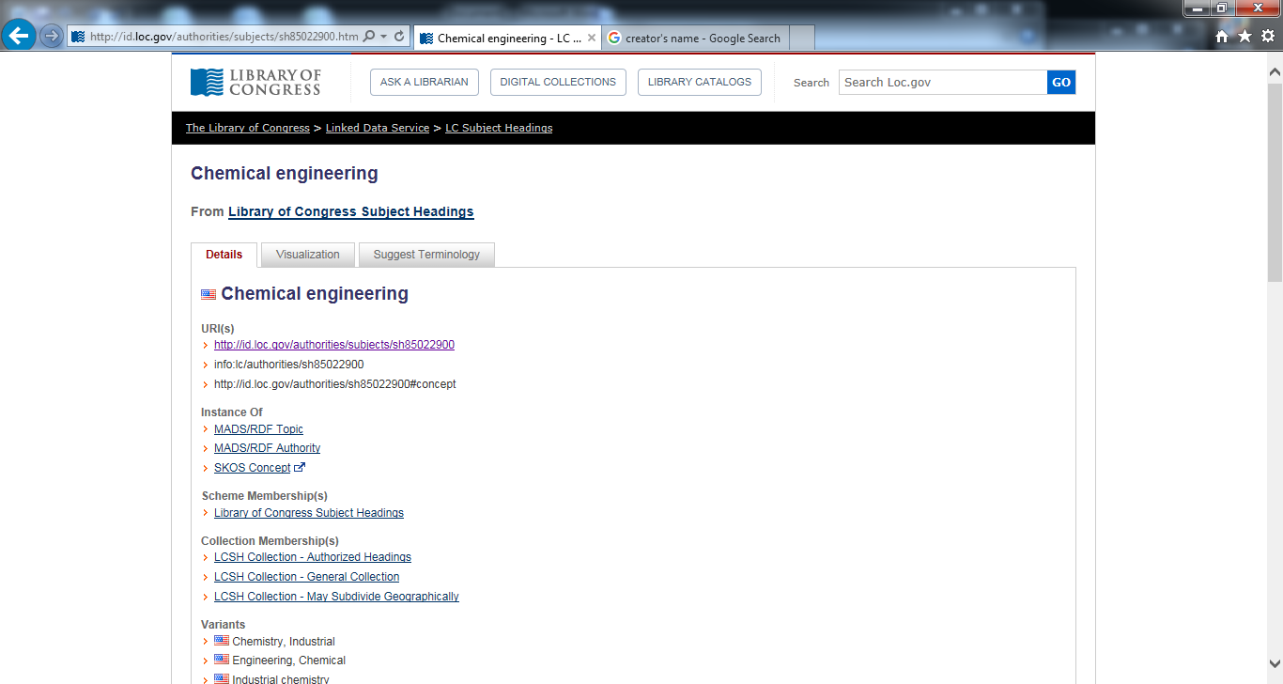
Example Record

Slide 34
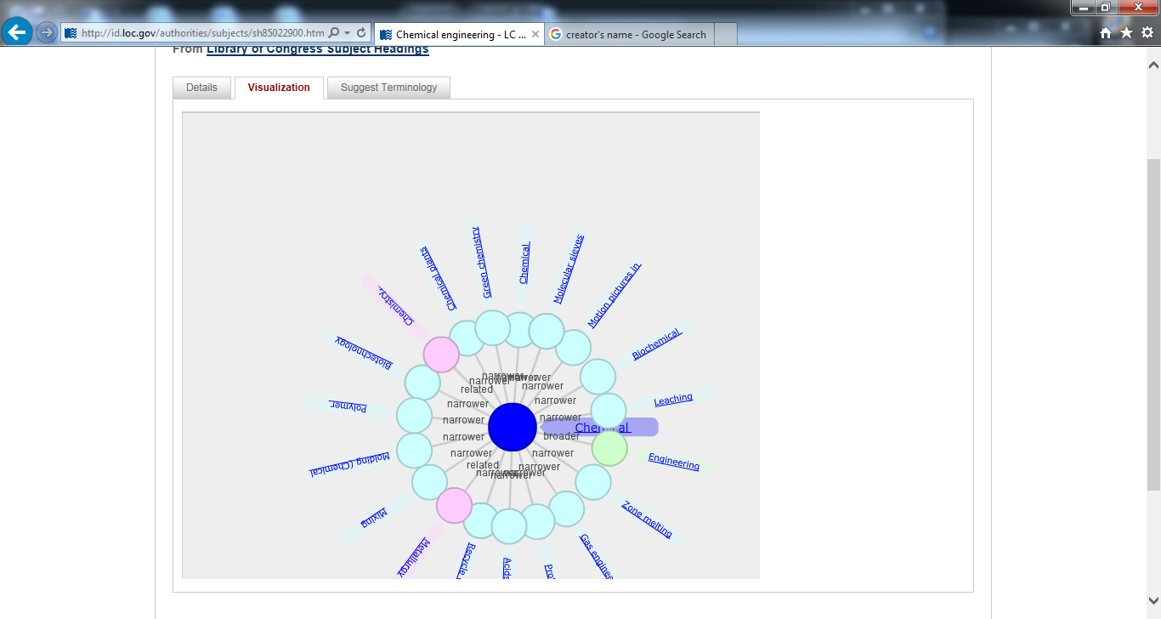
Example Record

Slide 35
Transition From MARC to BIBFRAME
ILS Vendors are preparing the transition from MARC to BIBFRAME
An Example: BIBFRAME Project by SirsiDynix, in partnership with Zepheira
- Phase 1: BLUEcloud Visibility (released, 2015)
- Phase 2: BLUEcloud Source

Slide 36
Transition From MARC to BIBFRAME - Continued
BLUEcloud Visibility - Bring library resources to the open Web
- Convert MARC records into BIBFRAME model
- Setup search engine to view new records
BLUECloud Source
- Catalog in BIBFRAME model
United States Army Corps of Engineers Research and Development Center (ERCD) Library has implemented the product (listed in BIBFRAME Implementation Register)

Slide 37
Transition from MARC to BIBFRAME
“When should we move to BIBFRAME?
BIBFRAME is far from an environment that you could move to yet.”
– BIBFRAME Frequently Asked Questions
http://www.loc.gov/bibframe/faqs/
“Resource management systems might make the transition from MARC to BIBFRAME in the next 3 to 5 years.” – Marshall Breeding
http://www.infotoday.com/cilmag/dec14/Breeding--Library-Technology-Forecast-for-2015-and-Beyond.shtml

Slide 38
What’s next?

Slide 39
Cataloging Goals and Trends: What Do Libraries Want?
More visible on the Internet
Google, Yahoo, Bing, and other search engines
Top of the search results
No more isolation and silos
Linked data and part of the Semantic Web
Enriched bibliographic data
Better presentation

Slide 40
Denvor Library in Google Search

Slide 41
The Roadmap
FRBR
RDA
BIBFRAME
Part of the Web
Semantic Web
Linked Data

Slide 42
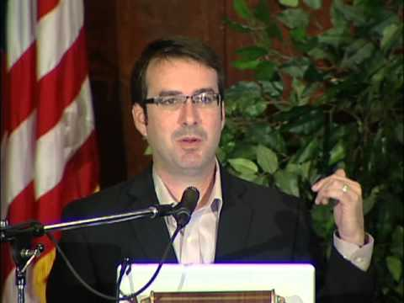
Zepheira & Eric Miller
Libhub Initiative
Make libraries more visible on the web
Bib data searchable by major Internet search engines such as Google, Yahoo, Bing, Yandex
Bib data get on the top of search results
Library Link Network
-library data (hours, locations, information, catalog, digital archives)is searchable by major Internet search engines such as Google, Yahoo, Bing, Yandex
Partners-EBSCO, Innovative, Sirsidynix
BIBFRAME Scribe-a training tool

Slide 43
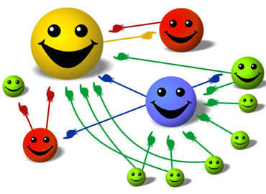
Libraries Get on the Top of the Search Results?

Slide 44
Other related projects
BIBFLOW
Joint project between Zepheira with University of California Davis Library
Impact of BIBFRAME on technical services and worklow
Linked Data for Libraries Project-Cornell, Harvard, and Standford
MARC Edit-MarkNext

Slide 45
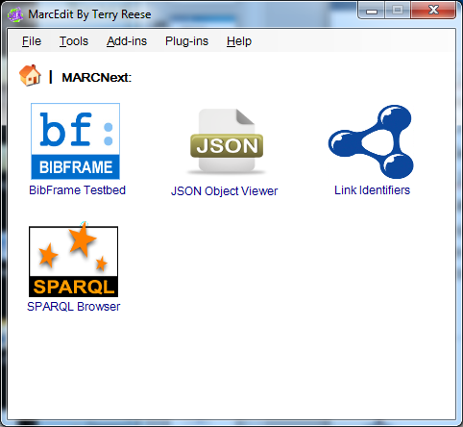
MarcNext in MarcEdit

Slide 46
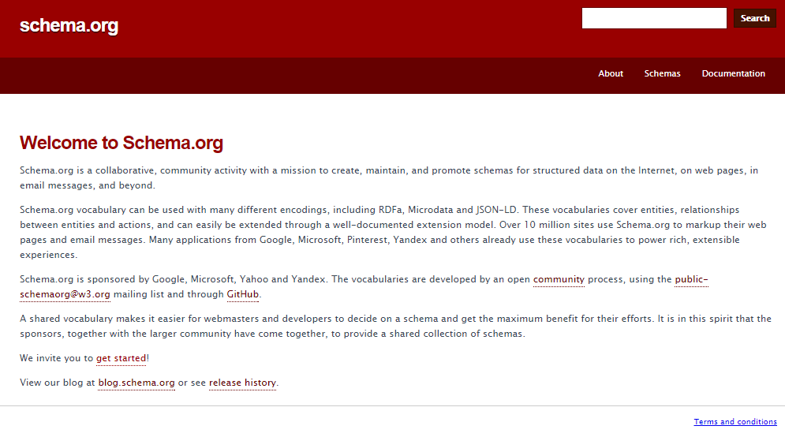
Schema.org

Slide 47
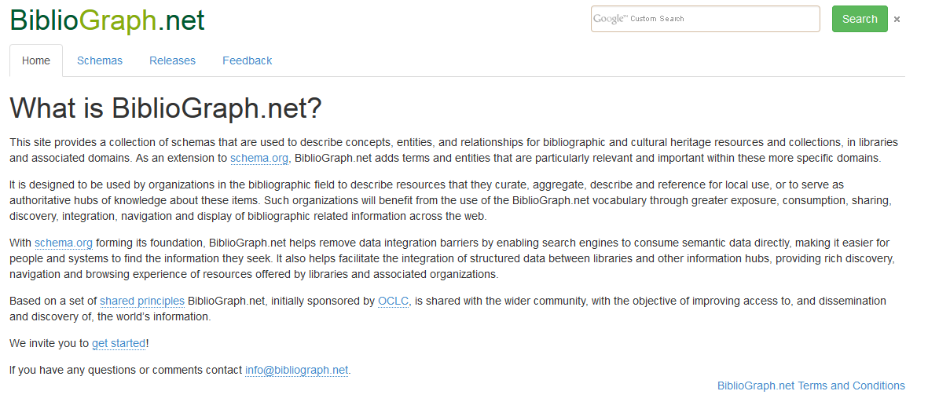
Align schema.org with BIBFRAME?
Schema.org falls short in describing library data
Schema Bib Extend Project sponsored by OCLC
Schema Bib Extend Community Group-proposes an extension to schema.org (anyone can join)
Schema.org has to approve it
Http://Bibliograph.net-Extension of schema.org

Slide 48
OCLC Linked Data Initiative
Another leader in Linked Data/Semantic Web
Expose Worldcat.org to the Web
A BIBFRAME tester
Actively involved in schema Bib Extension-Align BIBFRAME with schema.org
Worldcat Works
Worldcat Identity
Sources-http://www.oclc.org/content/dam/research/publications/library/2013/2013-05.pdf
Notes:
The organization has been working to expand Schema.org vocabularies to better accommodate library data.
To that end, OCLC has been centrally involved with the World Wide Web Consortium’s (W3C) Schema Bib Extend community group that aims to expand schema.org markup language to include additional bibliographic information and other data used by libraries.

Slide 49
What remains to be done?

Slide 50
Some of the Challenges?
BIBFRAME-continued improvement
BIBFRAME vs. Schema.org-alignment
Legacy data-clean up
MARC conversion-huge project
MARC data loss as oncologies and vocabularies will not be enough to cover all?
Library systems-costly to integrate BIBFRAME
Different flavors of BIBFRAME, standards, data model?
Release the bib data on the web?

Slide 51
QandA

