Slide 1
Which Citation Manager?
~ A Conversation Starter
Mei Ling Lo
(mlo@rutgers.edu)
Roberta Tipton
(tipton@rulmail.rutgers.edu)
Rutgers University Libraries
Notes:
This topic of citation management software is well covered in places like wiki. There are numerous articles that compare various software.

Slide 2
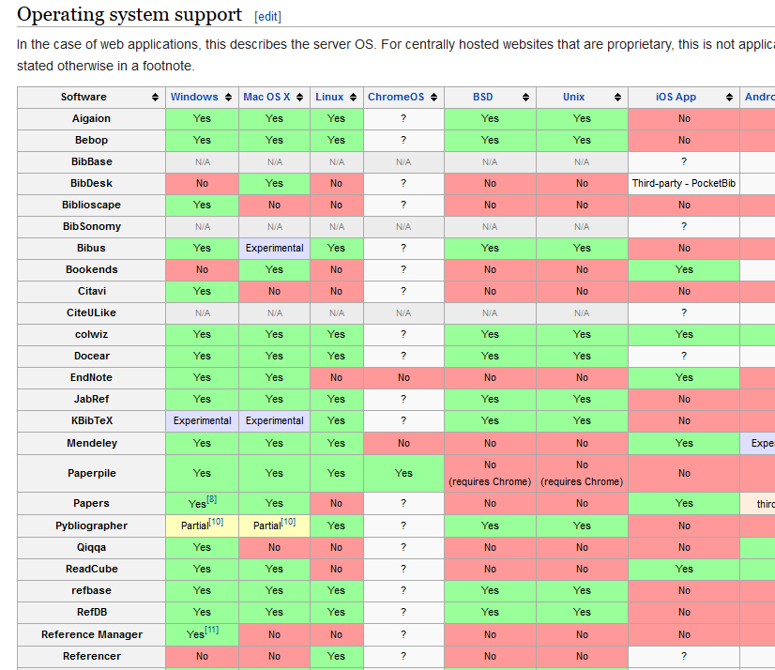
Citation Management Software
Citation Management Software
Comparison of reference management software. (2015, April 10). In Wikipedia, The Free Encyclopedia. Retrieved 18:24, April 13, 2015, from http://en.wikipedia.org/w/index.php?title=Comparison_of_reference_management_software&oldid=655835549
Notes:
This topic of citation management software is well covered by Wiki, and other research literature.

Slide 4
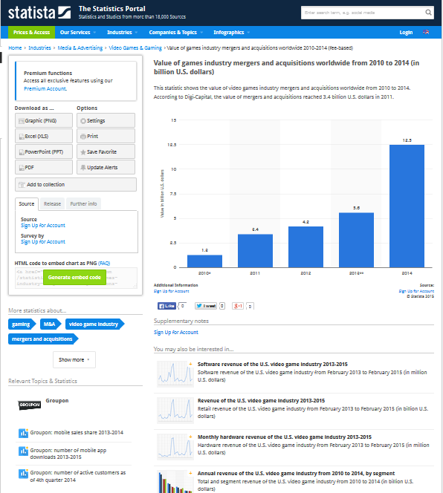
How to cite different types of materials?

Slide 5
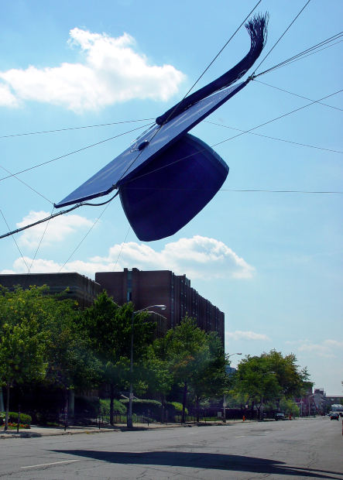
Undergraduate students:
Lack patience
Not enough time
Unwilling to go through the steep learning curve
Graduate students and faculty:
More willing to invest time on learning citation management software
Has the need to save/organize/store the citations and the PDF files.

Slide 6
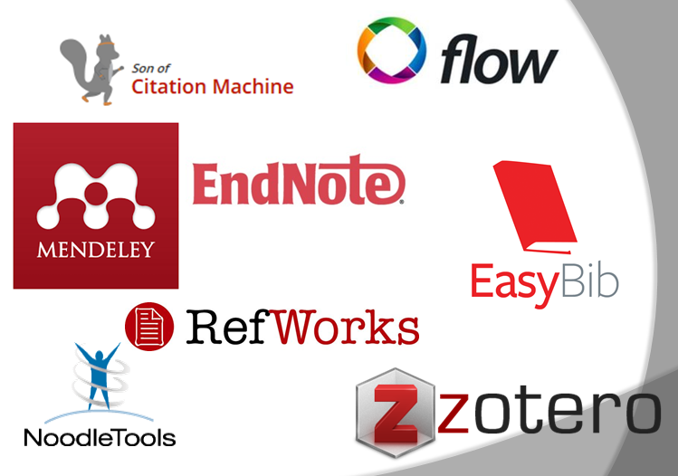
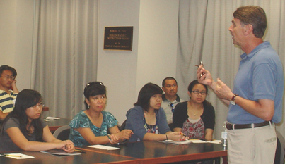
Why is it so difficult to find a winner?
Which citation management tool should we use?
Which tool should we teach our students?
Which tool should we support?

Slide 7
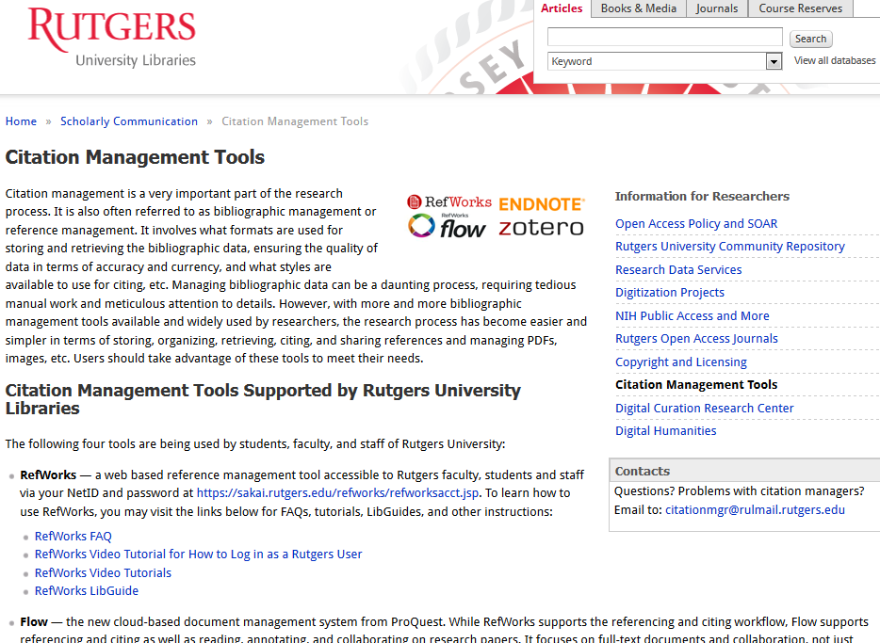
Citation Management Team was established.
Members:
Marcie Anszperger
Joseph Deodato
Theodora Haynes
Chuck Hedrick
Dave Hoover
Mei Ling Lo
Stephen Modica
Jill Nathanson
Roberta Tipton
Yingting Zhang

Slide 8
Citation Management Team
Provide an email address for answering
questions specific to citation management
Share our expertise
Create supporting materials for the tools
Organize workshops

Slide 9
Big Ten Universities – what tools do the libraries support?
 | Endnote/Endnote Basic | Refworks | Flow | Mendeley | Zotero | Other
University of Illinois at Urbana - Champaign | yes | yes
Indiana University | yes |  |  | yes | yes | Reference Manager
University of Iowa | yes | yes | yes | yes | yes | Papers
University of Maryland | yes | yes |  | yes | yes
University of Michigan | yes | yes |  | yes | yes
Michigan State University | yes |  |  | yes | yes | Papers2
University of Minnesota | yes | yes |  | yes | yes | Paperpile, BibTeX
University of Nebraska-Lincoln |  | yes
Northwestern University | yes |  |  |  | yes
Ohio State University | yes | yes |  | yes | yes | Papers
Penn State University | yes | yes |  | yes | yes
Purdue University | yes |  |  |  | yes
Rutgers University | yes | yes | yes |  | yes
University of Wisconsin-Madison | yes |  |  | yes | yes | Papers

Slide 10
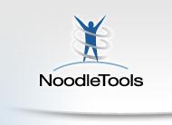
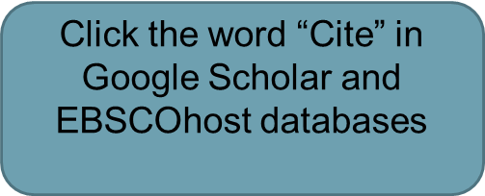
Which citation management tools do our undergrads use?
Express

Slide 11
Which citation management tools should we support?

Slide 12
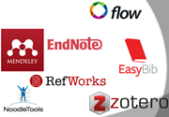
Who can download citations directly from databases?
NoodleTools MLA Lite
BibMe
Son of Citation Machine
EasyBib
Flow
Mendeley
Zotero
RefWorks
EndNote
Databases
Users have to manually enter the citation information.
Users can export the citations to the tools.

Slide 13
Who can add items from a website with a click?
Proquest Flow (easy)
Zotero (easy)
Mendeley (easy)
RefWorks (use RefGrabit)
Endnote (use Bookmarklet or add on)
BibMe
Son of Citation Machine
EasyBib

Slide 14
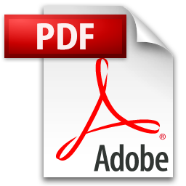
Who can extract embedded data from the PDF easily?
Proquest Flow
Zotero
Mendeley
Endnote (only works for some recent PDFs)
RefWorks
Son of Citation Machine
BibMe
EasyBib
Metadata can be extracted from the PDF files to create a citation that has authors, titles etc.
Notes:
This feature is particularly useful for users who have saved large amount of PDFs and have not had any citation information stored for those PDF files.

Slide 15
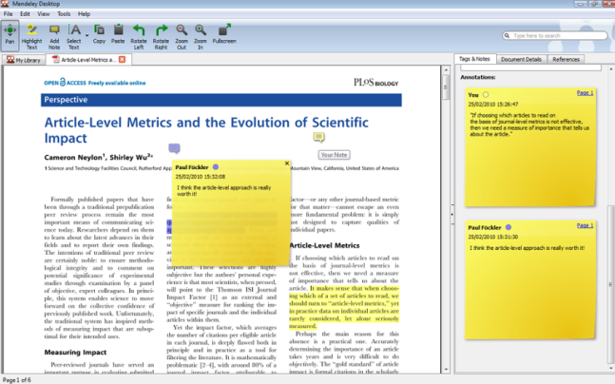
Who can annotate PDFs ?
RefWorks
Son of Citation Machine
NoodleTools
BibMe
EasyBib
Flow
Zotero
Mendeley
Endnote

Slide 16
Who can store attachment such as a data set or an image?
EndNote
Zotero
Mendeley
RefWorks (with difficulty)
Flow
Son of Citation Machine
NoodlesTools
BibMe
EasyBib

Slide 17
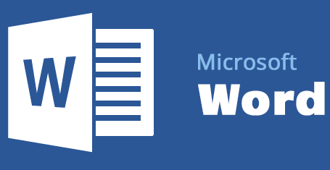
Who works well with Microsoft Word?
EndNote
Flow
Mendley
Zotero
RefWorks
NoodleTools MLA Lite
EasyBib
BibMe
Son of Citation Machine
Plug-in

Slide 18
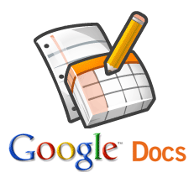
Who works well with Google Docs without too many steps?
Flow (Google Add On)
Mendeley
Zotero (drag & drop)
EasyBib (Google Add On)
RefWorks (very complicated)
Endnote (needs to convert and upload files)
Son of Citation Machine
BibMe
NoodleTools

Slide 19
Who have apps available for tablets?
Zotero (Zotpad)
Mendeley (PDF reader)
Noodletools Companion
EndNote
EasyBib
RefWorks (no separate app, but RefMobile available)
Flow (no app, but does support mobile device)
BibMe
Son of Citation Machine

Slide 20
Who can link to the PDFs in Dropbox?
Mendeley
EndNote
RefWorks
Flow
Zotero
NoodleTools MLA Lite
EasyBib
BibMe
Son of Citation Machine
Dropbox

Slide 21
For more detailed comparison, visit http://www.tinyurl.com/rutgers-citation-tools

Slide 22
“There is no such thing as the ‘best’ reference manager but only the reference manager that is best for you.”
http://www.docear.org/2014/01/15/comprehensive-comparison-of-reference-managers-mendeley-vs-zotero-vs-docear/

Slide 23
1. Which citation managers does your library or university pay for? 2. Which citation managers do your students and faculty use most often? Are they the same as above or different? 3. Are you ever asked to support software that you do not provide? If so, how do you cope with the request? 4. Do you ever enlist computing services personnel to help you with citation manager problems, especially difficult installations? Is this successful? 5. What other issues have you encountered with support for citation managers?

Slide 24
Mei Ling Lo
(mlo@rutgers.edu)
Roberta Tipton
(tipton@rulmail.rutgers.edu)
Rutgers University Libraries

