Slide 1
ChromeDuino
Create Arduino-compatible sketches on Chromebook or in Chrome browser!
Available on Chrome web store
Easy setup!!!

Slide 3
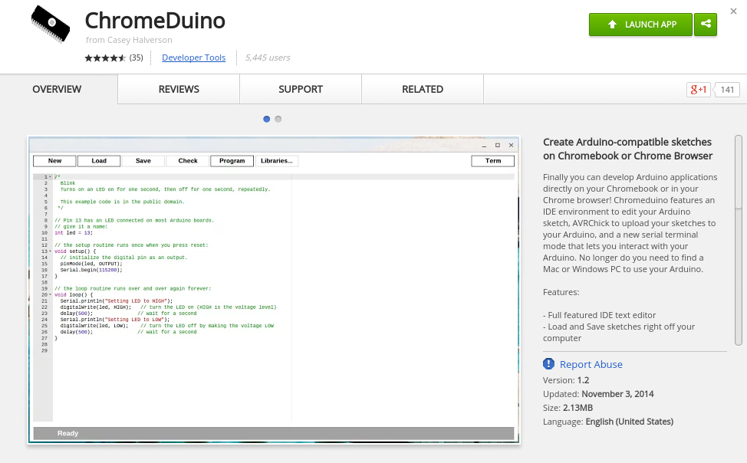

Slide 4
1
2

Slide 5
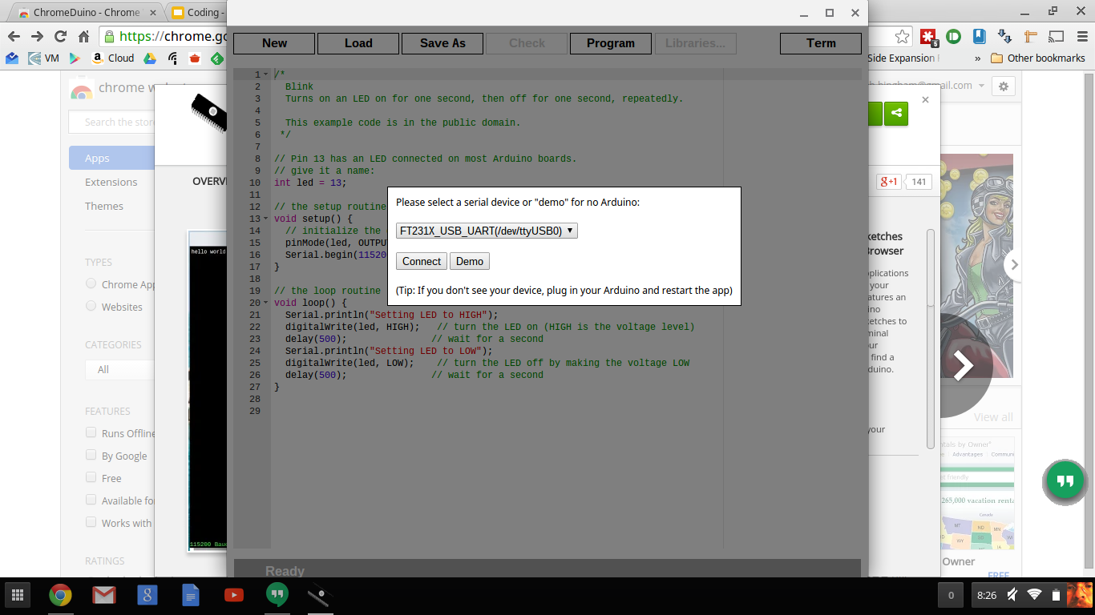

Slide 6
Make sure your Arduino board is connected to your device and...
Click on Connect!

Slide 7
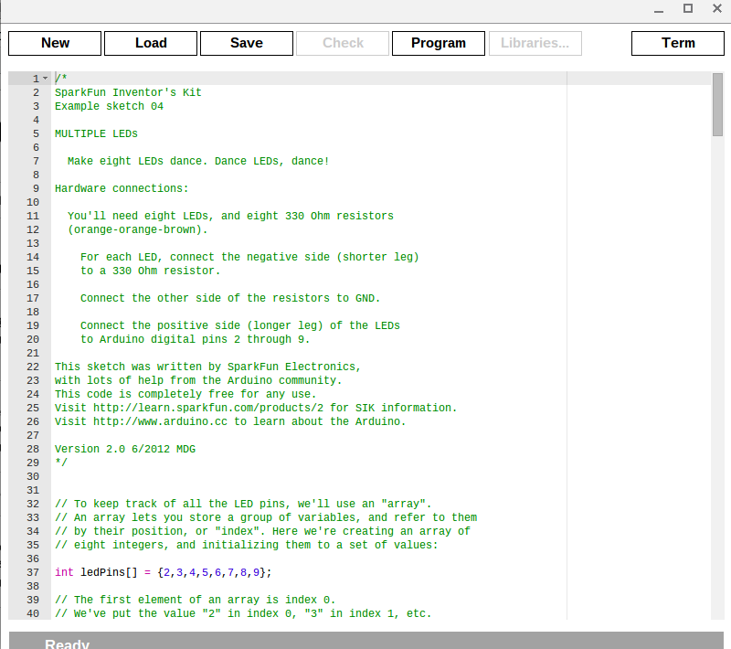

Slide 8
CodeBender
Online Arduino Development Environment
Free!
https://codebender.cc/

Slide 9
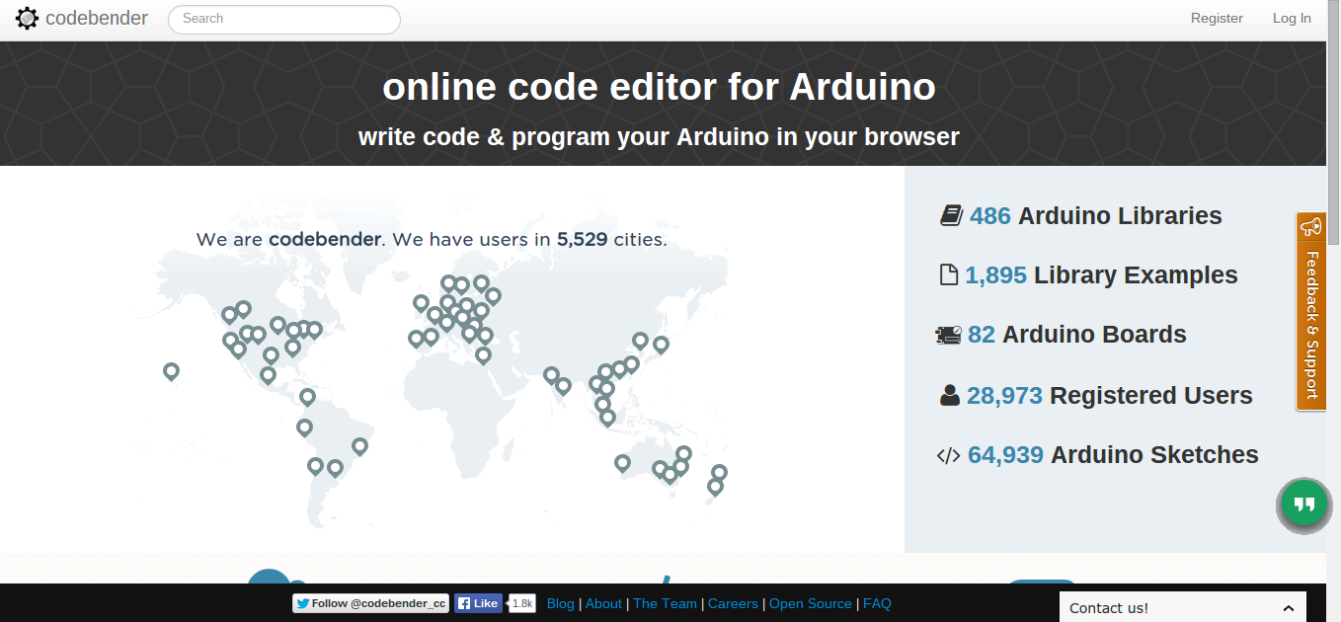

Slide 10
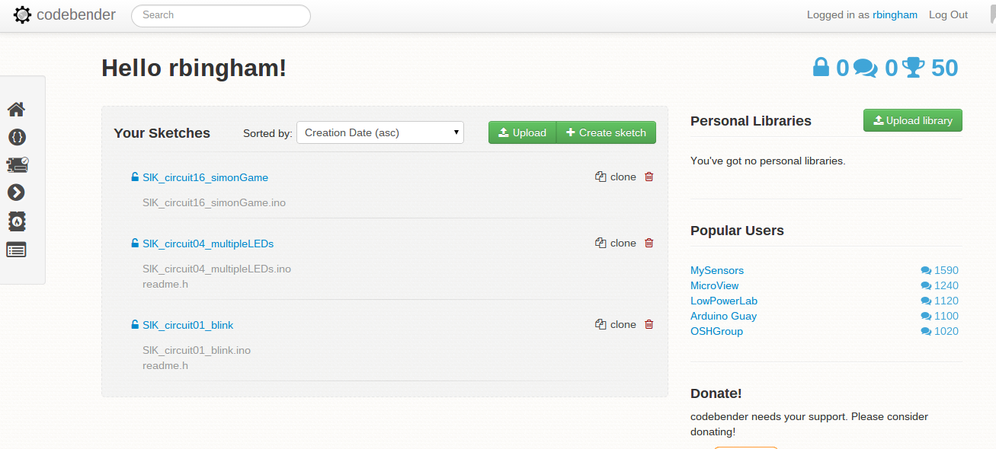

Slide 11
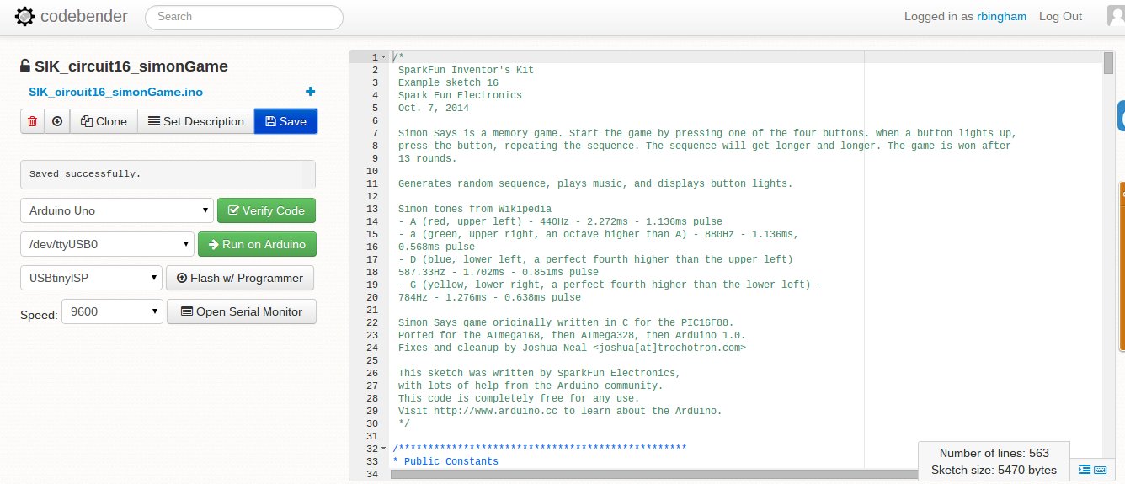

Slide 12
123D Circuits
Free online circuit simulator
Includes Arduino simulation
From Autodesk
http://123d.circuits.io/

Slide 13
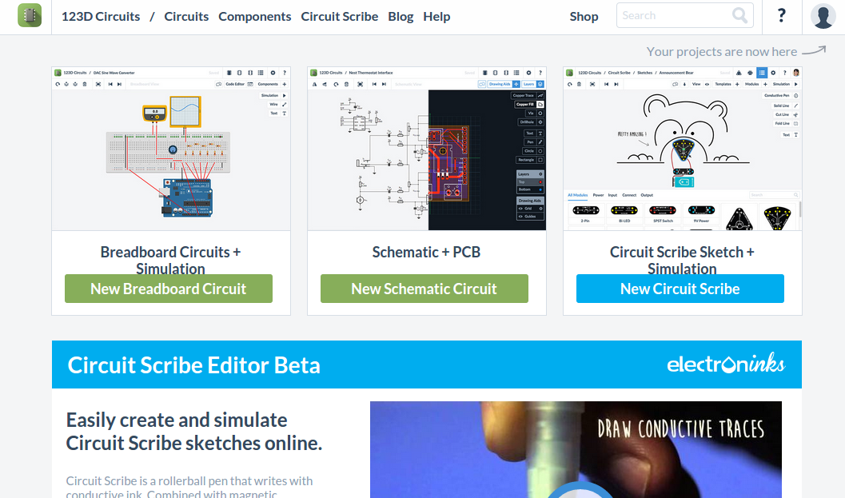

Slide 14
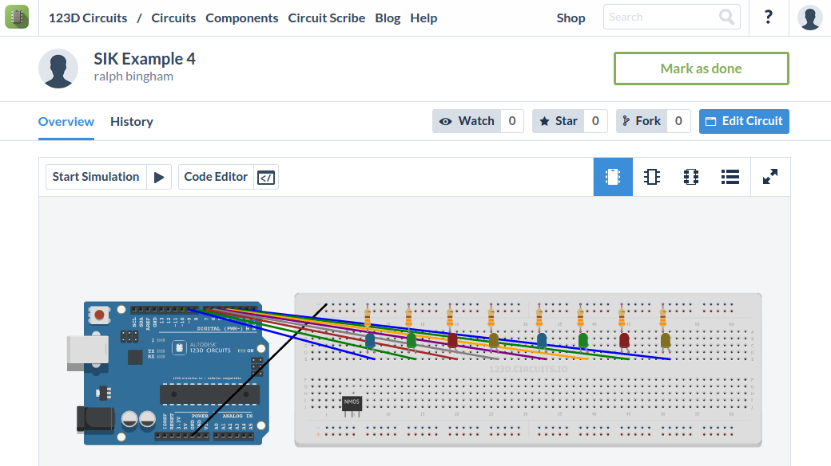

Slide 15
Ralph Bingham
Head of Reference & Digital Services
Gloucester County Library System
rbingham@gcls.org
856/223-6045

