Slide 1
Using
LibraryH3lp
Simple Online Chat Reference
Jennifer Heise, Drew University

Slide 2
Why use online chat?
Connection with online users
Easier than phone for some users (deaf, ESL)
Point of Use help for online resources

Slide 3
LibraryH3lp
created by librarians in Code4Lib
hosted service
flat rates (inexpensive), with multiple accounts, queues, interfaces
device-independent
embedded chat window for web pages
texting add on available

Slide 4
Design your own chat window
Configurable widgets
Pop-up, Embedded, ‘Follow-me’ and Proactive types
Simple javascript can go on most web pages
Notifies user if no-one is available
Make different widgets & queues
(Does not request user login/email)

Slide 5
Staffing
Each staff member has an account
Logs in through a web page
Audible beep
canned responses available
Logs interactions
Addresses can be blocked

Slide 6
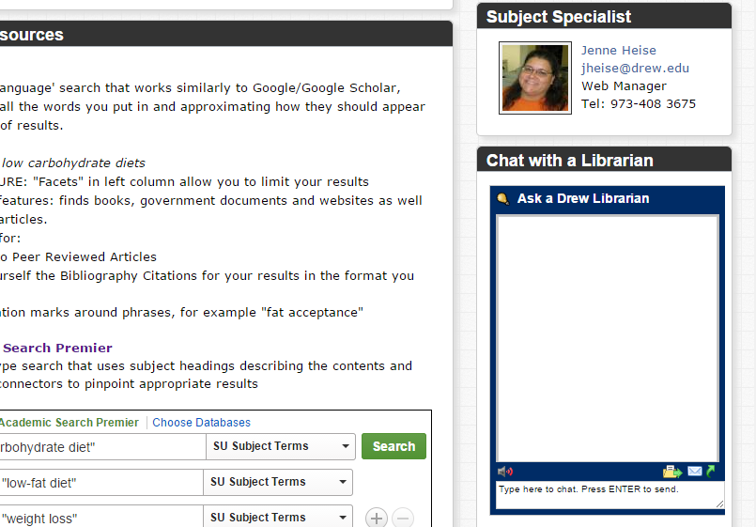
Users See

Slide 7
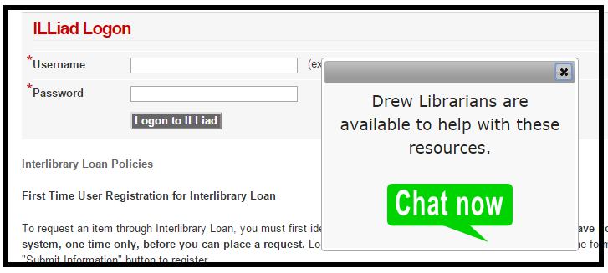
Users see:
Or Proactive link pops up:

Slide 8
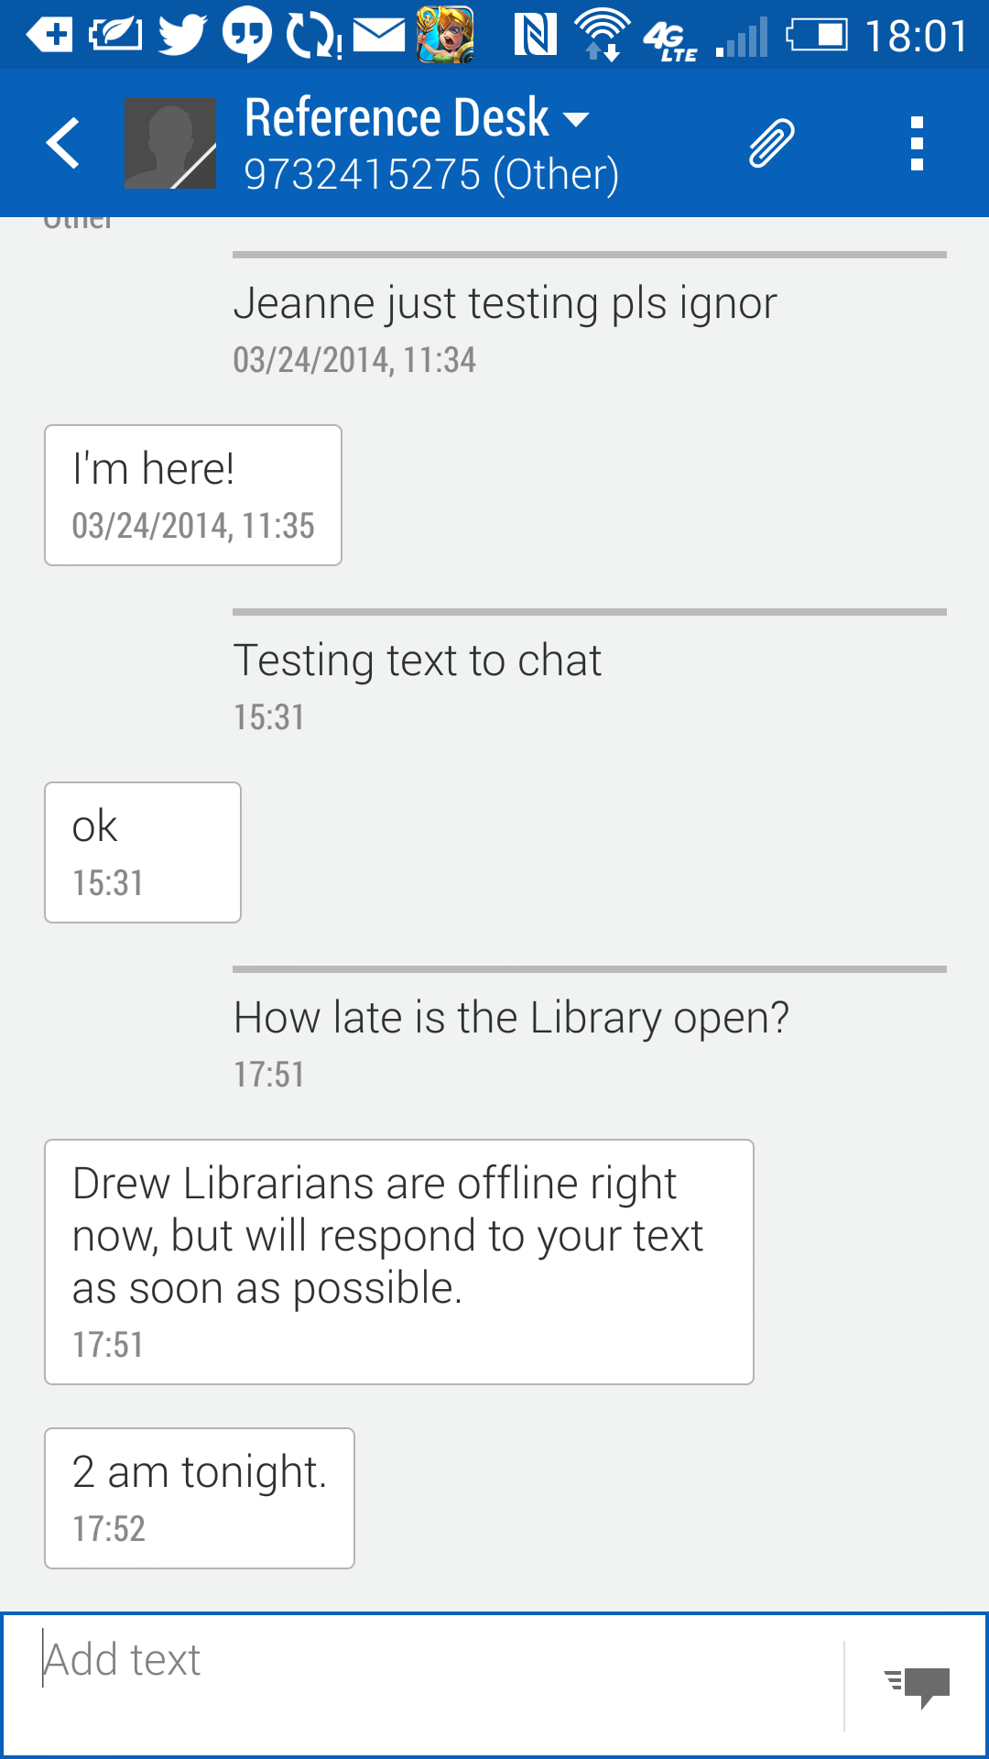
Text messaging

Slide 9
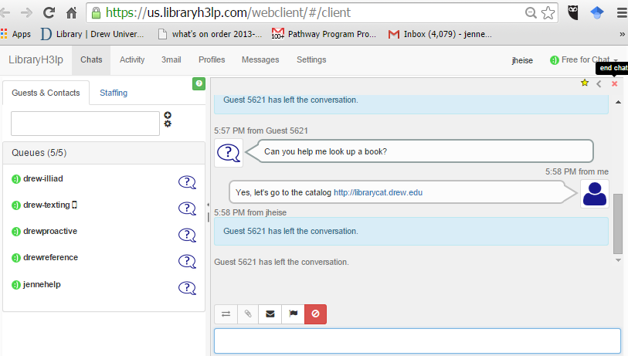
Librarian Sees:

Slide 10
More Information
LibraryH3lp: https://us.libraryh3lp.com/
Jennifer Heise - jheise@drew.edu, 973-408-3675

Slide 11
References
Stacey E. Kimmel and Jennifer Heise. 2003. Virtual reference services: Issues and trends. Binghamton, NY: Haworth Information Press.
Pam and Eric Sessoms. 2008. “LibraryH3lp: A new flexible chat reference system.” Code4Lib Journal(4): 107.
Danielle Theiss-White, Jenny Dale, et. al. 2009. “IM'ing overload: Libraryh3lp to the rescue.” Library Hi Tech News 26 (1/2): 12-7.
Alexa Pearce. 2010. “Text message reference at NYU libraries.” The Reference Librarian 51 (4): 256.
Amanda Bielskas, and Kathleen M. Dreyer. 2012. IM and SMS reference services for libraries. (THE TECH SET® #19). Chicago: ALA TechSource.
Beth C. Thomsett-Scott. 2013. Implementing virtual reference services : A LITA guide. Chicago: ALA TechSource.
SQ Yang and HA Dalal. 2015. “Delivering virtual reference services on the web: An investigation into the current practice by academic libraries.” Journal of Academic Librarianship 41 (1): 68-86.
Alison Steinberg Gurganus. 2015. “Virtual reference in a community college library: Patron use of instant messaging and log-in chat services.” Dissertation.

