Slide 1
Harnessing the Power of FANDOM
NJLA Conference 2016

Slide 2
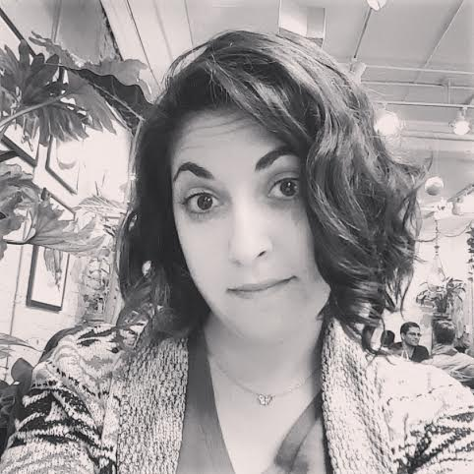
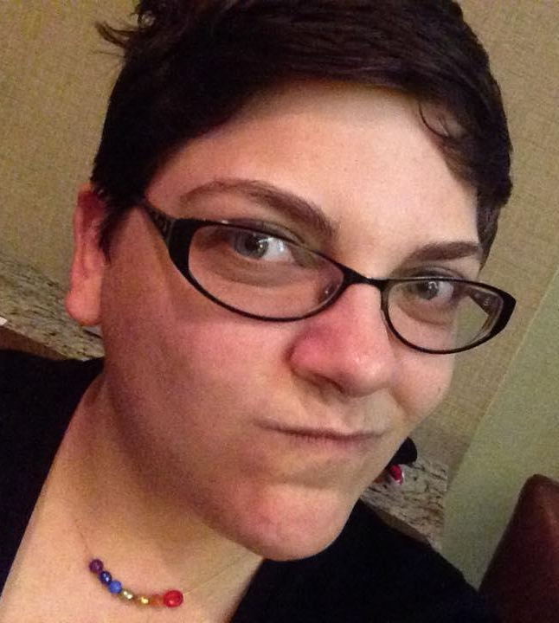
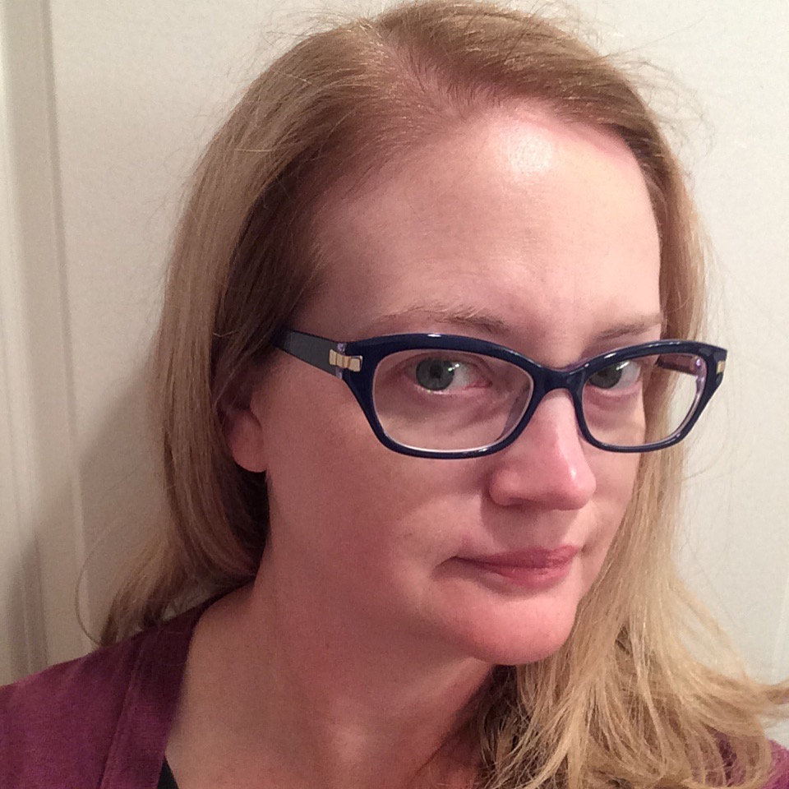
Presented by:
Katie Bojanek
Young Adult Librarian
Warren Township Library
Jessica Schneider Teen Services Librarian East Brunswick Public Library
Twitter: @jeschnei
Megan England
Young Adult Librarian Jefferson-Madison Regional Library (Crozet, VA)
Twitter: @geektasticlib
Liz Burns
Head of Readers’ Services
Talking Book and Braille Center
Twitter: @lizb

Slide 3
What is a Fandom?
1
A community of fans surrounding a particular interest

Slide 4
Fandom is...
The fan community for a book, movie, television show, game, band, etc.
There is a fandom for just about everything.

Slide 5
Who are the fans?
Whovians (Doctor Who)
Trekkies (Star Trek)
Little Monsters (Lady gaga)
Sherlockians (BBC Sherlock, ACD Canon, Elementary, etc.)
You’re never too old to be in fandom.

Slide 6
Where is Fandom?
2
On the internet, mostly.

Slide 7
Finding Fandom
Online
Tumblr
Livejournal
AO3/FFN/Wattpad (more later)
Reddit
Facebook Fan Pages
In-Person
Conventions
Local meetups
School clubs
Libraries!

Slide 8
Fandom Terms
3
What is a ship and why am I on it?

Slide 9
Basic Terms
Ship - Short for relationship. A romantic pairing between characters. (verb: “I ship Johnlock!” noun: “I’m going down with my ship.”)
OTP - One True Pairing. A fan’s ultimate ship. (Ex: “Korrasami is my OTP!”)
OT3 - An OTP, but with three characters. (Ex: “Star Wars TFA is the ultimate OT3 movie!”)
Canon - the source material (often: “I really hope my ship becomes canon!”)

Slide 10
Basic Terms
Slash - A romantic relationship between two male characters (Also: femslash)
This term comes from the way ships used to be (and sometimes still are) named: Kirk/Spock
Beta Reader - A volunteer editor
Mary Sue/Gary Stu - An idealized character, often perceived as an author self-insert. Always negative connotation.
RPF - Real Person Fic. Fanfiction written about real people (actors, musicians, etc.)

Slide 11
Basic Terms
Headcanon - Something that is totally canon… inside your own head. Something a fan prefers to believe about the source media. (Headcanon: Finn secretly kept adventure novels under his bed in the stormtrooper barracks.)
Fanon - A collection of concepts and ideas that are used in many fanworks, but don't necessarily exist in canon. Headcanons that are widely accepted throughout the fandom.

Slide 12
Basic Terms
AU - Alternate Universe.
Crossover - A fanwork that melds two or more fandoms.

Slide 13
All About Shipping
Fans often have VERY strong opinions about their ships and the characters involved! Ship and let ship. Keep the drama outside the library. Ship wars are a thing.
Not all ship names involve the character’s actual names.
Johnlock = John & Sherlock
Stormpilot = Finn & Poe (Star Wars: TFA)

Slide 14
Fan Works
4
Fiction, Art, Meta, Vids, and Cosplay.

Slide 15
Fanfiction

Slide 16
Fanfiction Basics
Fanfic is fiction written by fans of a particular media that use the characters and/or setting of the established source material.
But isn’t that copyright infringement?
Nope. It’s Fair Use. See Campbell vs. Acuff-Rose. For more info, visit the Organization for Transformative Works.

Slide 17
Who reads fanfic?
According to the unofficial AO3 census (n=10,005):
Mostly women
Mostly college age or older
Lots of LGBTQ folks
Love numbers? Check out fandom statistics wizard Destinationtoast: http://destinationtoast.tumblr.com/stats

Slide 18
Debunking fanfic myths
It’s all terrible.
It’s bad for teen literacy
It’s just practice for “real” writing
Just like everything in the world, there’s bad in with the good. Consider this:

Slide 19
Debunking fanfic myths
MANY published authors have come out of the fanfic world (not just E.L. James!), and continue to read and write fanfic after starting a writing career.
There are stories out there with millions of hits, comments, and kudos. Seriously good stuff.
It’s a great place for ESL folks to practice their language skills.
It gives writers a place to develop their skills, work with beta readers, and get feedback.

Slide 20
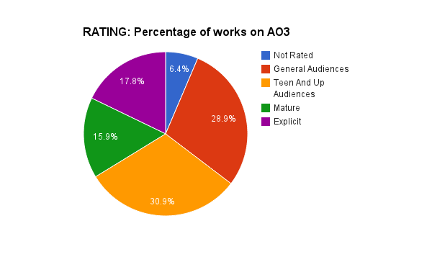
Debunking fanfic myths
It’s mostly erotica
Nope. Wattpad & ffn don’t allow ratings higher than Mature. On AO3, only 17.8% of works have an Explicit rating.

Slide 21
Major fanfic sites
Fanfiction.net
Wattpad
Livejournal
Fansites
Archive of Our Own (AO3)
Allows for thorough tagging and archive warnings.

Slide 22
What the library can do:
Provide writing books
Hold writing contests
Purchase writing software like Scrivener
Make sure major fanfiction sites aren’t blocked by your filters
Don’t be judgy!

Slide 23
Meta

Slide 24
Meta Analysis
Deep analysis of the source material: themes, characters, subtext, metaphors, etc.
More popular in some fandoms than other

Slide 25
What the library can do:
Provide books on critical analysis
Where allowed, consider suggesting popular fandom media as legit choices for analytical assignments
Talk deeply with fans about their favorite media!

Slide 26
Fanart

Slide 27
What is fanart?
Fanart is art created by artists that depict characters and stories from previously published works
These include artist interpretations of these characters
Fan art can be many different mediums including drawings, paintings, and sculptures

Slide 28
Major fanart sites
Deviantart
Tumblr
Fanart-central.net
Fan websites
Etsy
Redbubble

Slide 29
What the library can do:
Provide a drawing tablet in your makerspace (wacom)
Consider drawing pencils for in-house use
Provide opportunities to display fanart in the library

Slide 30
Cosplay

Slide 31
What is cosplay?
Cosplay is a combination of the words “costume play”
Cosplay is where fans dress up as and sometimes perform as their favorite characters

Slide 32
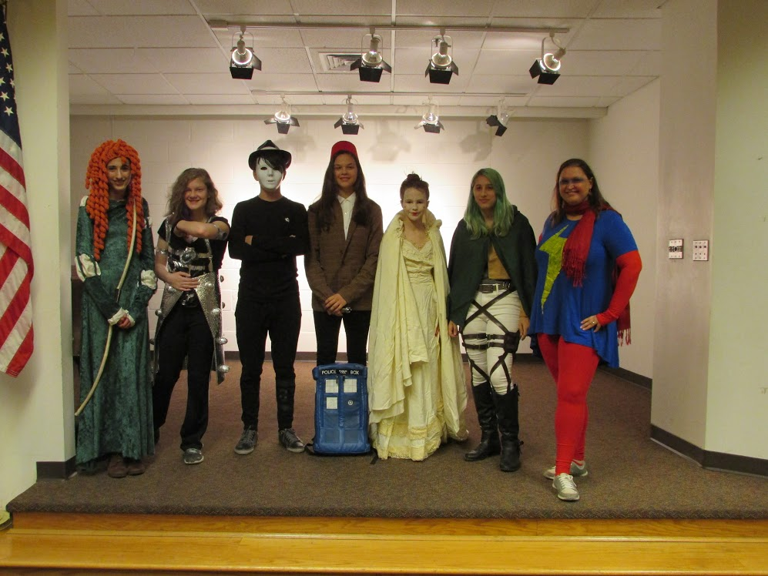

Slide 33
Who cosplays?
Cosplayers are all ages
Some make homemade costumes, some buy packaged costumes, and some use pieces they buy from stores or the internet

Slide 34
What can the library do?
Hold cosplay meet ups or events
Provide books about sewing or costume making
Put a sewing machine in your makerspace

Slide 35
Fanvids

Slide 36
What are fanvids?
Fans download videoclips from their favorite movies or TV shows and edit them together to form a new narrative or set them to music
Fans dress up in cosplay to shoot their own videos
Fans perform music from the show, create meta videos, craft tutorials, and more.

Slide 37
What can the library do?
Provide video editing software
Offer video cameras as part of your makerspace
Allow people the space to shoot their own videos in the library.
Offer a workshop on copyright & youtube so their vids don’t get taken down!

Slide 38
Fandom Programs
6
Parties, crafts, and watch-alongs,
oh my!

Slide 39
Fandom as a social experience
The best thing about fandom: You’re not alone in loving the thing! The whole point is community.
An automatic point of connection; something in common
The library can facilitate

Slide 40
The Harry Potter Alliance
@ YOUR Library
Fandoms and the Power of Good
Get your teens involved in their community and fighting for causes that matter to them!

Slide 41
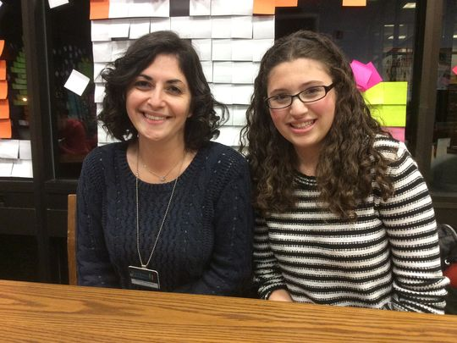
The Harry Potter Alliance turns fans into heroes.
We’re changing the world by making activism accessible through the power of story.
https://dobbysfavoritesock.wordpress.com/
Library-specific chapters
Yearly National Campaigns
NOT just about fundraising!
Take on any cause and any fandom your teens feel strongly about!
http://hpachapters.invisionzone.com/ccs_files/Libraries/Libraries_FAQ.pdf
www.thehpalliance.org

Slide 42
Programs & Events
by
Dobby’s Favorite Sock
Odds in Our Favor - Hunger Games Monopoly
Frozen Party
Rutgers Quidditch Game
Welcome to Hogwarts
Harry Potter Fanfiction Contest and Coffee House
Harry Potter Trivia Night
Coming to America
Read to a Wizard Day

Slide 43
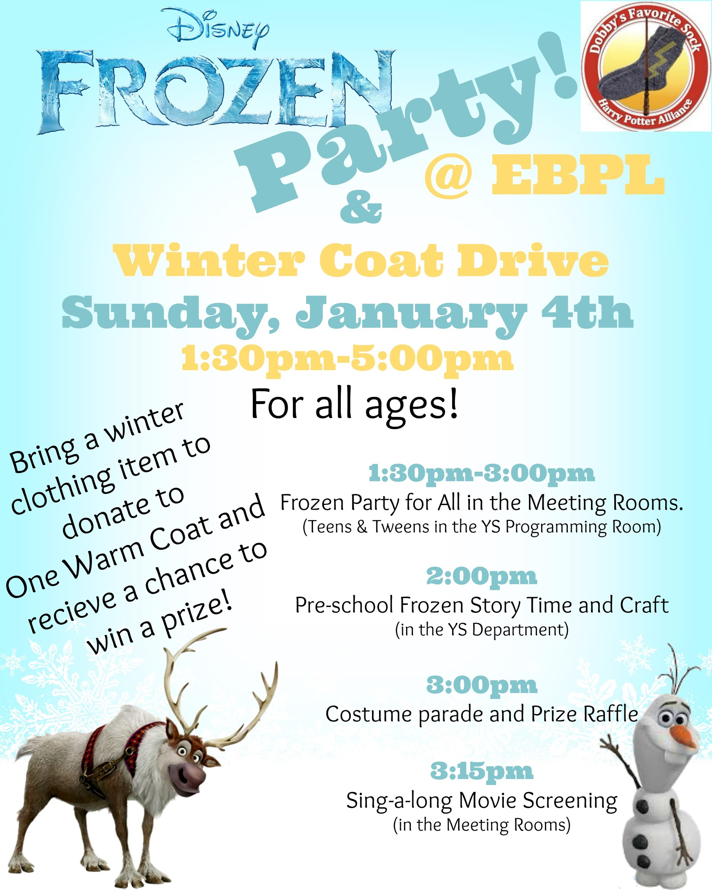
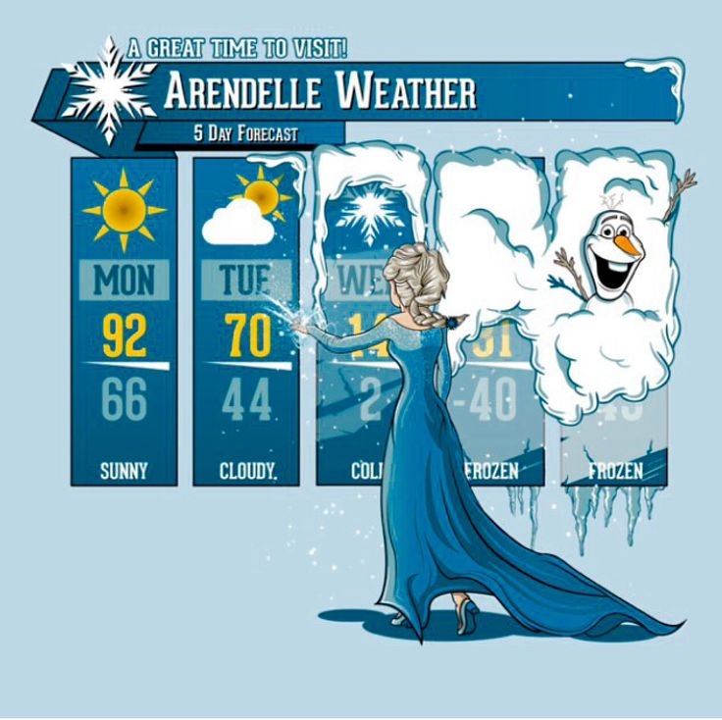
Frozen Party
Collecting coats and other warm clothing for the Frozen Citizens of Arendelle

Slide 44
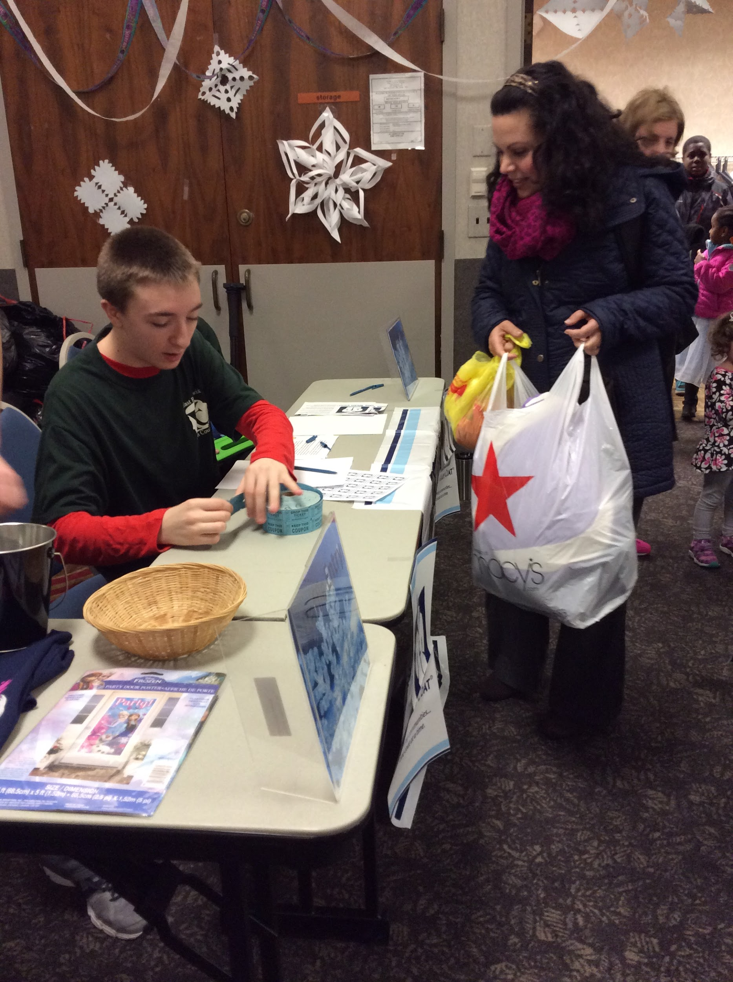
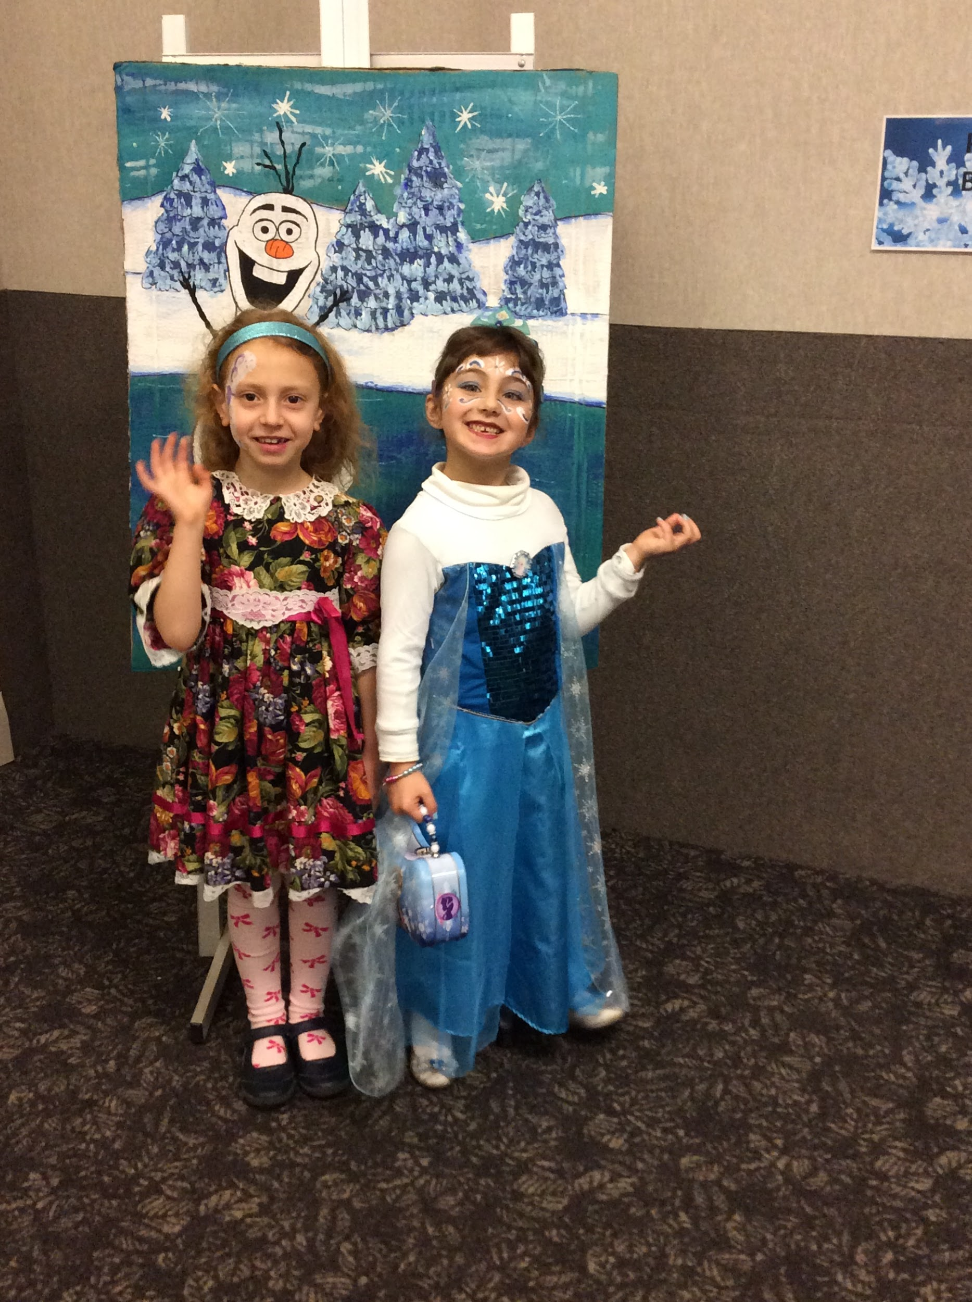

Slide 45
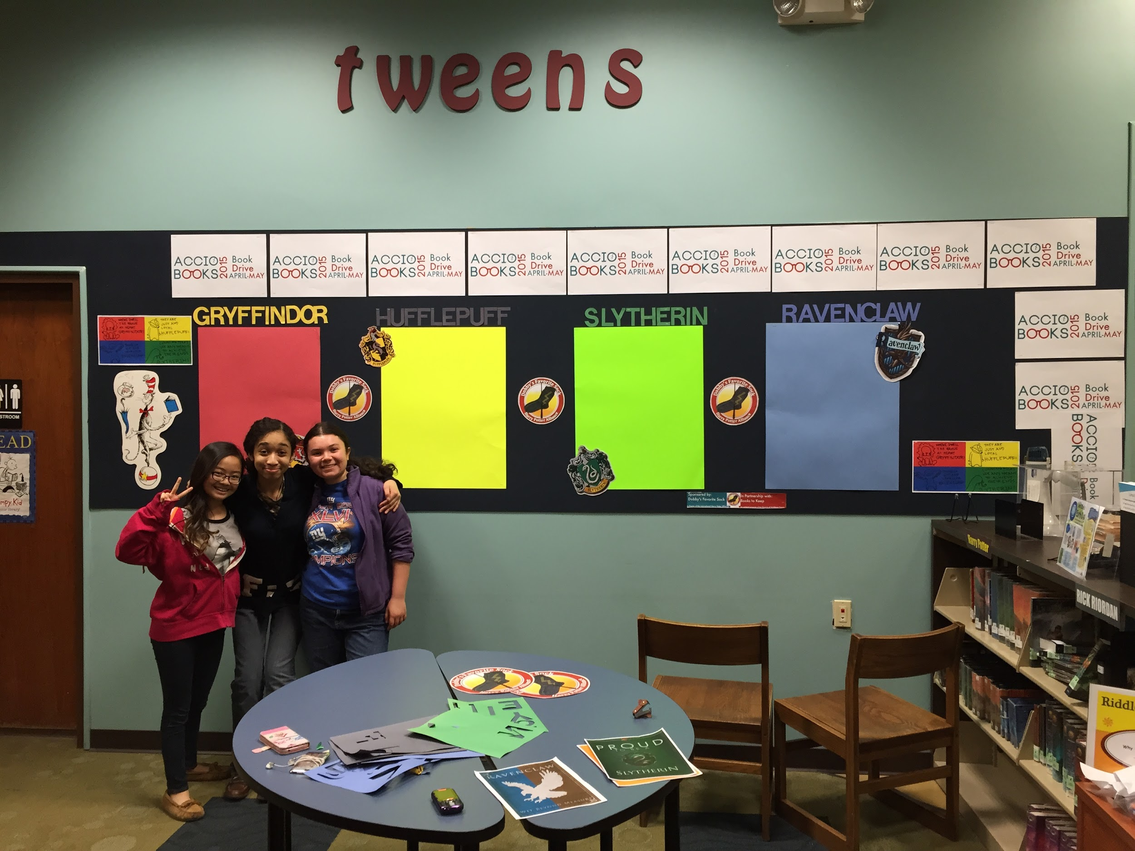
Book Count as of May 16th: 2,586!

Slide 46
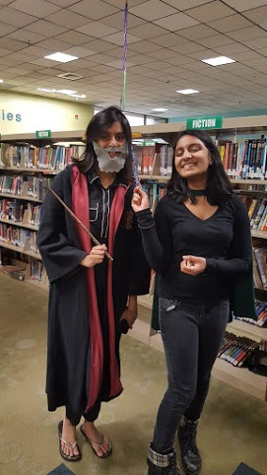
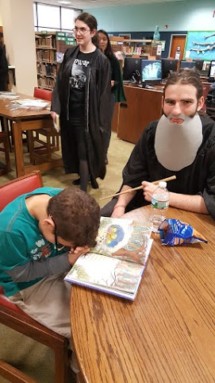
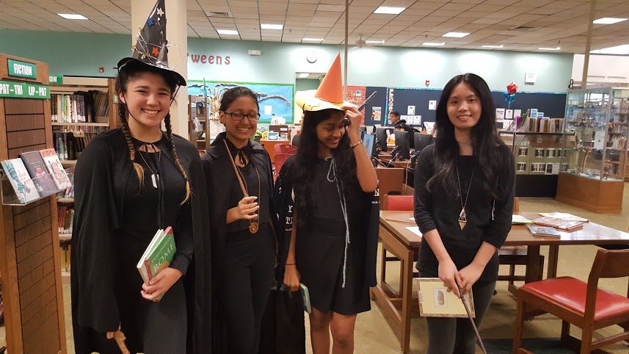
Read to a Wizard Day

Slide 47
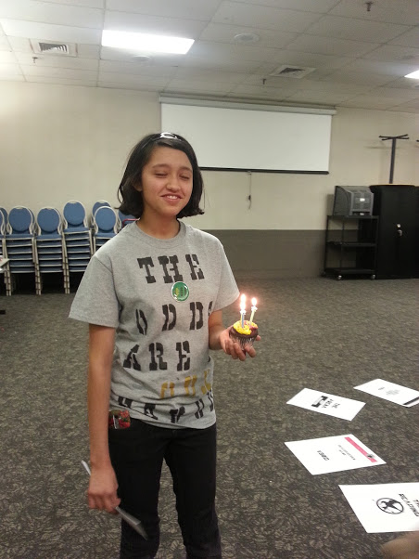
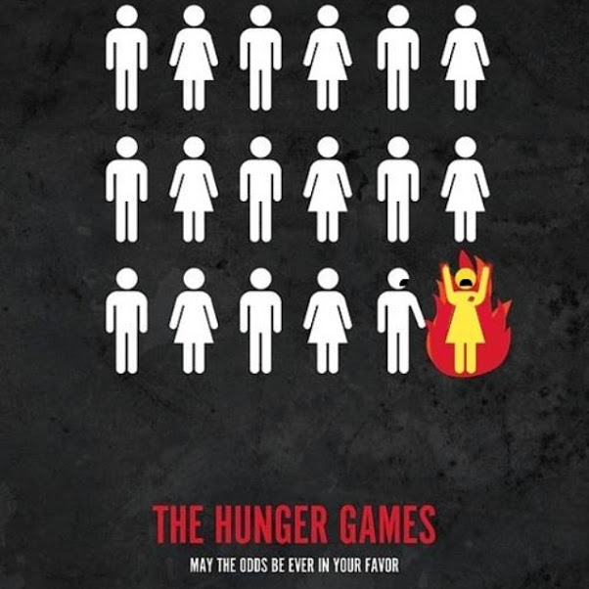
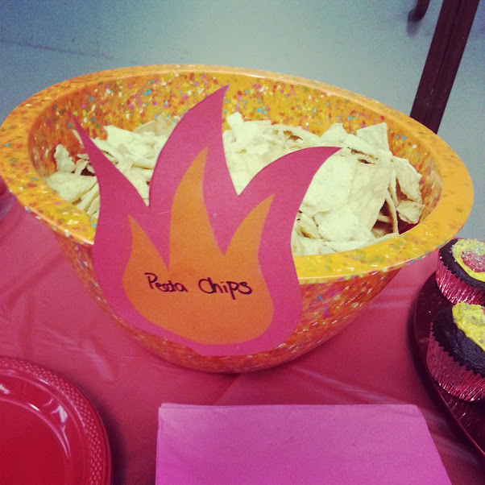
The Odds are in OUR Favor:
Hunger Games Monopoly -
Economic Inequality Awareness Campaign
http://www.teenlibrariantoolbox.com/2013/12/tpib-hunger-games-monopolgy-from-kearsten/

Slide 48
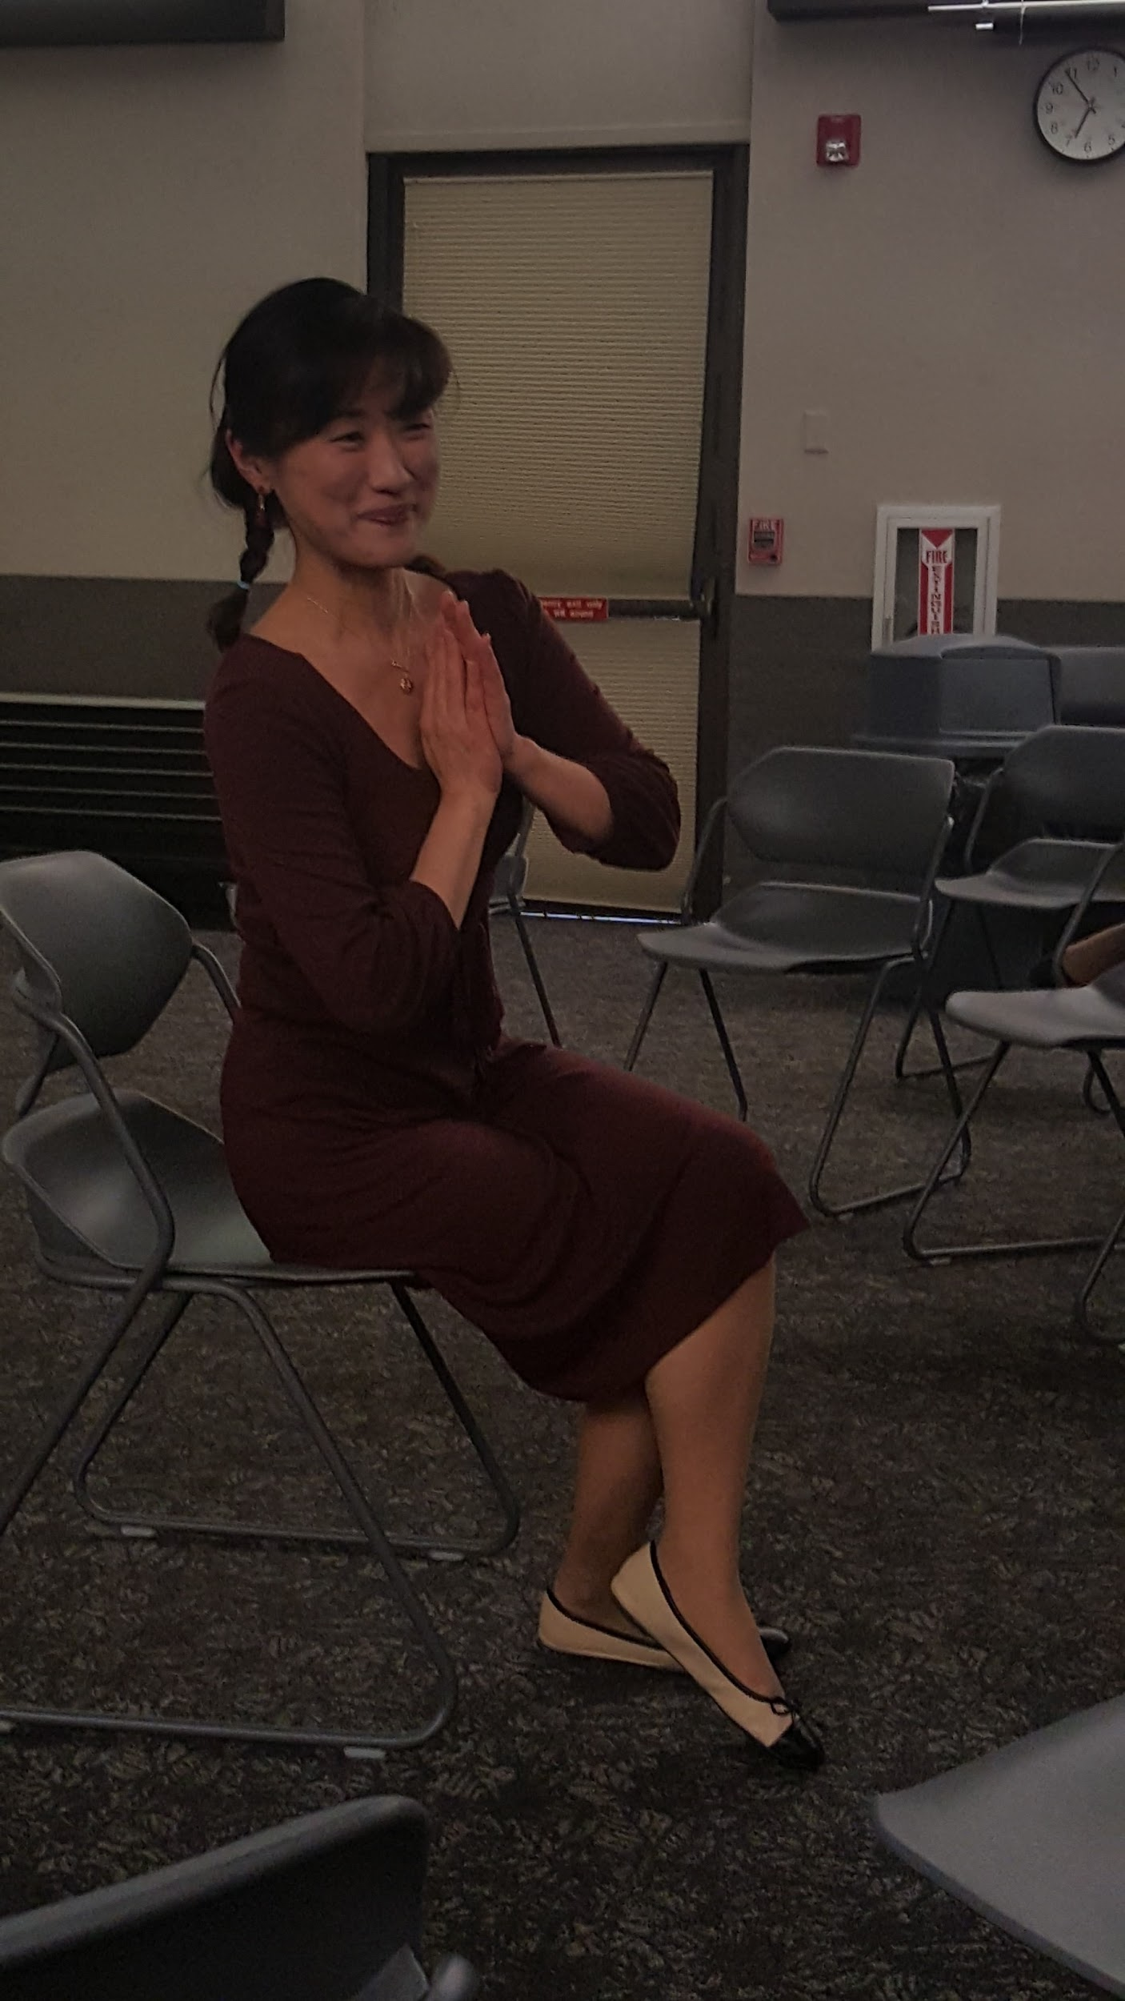
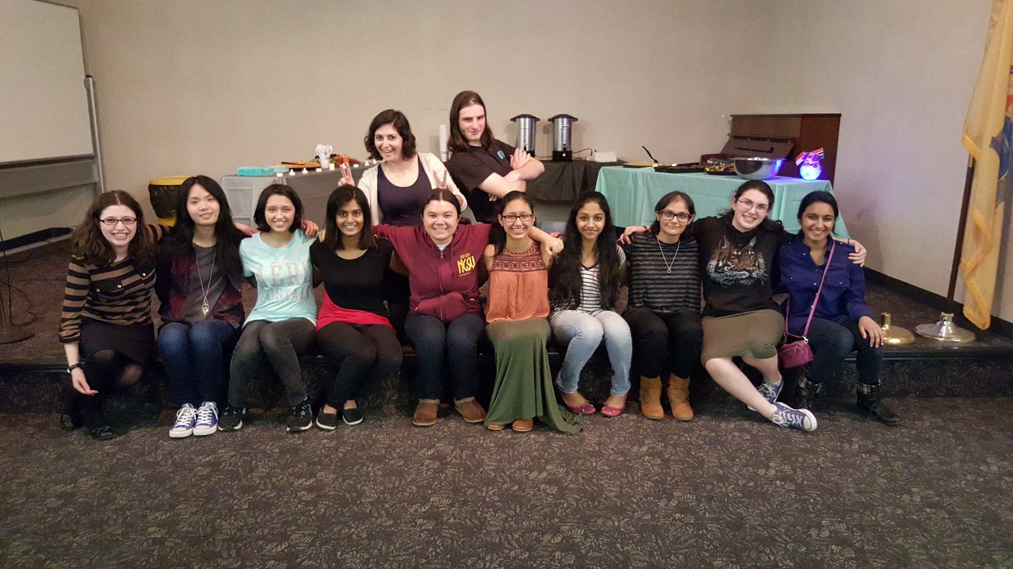
Coming to America: Stories
Fandom: Humans of New York
Cause: Immigration Issues
http://www.humansofnewyork.com/

Slide 49
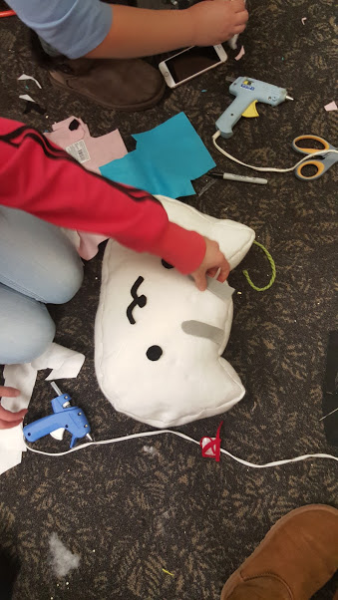
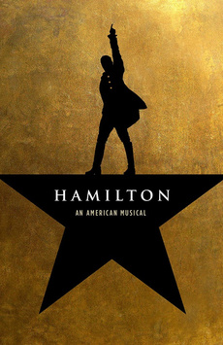
Fandom Programs for all ages
- Harry Potter Party
- Pop Culture Trivia
- Fandom Cupcake Wars
- Supernatural Party
- Fandom Crafts
- DC vs. Marvel Party
- Library Comic Cons
- Neko Atsume Cat Pillows
- Hamil...tunes?

Slide 50
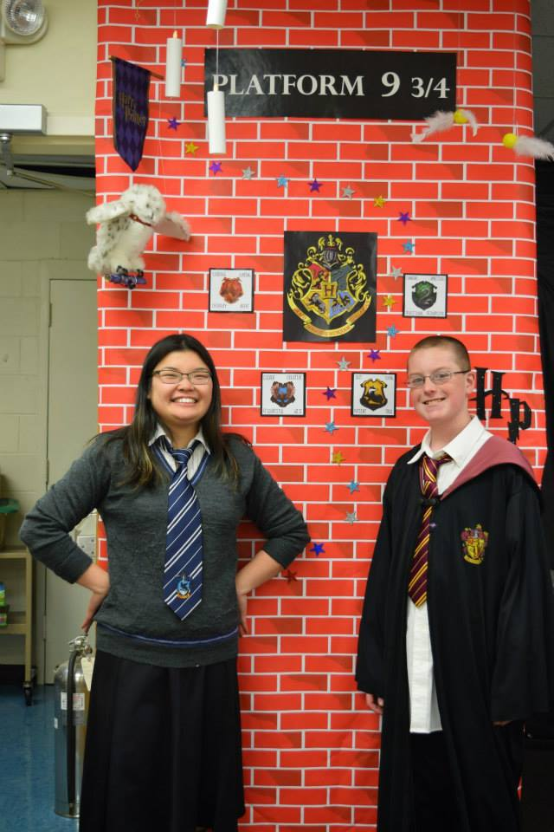

Slide 51
What’s YOUR fandom?
Before you invest a lot of time and energy: find out which fandoms your patrons are into!
Program: Fandoms Unite!
Fandom IDs
Preach your fandom
Trivia teams
Etc.
Name: __________________
Age: ______
Primary Fandom: __________
Other Fandoms: __________
________________________
Ask me about my ship!

Slide 52
Support the fandoms
Once you know which fandoms your patrons are into:
Buy the books/manga/graphic novels
Buy the DVDs, including TV show sets if possible
Include video games if possible! Video game fandoms are a thing
Be welcoming

Slide 53
A Final Thought
7
Here’s the ultimate takeaway.

Slide 54
Passionate.
People involved in fandom are one thing above all else:
They are simmering with enthusiasm for books, TV shows, movies, and video games, all of which are things libraries can provide. Tap into that enthusiasm for great results in programming, circ numbers, and patron interactions.
And if you can tap into your own inner fan and share some of your own enthusiasm with your patrons? All the better.

Slide 55
Thanks for joining us today!
Any
Questions?

