Slide 1
Hands-on with
Gaming & Geek Culture
NJLA Pre-conference 2016

Slide 2
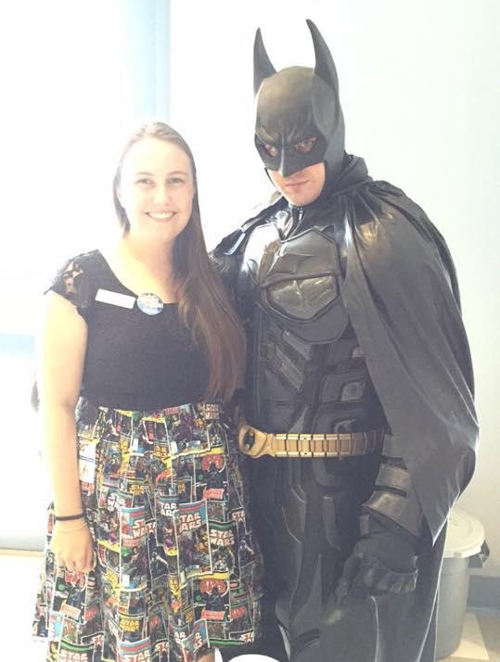
Presented by...
Alanna Graves Teen Services Librarian Cape May County Library
Twitter: @LannaLibrarian
Katie Bojanek
Young Adult Librarian
Warren Township Library
Jessica Schneider Teen Services Librarian East Brunswick Public Library
Twitter: @jeschnei
Megan England
Young Adult Librarian Jefferson-Madison Regional Library (Crozet, VA)
Twitter: @geektasticlib

Slide 3
Benefits of Gaming
Gaming is often social
Requires strategic thinking
Promotes creativity through storytelling
Relieves stress
Improves spatial reasoning, navigation, and memory
...it’s fun!

Slide 4
Types of Gaming
Because there are lots of ways to get your geek on!

Slide 5
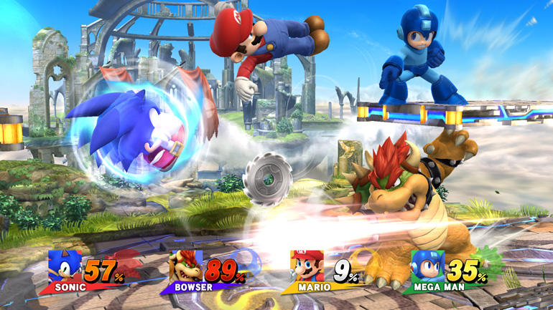
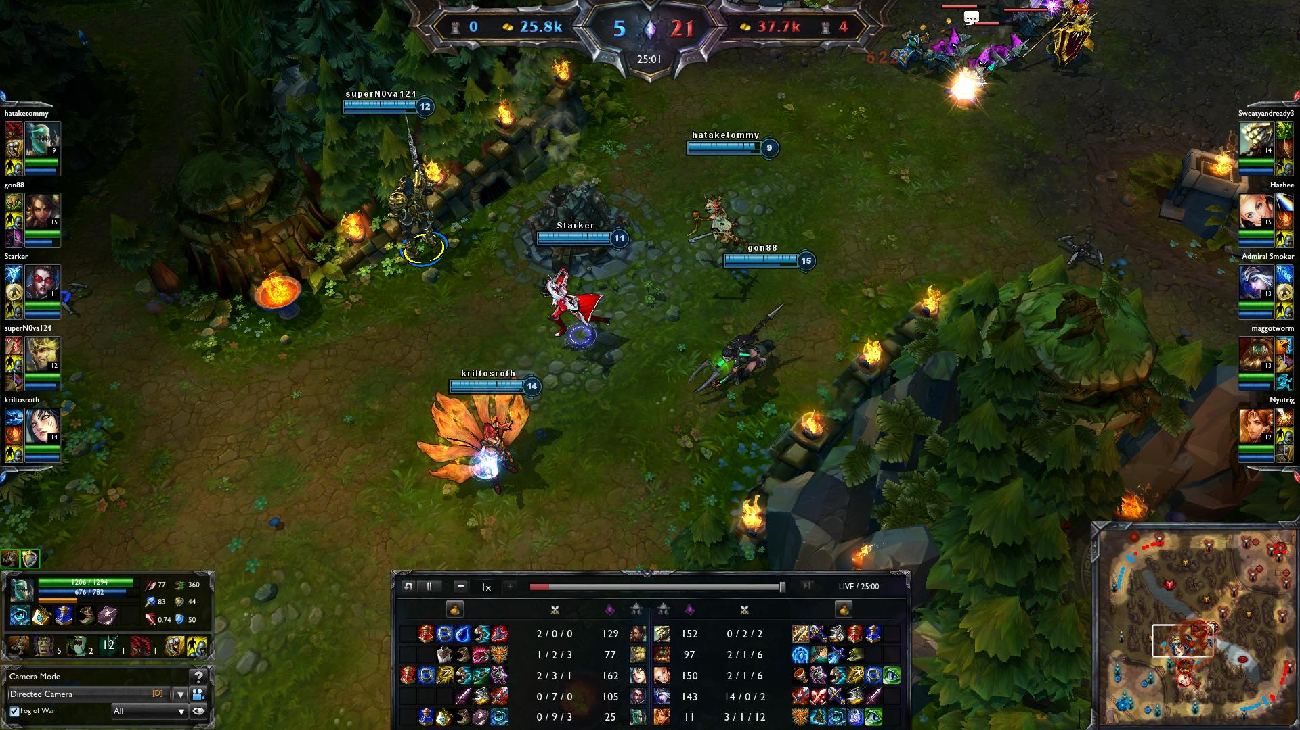
Video Games
Console-based games
Wii U
Xbox One
Playstation 4
Computer-based games
Minecraft
Steam
MMORPGs (Massively Multiplayer
Online Role-Playing Games)
MOBAs (Multiplayer Online Battle Arenas)

Slide 6
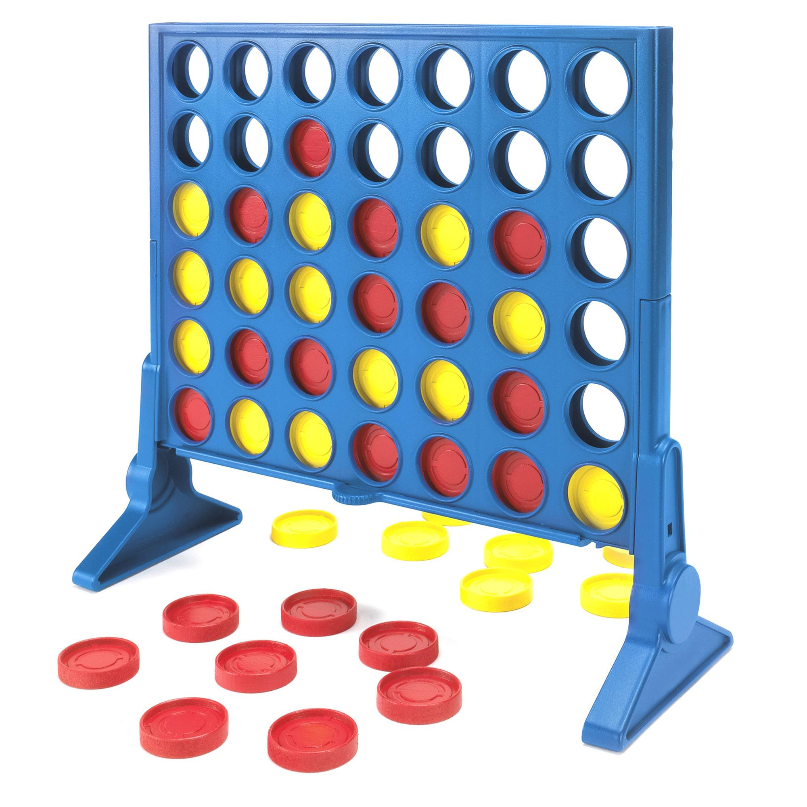
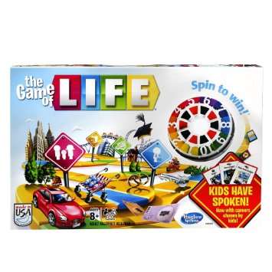
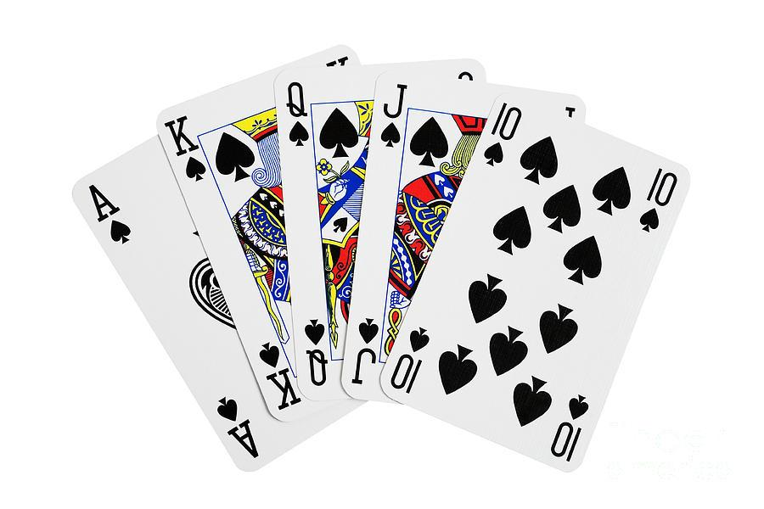
Board & Card Games
What we are NOT talking about:

Slide 7
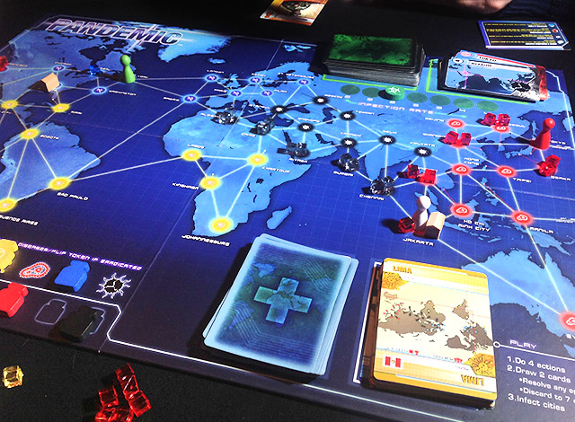
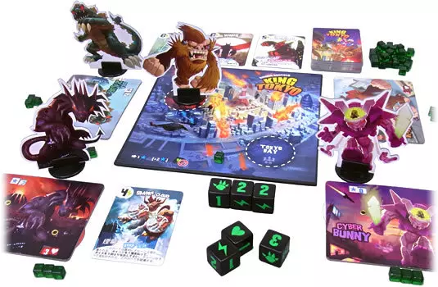
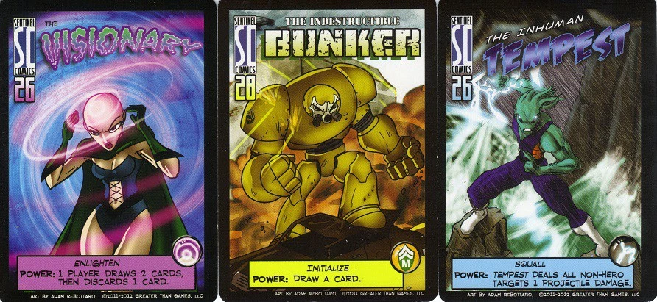
Board & Card Games
What we ARE talking about:

Slide 8
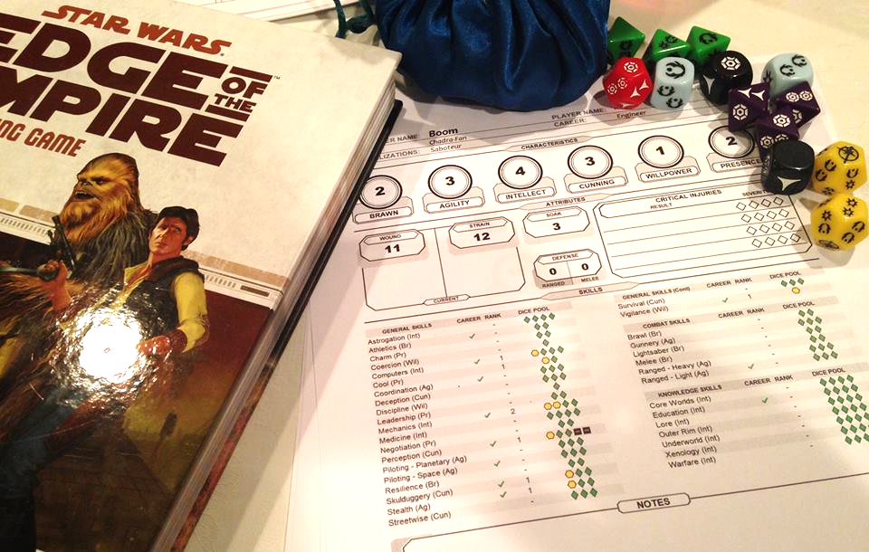
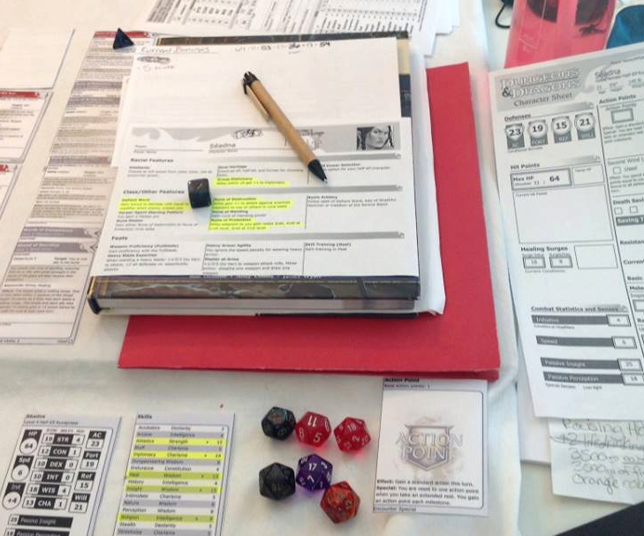
Tabletop RPGs
Dungeons & Dragons and
similar games
Theater of the mind
Storytelling
Also called ‘pen and
paper’ games

Slide 9
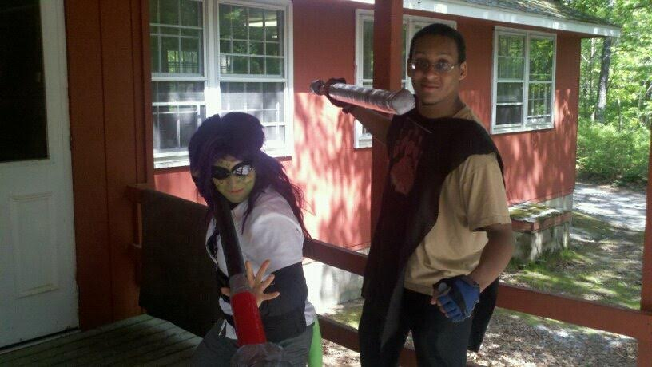
Live-Action Roleplaying (LARPing)
-Uses pencil and paper role play mechanics
-Uses acting and improv to create story
-Sometimes involves intricate costumes

Slide 10
Less Feasible Gaming Styles
Miniature war gaming
Collectible card games
For these types of gaming, you can provide the space, but they involve players spending lots of their own money to collect cards or pieces that make their decks or armies stronger. Purchasing for a library may be cost-prohibitive, and there are many barriers to entry for new players.

Slide 11
Gamer Lingo
so you can at least know what everyone’s talking about!

Slide 12
Gamer Terms
Triple-AAA: A universally well-rated game with lots of money and studio support behind it. A major release.
Guild/Clan: An organized group of players who often tackle a game’s content together.
Camping: Hanging out in one place to repeatedly kill people. Rude. (Frequently: Camping a spawn point, the location where players come back to life after dying.)
Tanking, Healing, DPS: The trinity of core game character roles. Tanks absorb damage and protect other players, healers heal, and DPS characters do damage. (Damage Per Second)

Slide 13
Gamer Terms, cont.
Spamming: Using the same move over and over again. Also, someone in a shooter who leaves their finger on the trigger the entire time. Annoying.
Lag: When players experience a delay between executing an action and the result happening in-game. In online gaming, caused by poor internet connection.
Nerf: When the developers of a game decide a charcter or feature is too powerful, they tweak it to bring it into balance with the rest of the game.

Slide 14
Gamer Terms: Acronymns
FPS: First-Person Shooter
RTS: Real-Time Strategy
RPG: Roleplaying Game. A core feature of the game is customizing and controlling a character of your own creation. Your decisions often affect the game’s outcome.
DLC: Downloadable Content. Ranges from extra fluff to must-have content.

Slide 15
Gamer Terms: Acronymns
XP: Experience points. Used to improve a character’s power level or attributes.
HP: Hit Points. How much life you have. When you run out of HP, you die.
PvP: Player vs. Player
PvE: Player vs. Environment
NPC: Non-Player Character

Slide 16
Programming When You Don’t Got Gamer Game

Slide 17
Gaming Tournaments
(get the teens to run ‘em!)

Slide 18
League of Legends
World-wide popularity
Pitch this as “teen professional development” and “college resume builder”
University esports team scholarships
http://promo.na.leagueoflegends.com/en/nacc-2015/
Robert Morris University: http://www.rmueagles.com/sport/0/147.php
As of March, 7 schools are now offering LoL scholarships
Career player salaries vary but the game is treated in many places like a professional sports career.
Shoutcasting = Sportscasting
Notes:
free-to-play multiplayer online battle arena, real-time strategy video game developed and published by Riot Games
As of January 2014, over 67 million people played League of Legends per month, 27 million per day, and over 7.5 million concurrently during peak hours.
The 2014 and 2015 tournaments each gave out one of the largest prize pools in eSports history, at 2.3 million dollars.
On July 11, 2013, Riot manager Nick Allen announced that the United States Citizenship and Immigration Services now recognizes League of Legends pro-players as professional athletes and the P visa application process is now simplified for them.
http://www.polygon.com/2016/3/30/11330776/league-of-legends-university-california-irvine-esports-scholarship-riot

Slide 19
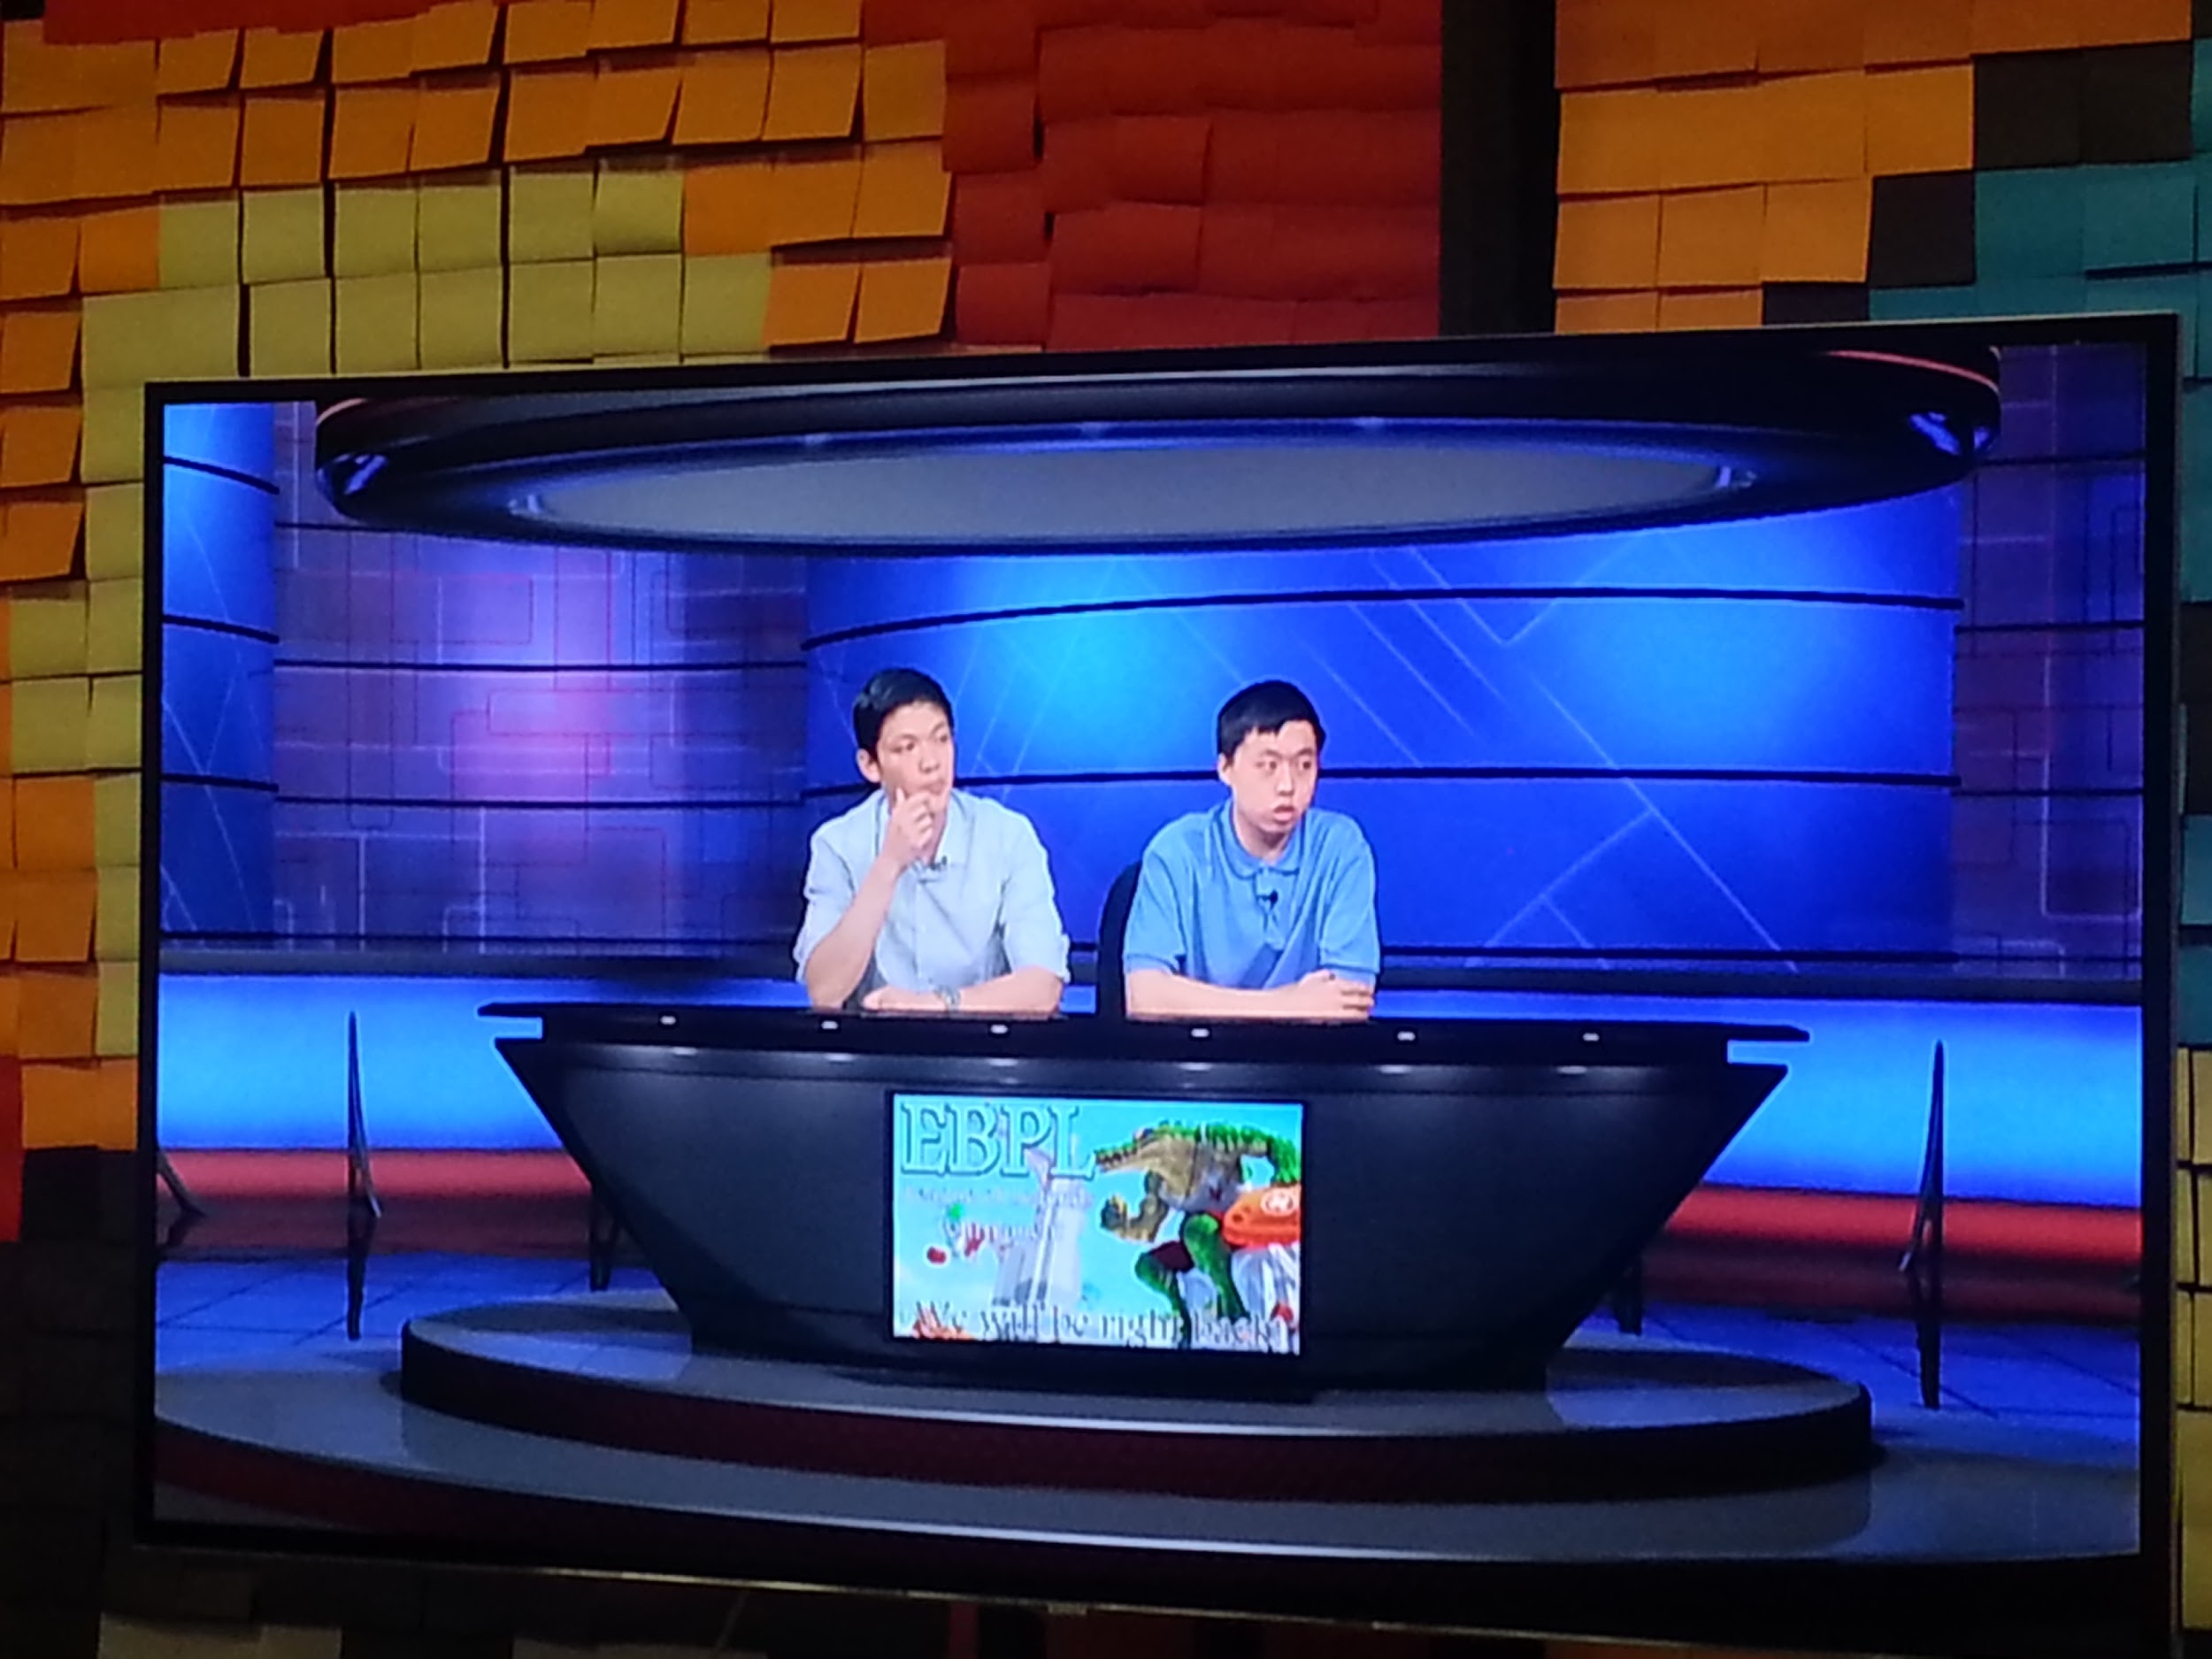

Slide 20
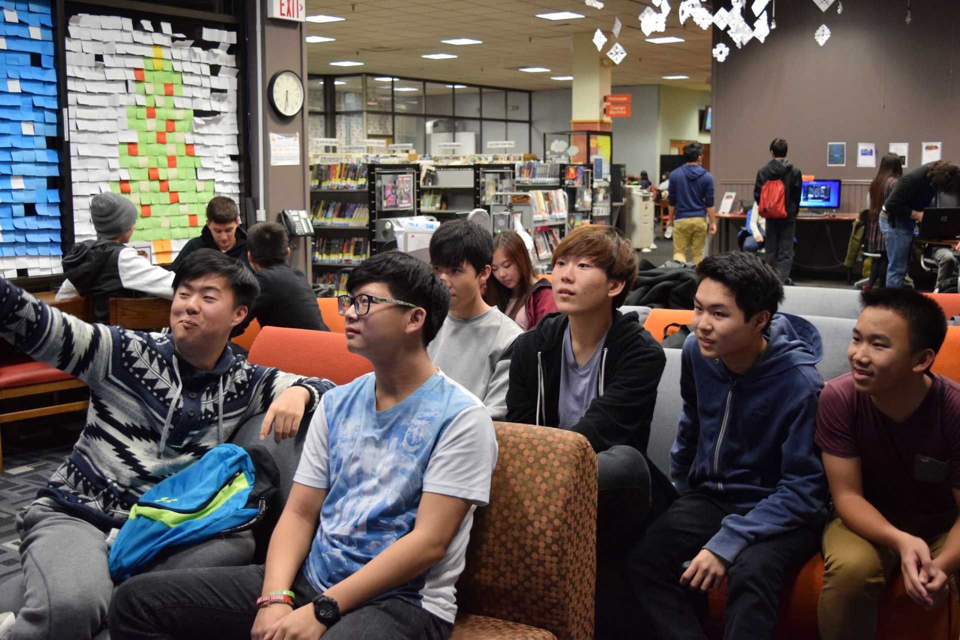
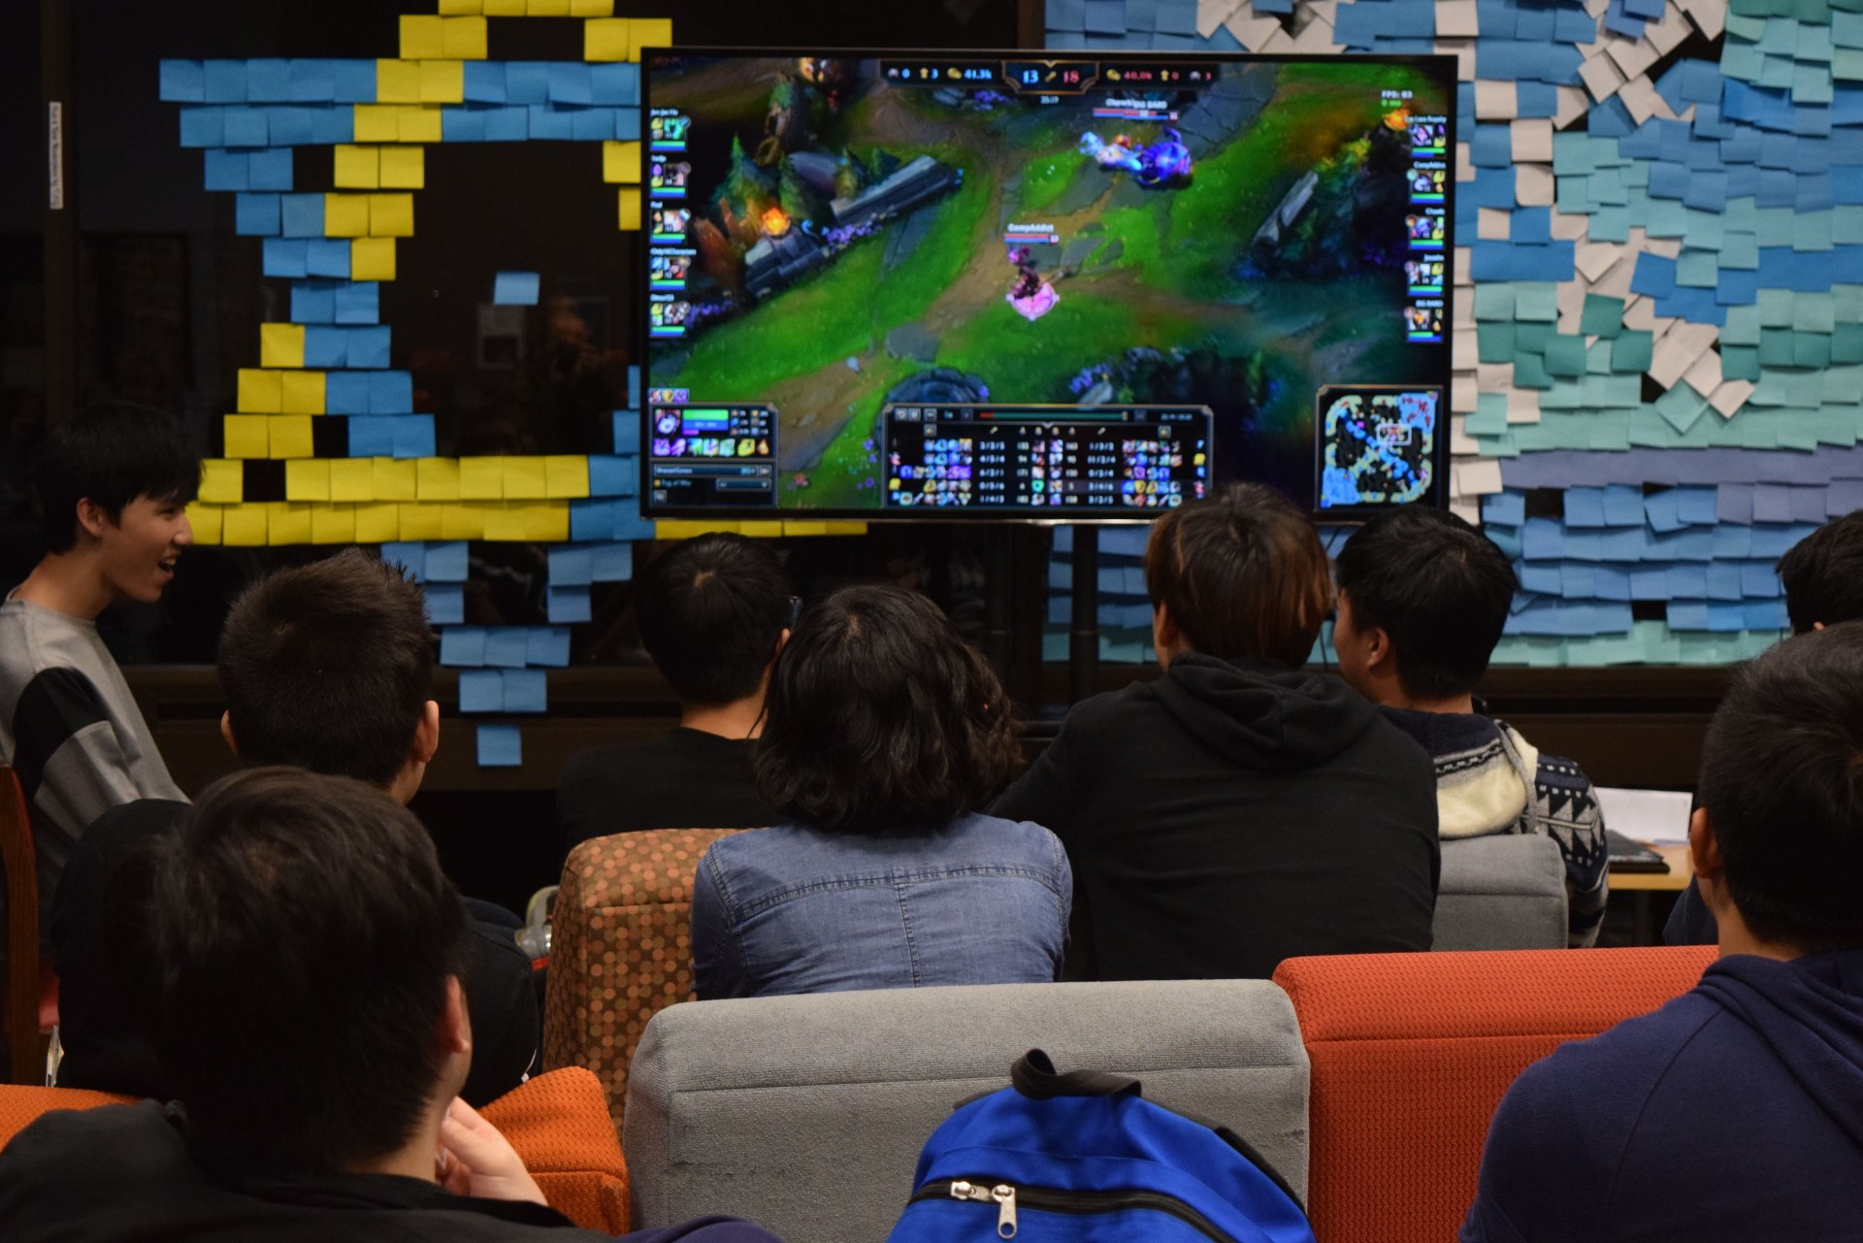
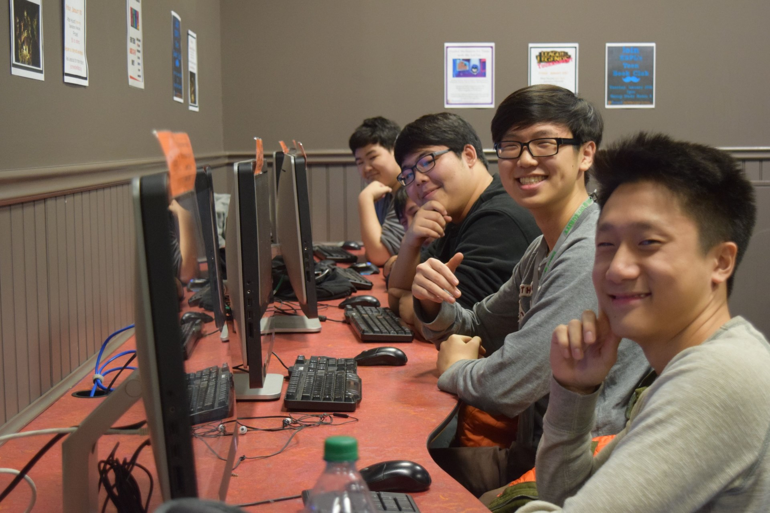

Slide 21
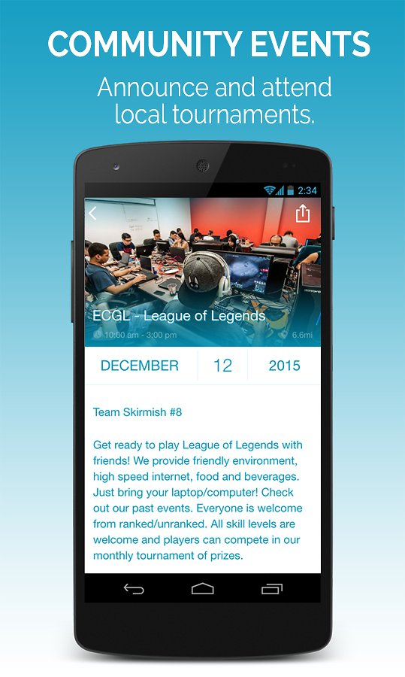
Gaming Partnerships
Places to partner with:
Riot - creator of League of Legends and other games
Hosts many tournaments
Gives us Riot points to give away to winners
Local gaming/comic book stores
Ward eSports: http://www.wardesports.com/
http://blog.wardesports.com/

Slide 22
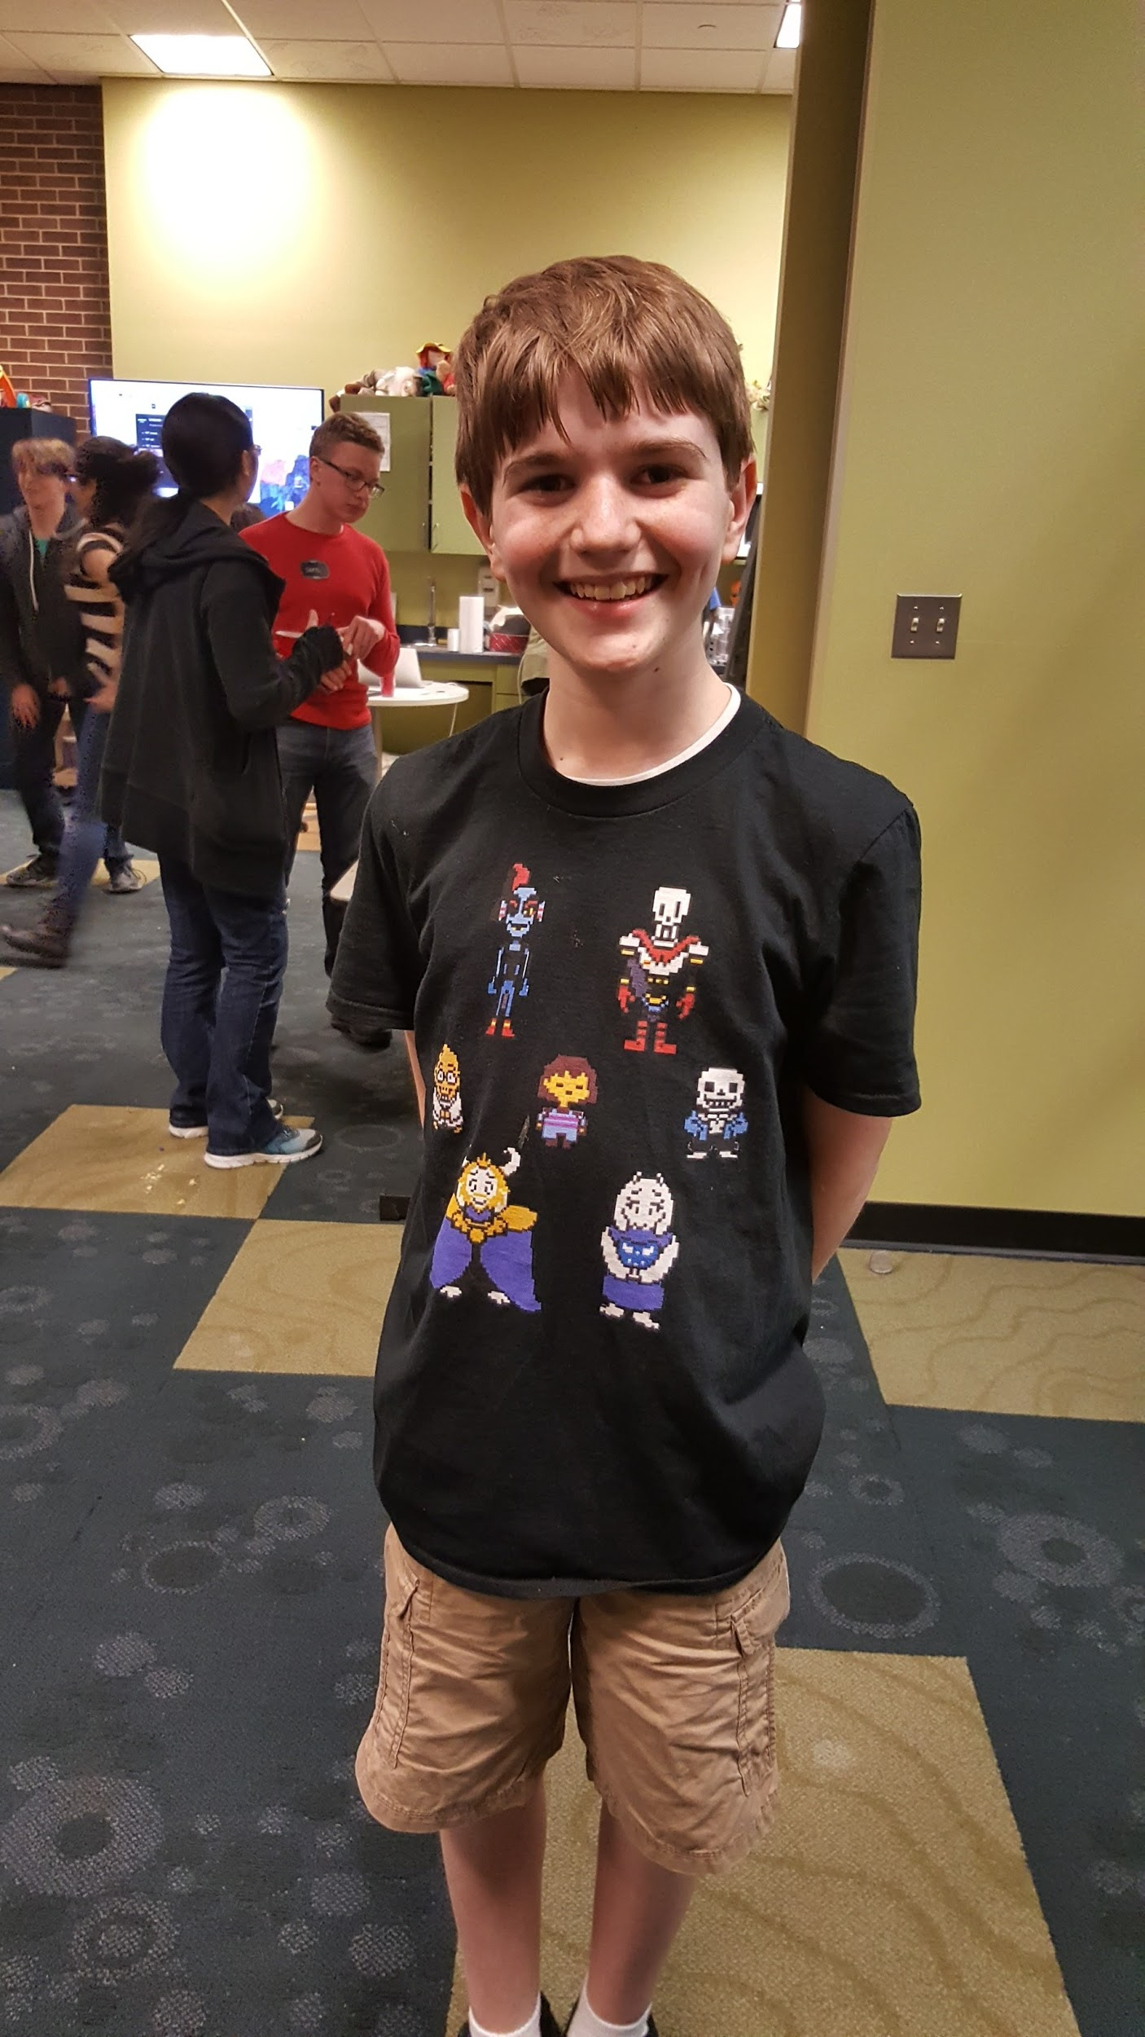
Game Themed Parties!
In this RPG, you control a human who falls underground into the world of monsters. Now you must find your way out... or stay trapped forever.

Slide 23
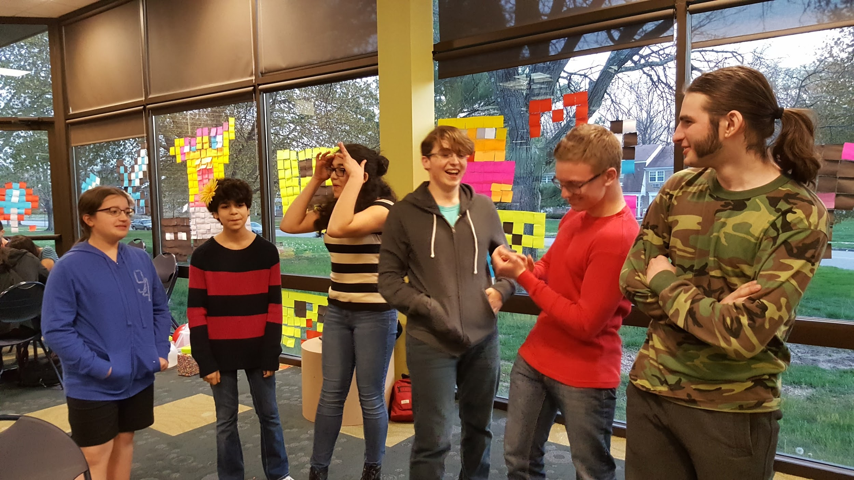
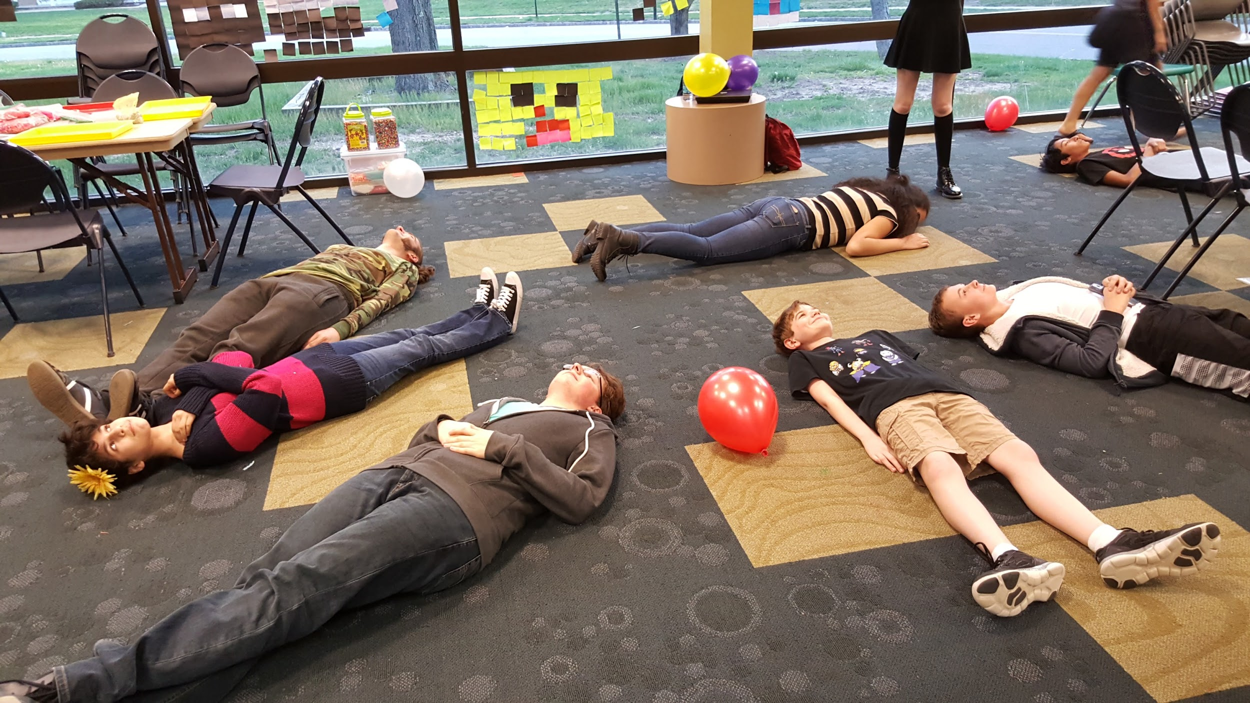
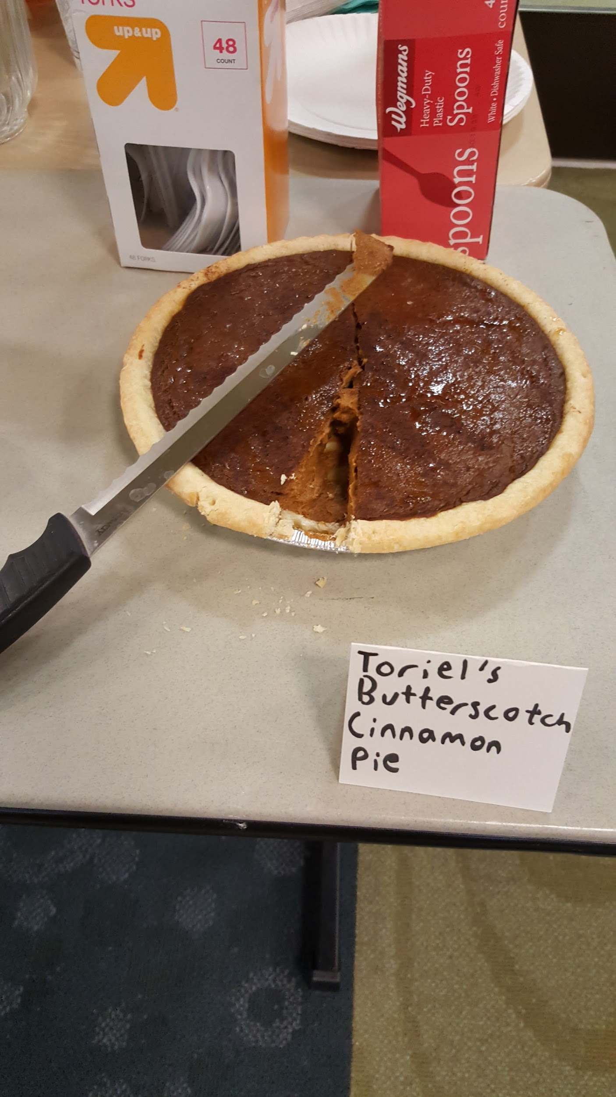
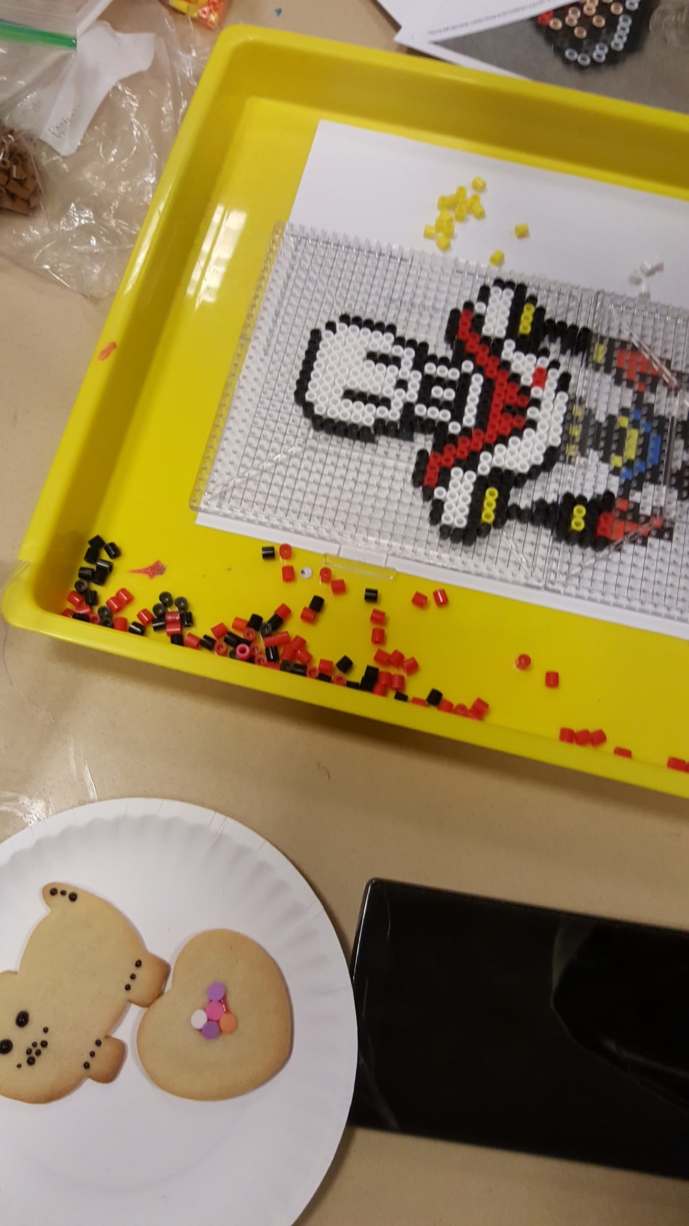
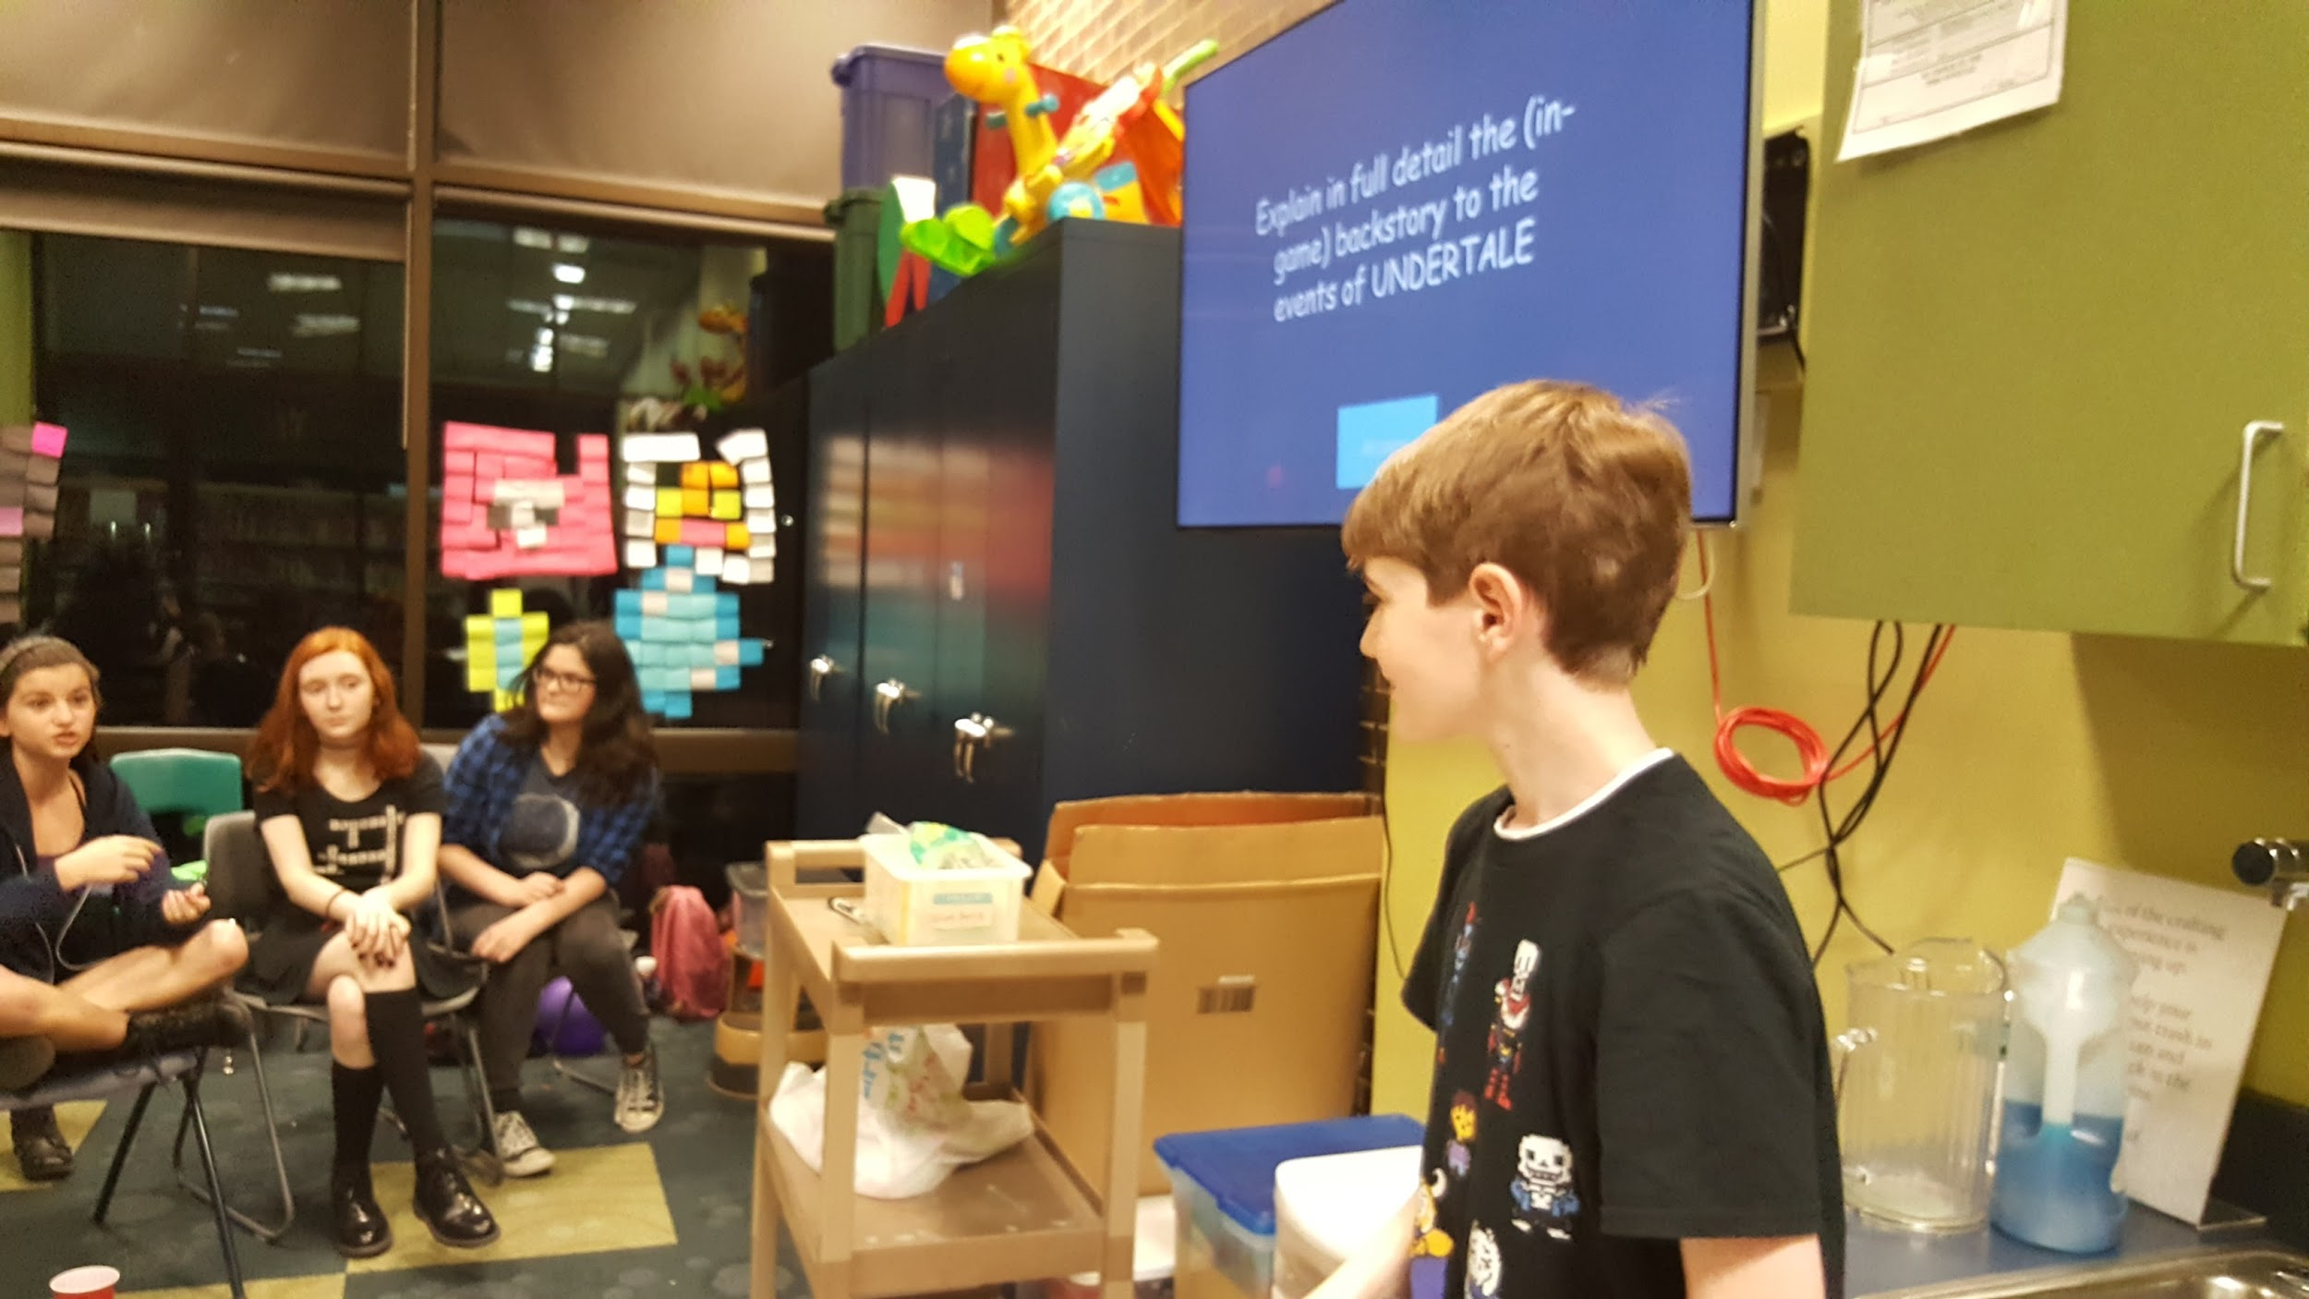
Notes:
Undertale trivia (jeopardy style)
Undertale themed snacks (butterscotch cinnamon pie, spider cider, doughnuts, spaghetti and more!
Pun contest
Cookie decorating

Slide 24
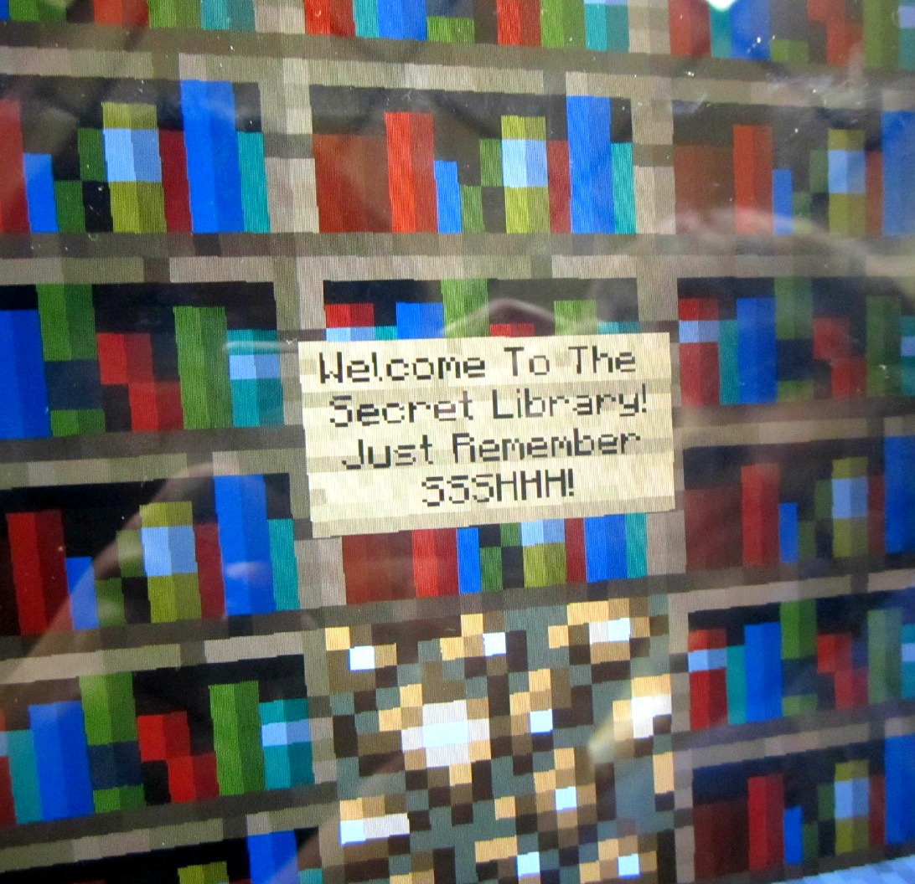
Minecraft
The Basics of Playing at the library
Minecraft Memberships: $25 FOR LIFE
Minecraft app for iPad: around $7
Minecraft passes taped by each computer with the username. Staff provide the password when asked so kids don’t use it to play at home. (username and password really long and complicated)
Previous libraries:
Minecraft servers & Minecraft Time*
http://www.fcminecraft.org/
Notes:
Gauquier, E., Schneider, J. Minecraft programs in the library, YALS, Winter 2013, Vol.11, Issue 2

Slide 25
Minecraft Parties
@ The East Brunswick Public Library
Minecraft parties come in two parts:
Part 1:
Taking turns playing Minecraft on the computers and iPads.
15 minute shifts.
Free play. Multiplayer or single, whatever mode they wish.
No formal challenges at EBPL because there are just too many attendees!
Teen volunteers in charge of logging kids onto computers and making sure the shifts change over.

Slide 26
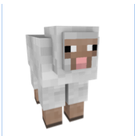
Minecraft Parties @ EBPL Part 2 - Getting Crafty
Minecraft-y Activities
LOTS of ideas on Pinterest
EBPL currently runs:
Minecraft Bingo
Go! Minecraft
Minecraft Memory
Minecraft themed Lego build
Minecraft Scavenger Hunt
Minecraft themed Post-it Note designs
Minecraft cooking
Minecraft origami/papercrafts
Minecraft themed perler bead art
Notes:
Minecraft Scavenger Hunt
1. Find a book that mentions one of the minerals that you mine for in Minecraft.
2. Yikes - Zombies! Witches! Ghasts! All manner of scary things!! Find where we keep the horror books in the kids section and answer what color sticker they have on them.

Slide 27
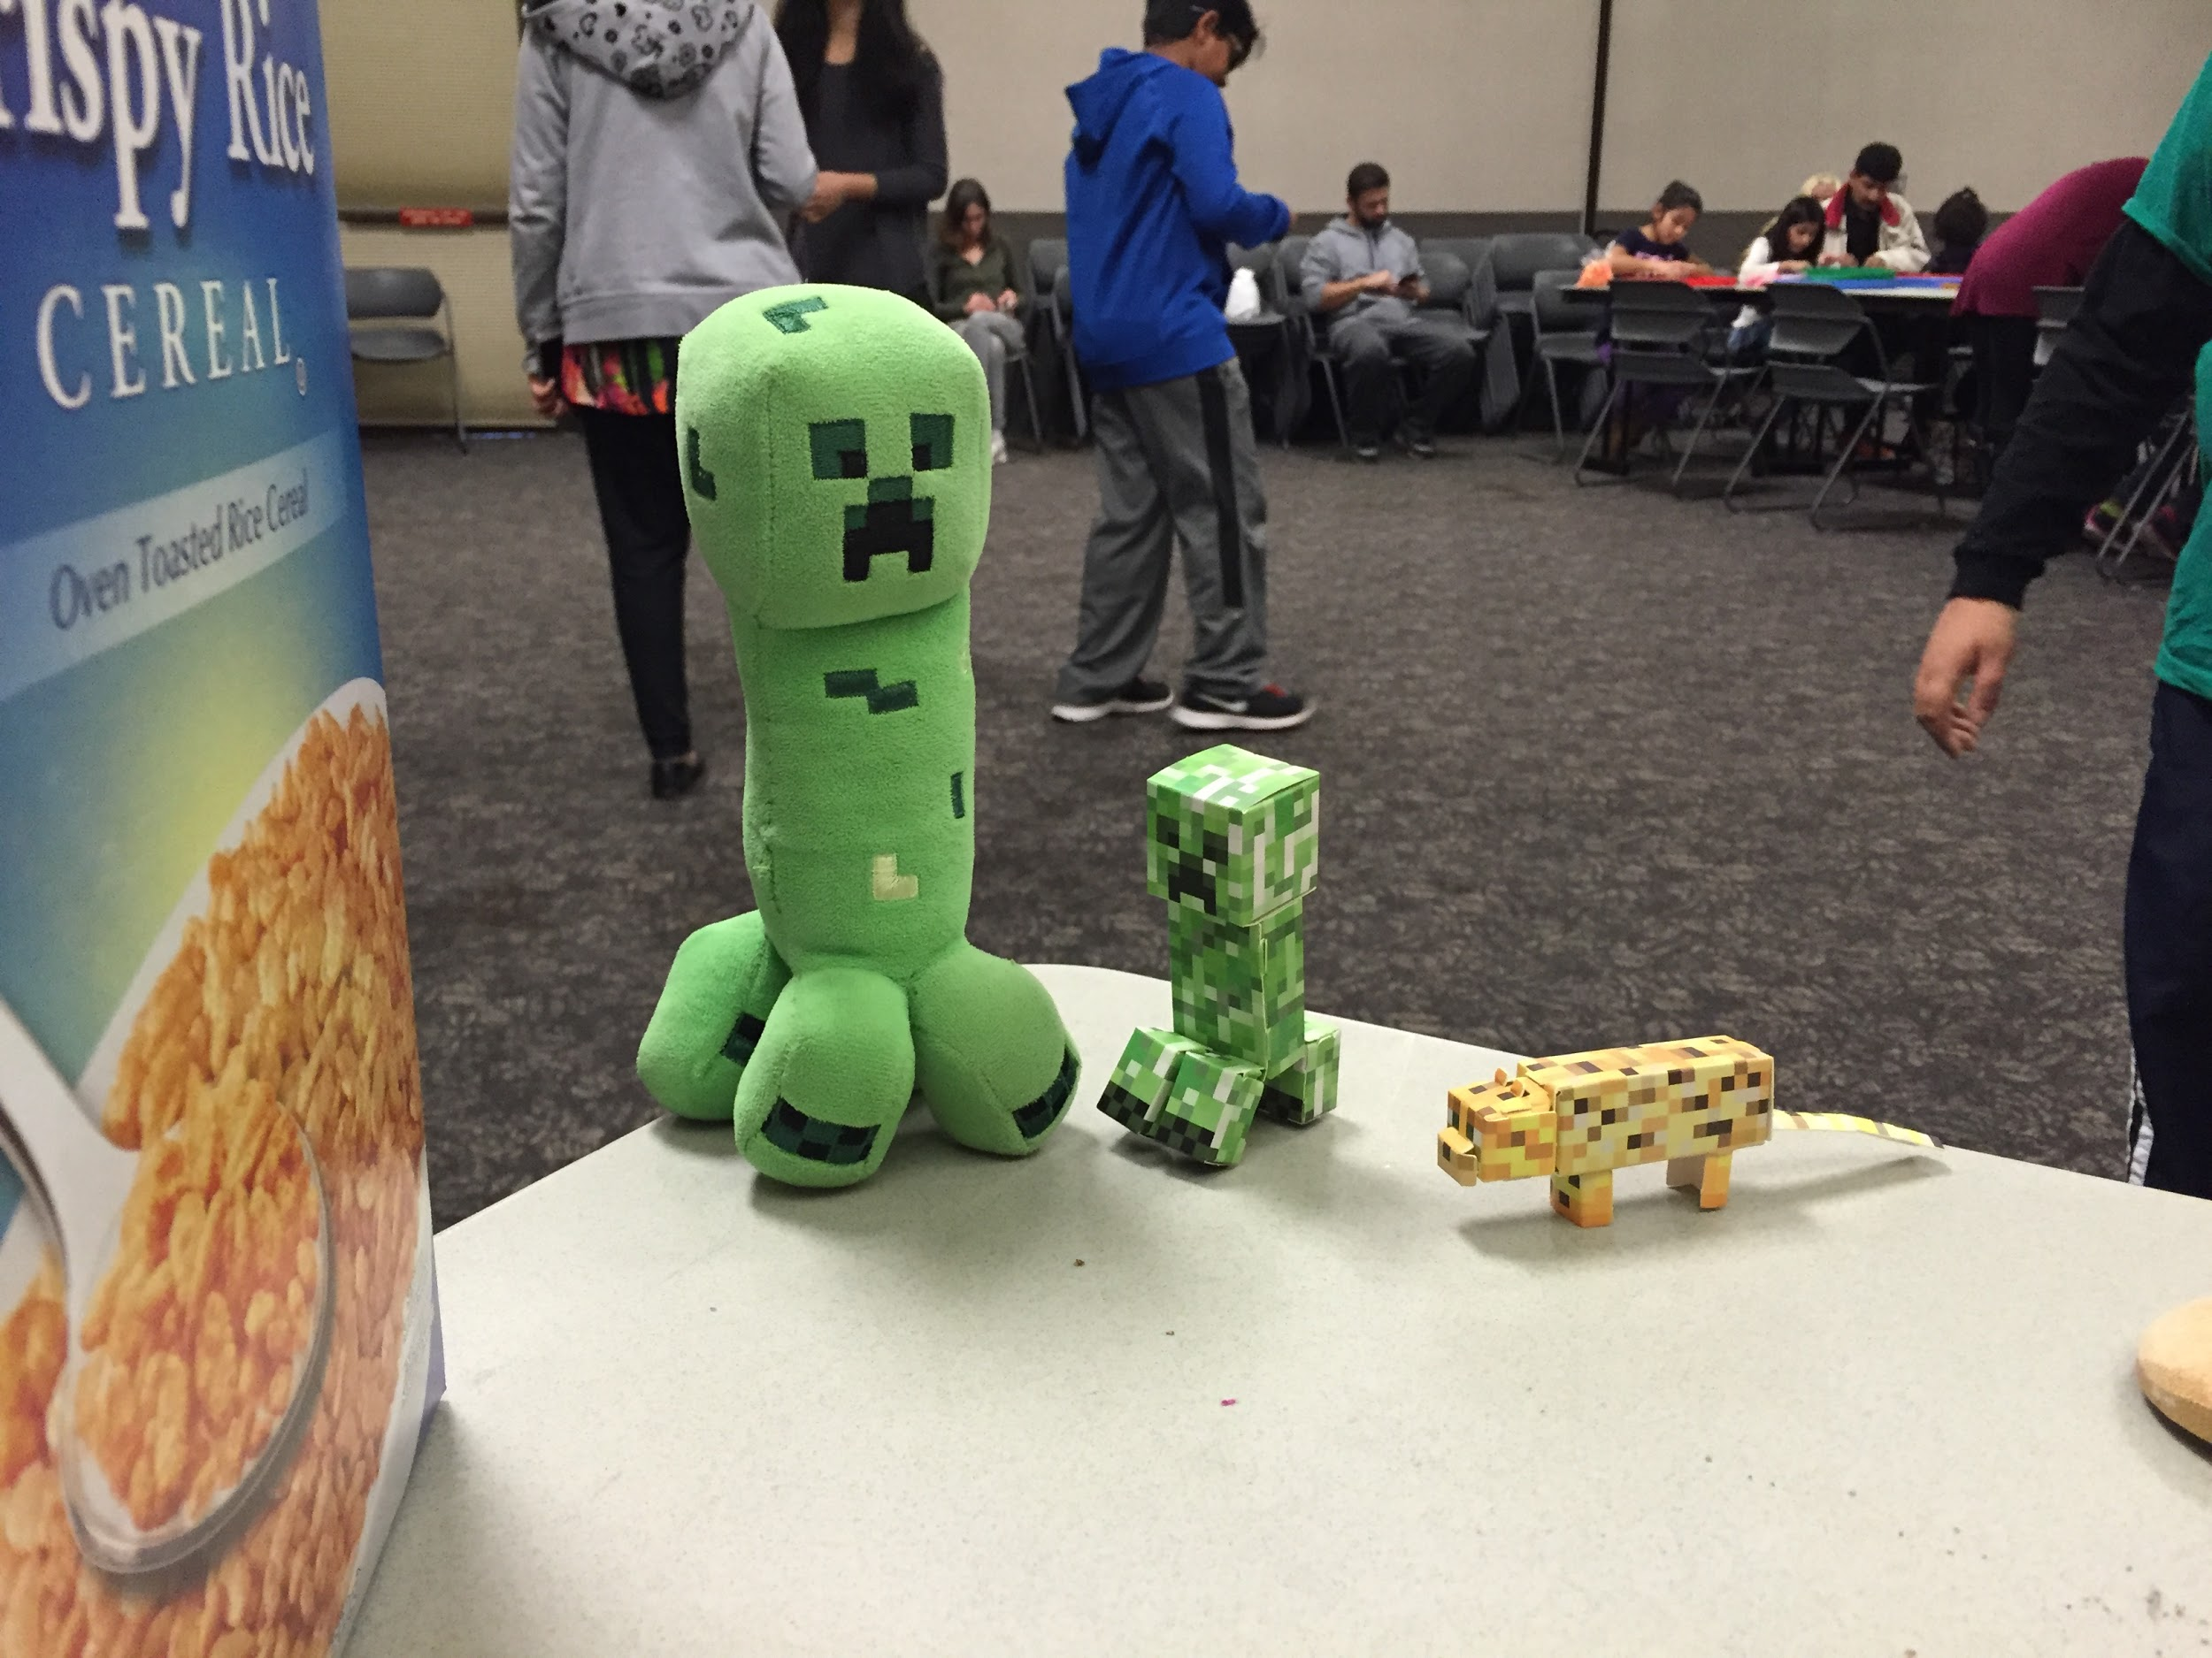
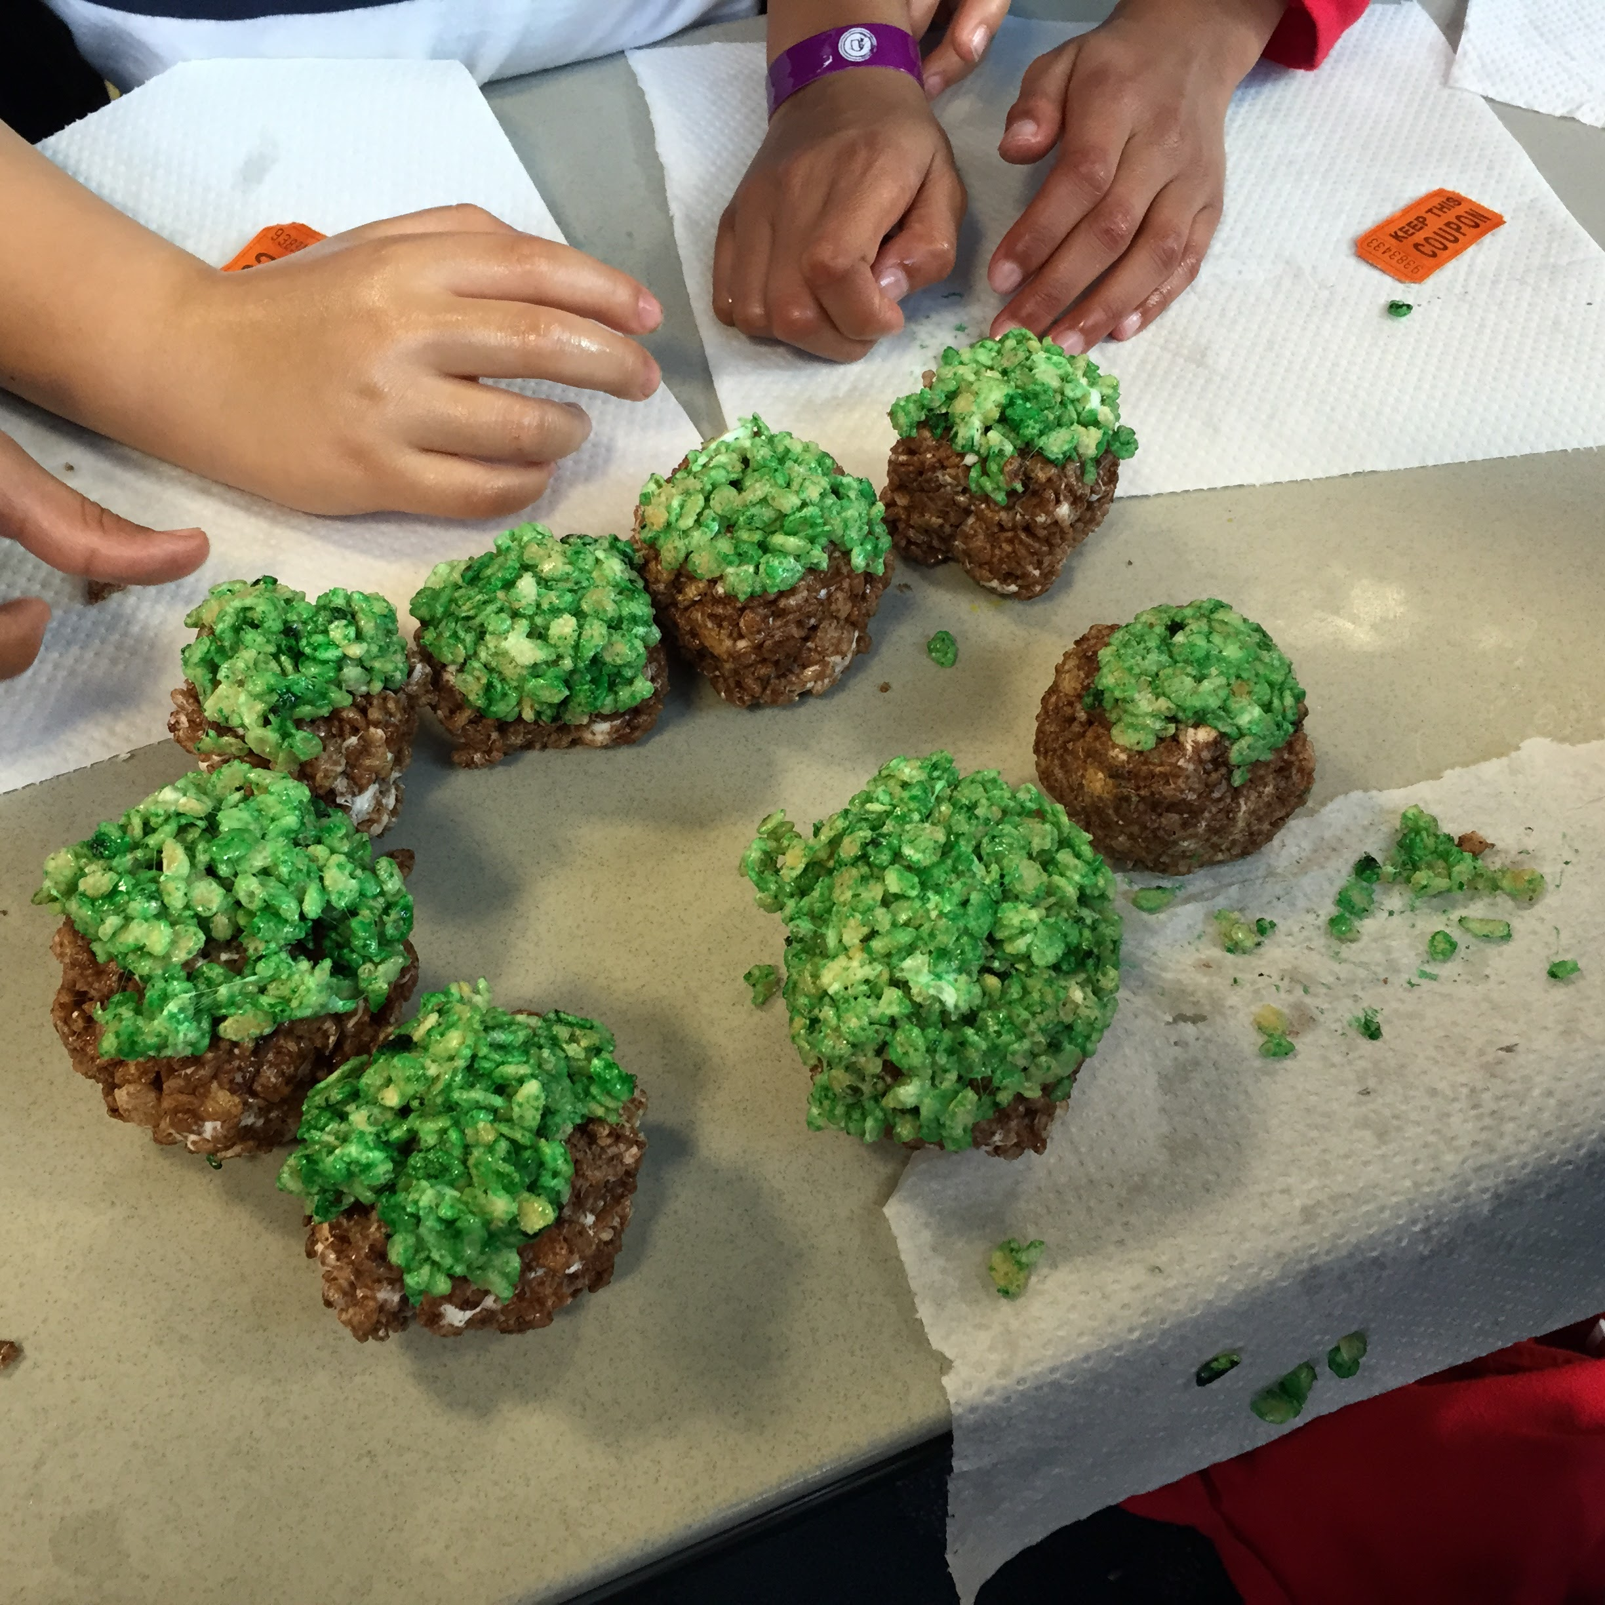
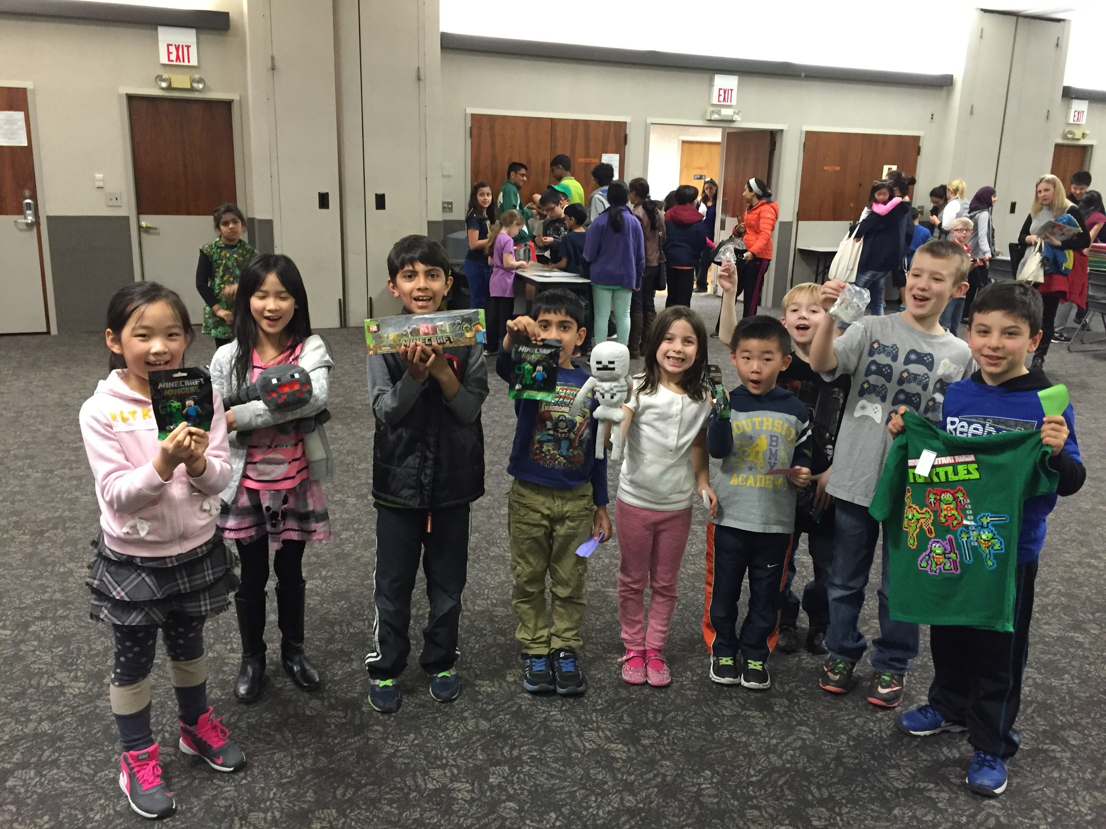
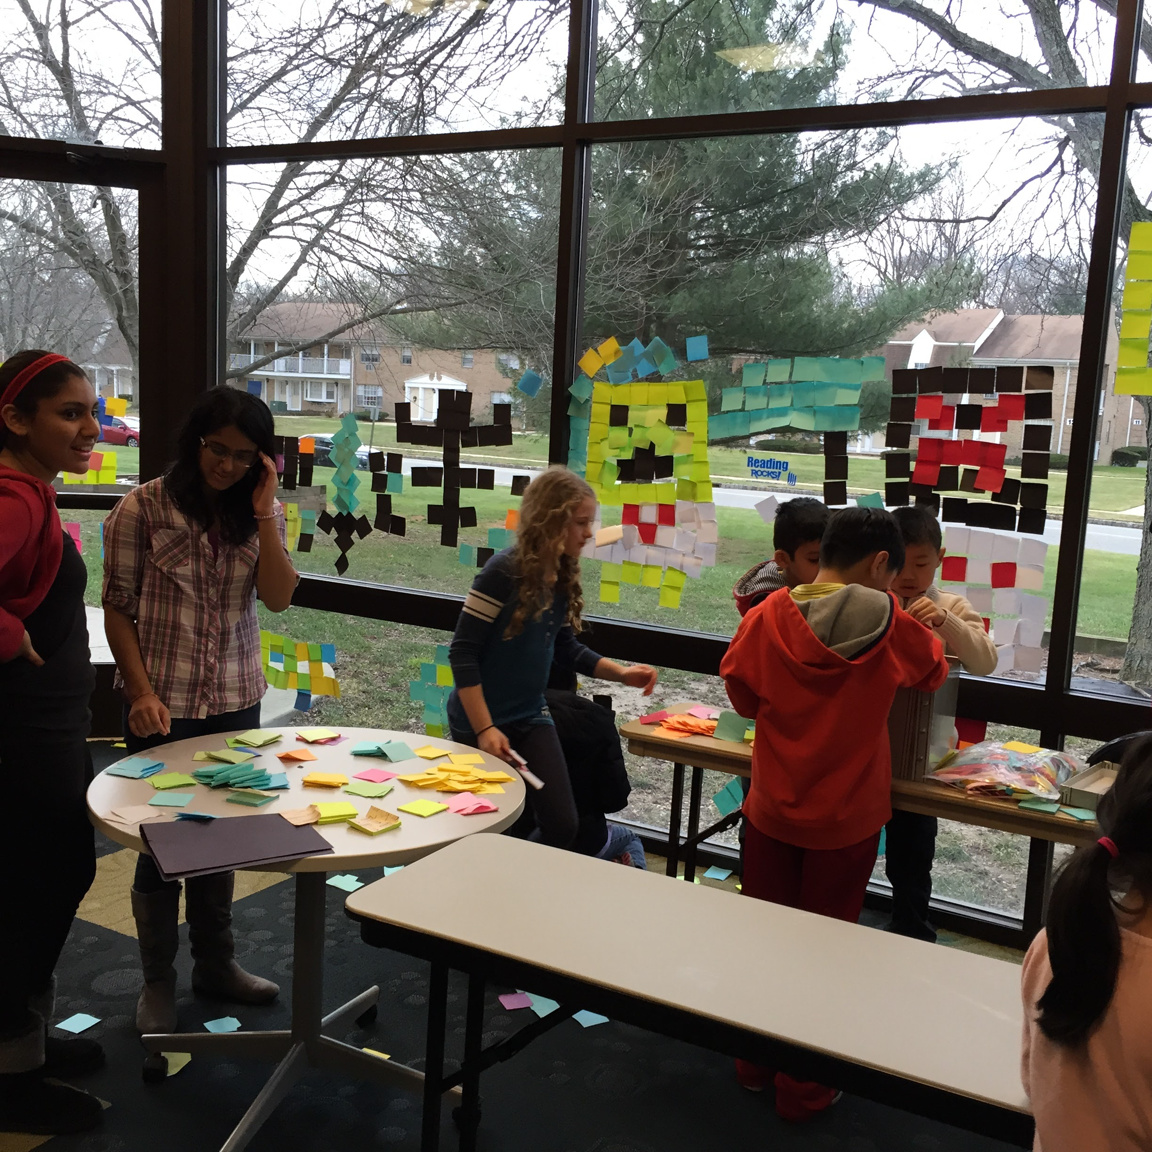

Slide 28
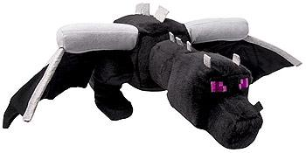
Minecraft Party Logistics
(how to host a Minecraft party for 130+ kids)
More kids than computers
1st idea - draw tickets for chance to play: total failure
2nd idea! - give out times passes : 8 passes per 15 minutes (Minecraft Tix)
80 timed tickets to play on computers (2.5 hours)
Kids who were late to the party (or opt out of playing) get a Crafting Slip
For each activity you do, you get a stamp on your crafting table. If you complete 4 activities, you get entered into a raffle to win a prize (minecraft swag)
Kids with the Crafting Slip (ie. came late or opted to not play), get 2 raffle tickets when they return their completed tables in compensation/incentive to do activities other than play Minecraft.
Raffle prizes: Cheap from Amazon! Give yourself plenty of lead time though as most come from China.

Slide 29
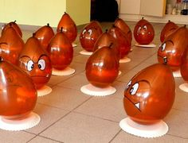
Game Themed Parties!
Mario and Nintendo

Slide 30
Super Smash Brothers and Mario Kart
Popular among all different ages
Different variations across systems
Easy to learn
Easy to set up tournaments with a bracket system, some come within the game

Slide 31
Other Program Ideas
-Escape the Room
-Live Action Angry Birds
-Jenga Tournament
-Minecraft Crafts
-Live Action Chess

Slide 32
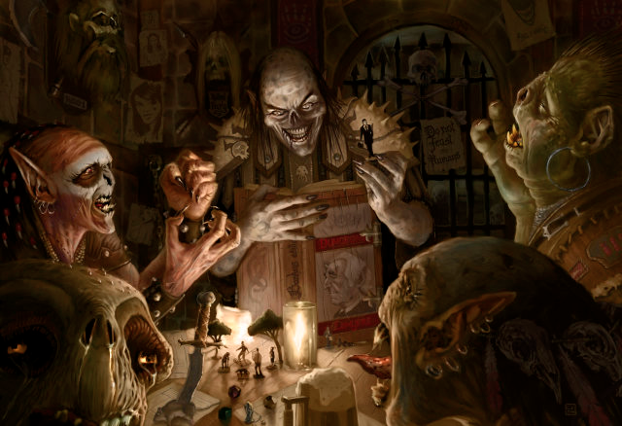
Offline Gaming
(put down the electronics and back away slowly)
Gamers Guild
Board Game of the Month
Dungeons & Dragons
Friday Game Day

Slide 33
Retro Game Day
Building on nostalgia, these all day programs have games ranging from the 1980’s through early 2000’s
Examples of games used:
Katamari Damacy
Burger Time
Pokemon Snap
Mario Kart
Super Mario Brothers
Typing of the Dead
Mortal Kombat
Duck Hunt

Slide 34
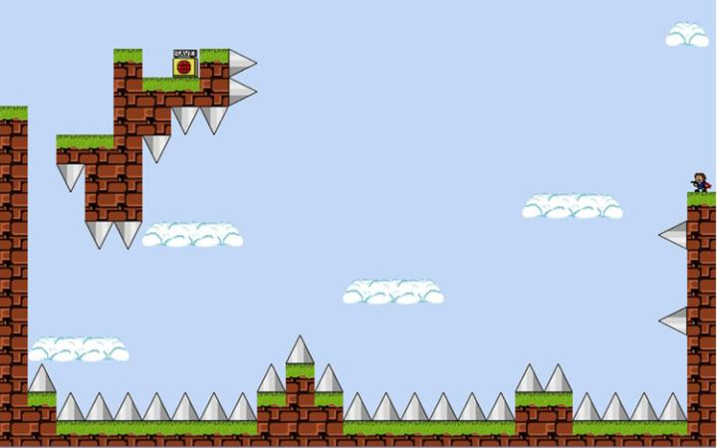
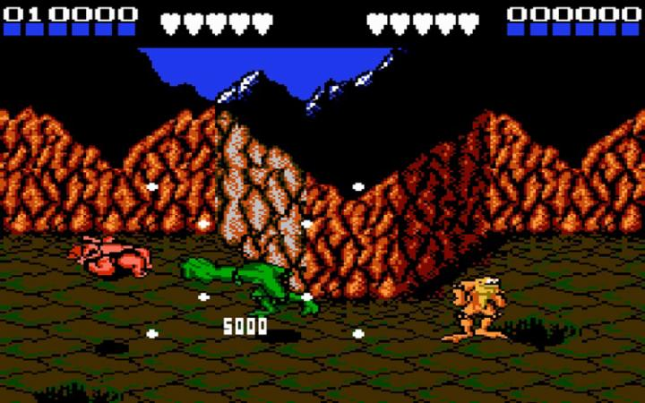
Day of FAIL
All the hardest video
games of all time!
Battletoads (NES, 1991)
Megaman (NES, 1987)
Ninja Gaiden (Xbox, 2004)
Contra (Arcade/emulator, 1987)
Discworld (PC/PS1, 1995)
Super Mario Bros: The Lost Levels (1993)
I Wanna Be The Guy (PC, 2007)
N+ (Xbox 360, 2008)
Super Meat Boy (Multi, 2010)
Ghosts & Goblins (NES, 1985)
The Binding of Issac (Multi, 2011)
Spelunky (Multi, 2008)
FTL: Faster Than Light (PC/Mac/iOS, 2012)
Teenage Mutant Ninja Turtles (NES, 1989)
Dark Souls II (Multi, 2014/2015)

Slide 35
International Tabletop Day
Run by Geek & Sundry
www.geekandsundry.com
Sign up online for a chance at free promotional materials and free games from sponsoring companies!

Slide 36
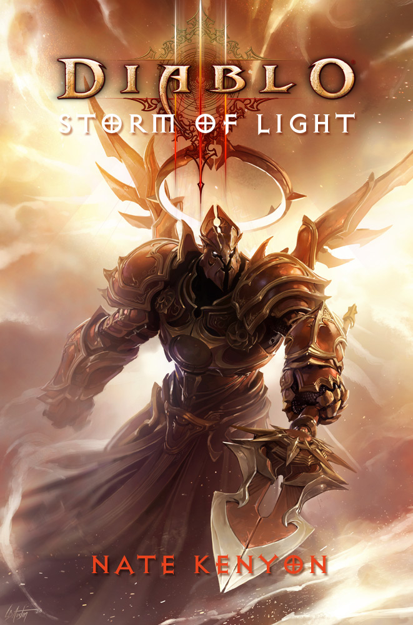
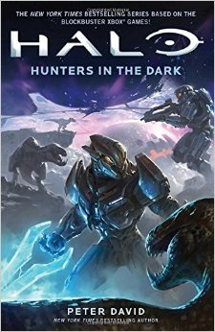
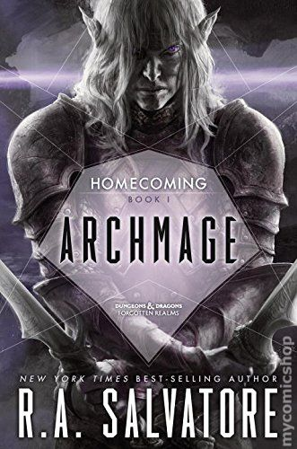
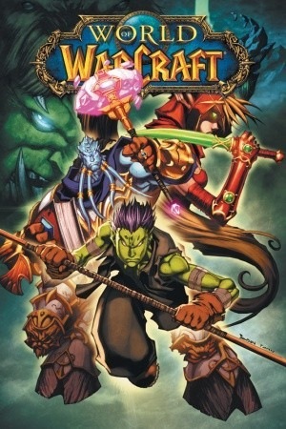
Novel Tie-Ins
Don’t forget displays, self-directed programs, and book clubs!
Dungeons & Dragons
Ravenloft
Forgotten Realms
Dragonlance
Dark Sun
Video Games
Halo
World of Warcraft
Diablo
Starcraft
...and many more!

Slide 37
Collection Development:
Video Games

Slide 38
Who does collection development for video games?

Slide 39
Who feels like they have no idea what they’re doing?

Slide 40
Video Games
High monetary investment! Ask your patrons what systems they already own
Average game: $60
Multiple platforms: PS4, Xbox One, Wii U
Backwards compatibility issue

Slide 41
Let’s compare Star Fox Zero

Slide 42
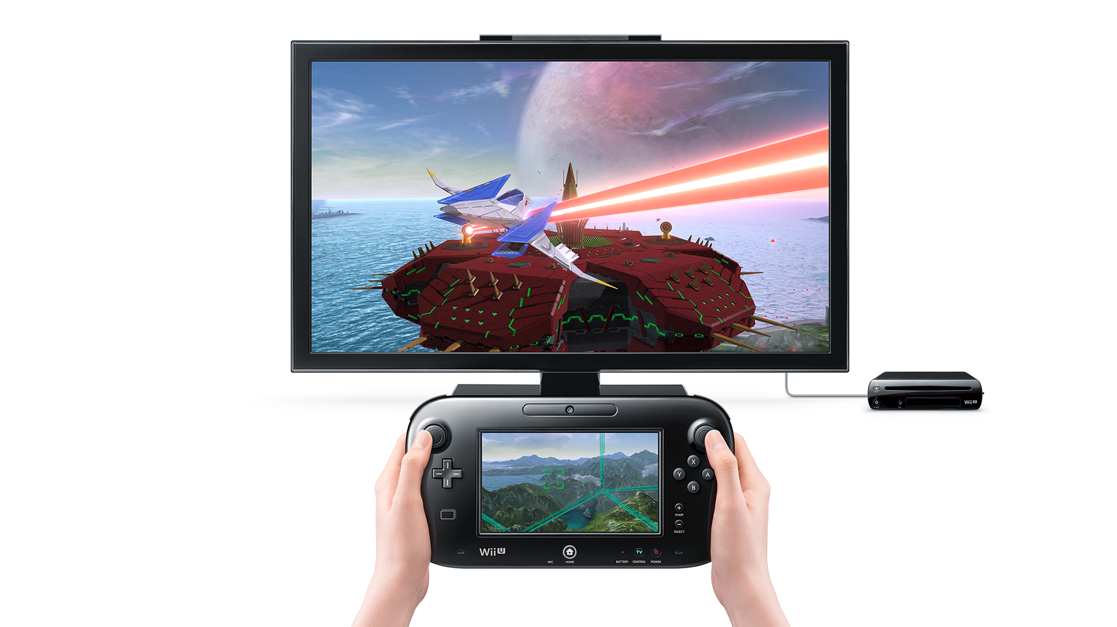
Let’s compare Star Fox Zero

Slide 43
Magazines

Slide 44
Magazines
Game Informer
Xbox

Slide 45
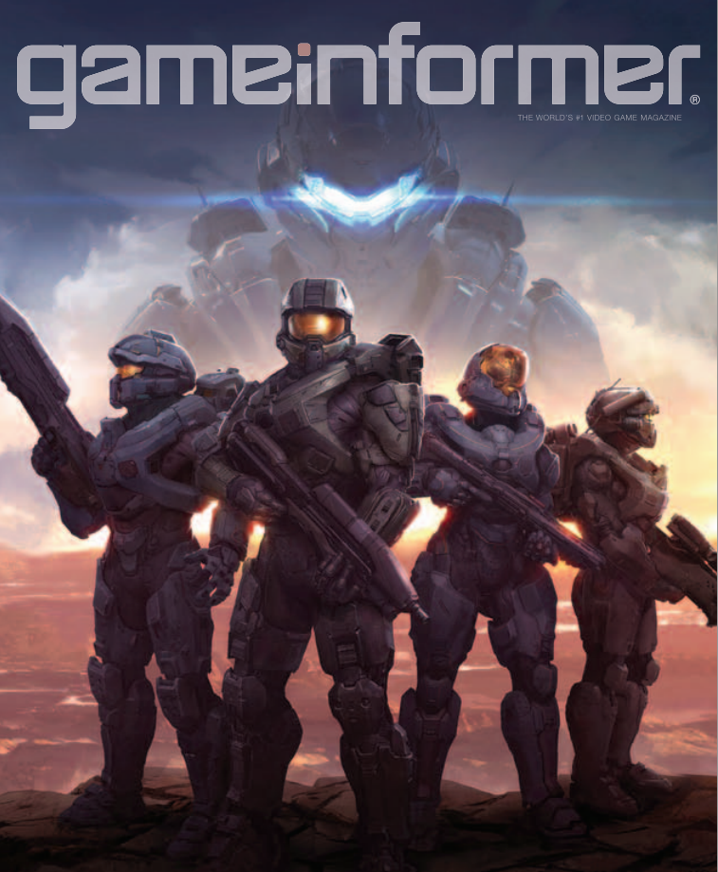
Magazines - Game Informer
Game Development Updates
Previews
*Video Game Release Schedule*
Reviews
13 issues for $20

Slide 46
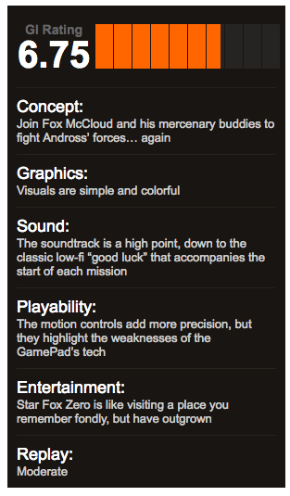
Magazines - Game Informer

Slide 47
Magazines - Xbox
Game Development Updates
News
Game Previews
Reviews
*Not the same online*
13 issues for $30

Slide 48
Magazines - Xbox Magazine
NONE.

Slide 49
Websites

Slide 50
Websites
www.kotaku.com
www.ign.com
www.opencritic.com

Slide 51
Websites - Kotaku
Geek posts
News
Minimal Video Game Reviews
Feminism
Hardcore gamers HATE IT

Slide 52
Websites - Kotaku

Slide 53
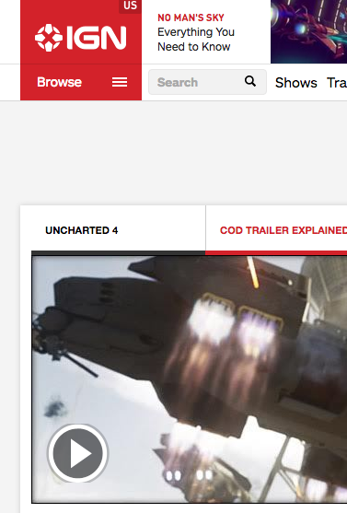
Websites - IGN
TV, Movies, and Comics
Cheat codes & walkthroughs
Video Game Reviews
Community oriented

Slide 54
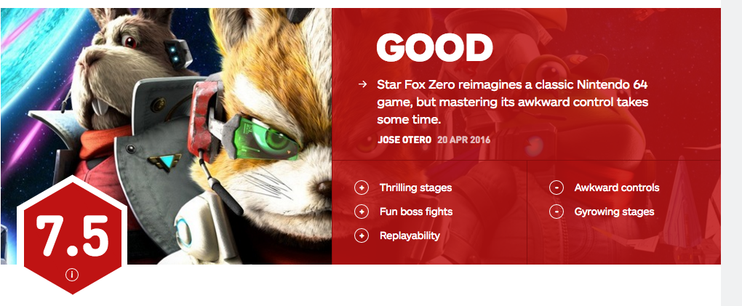
Websites - IGN

Slide 55
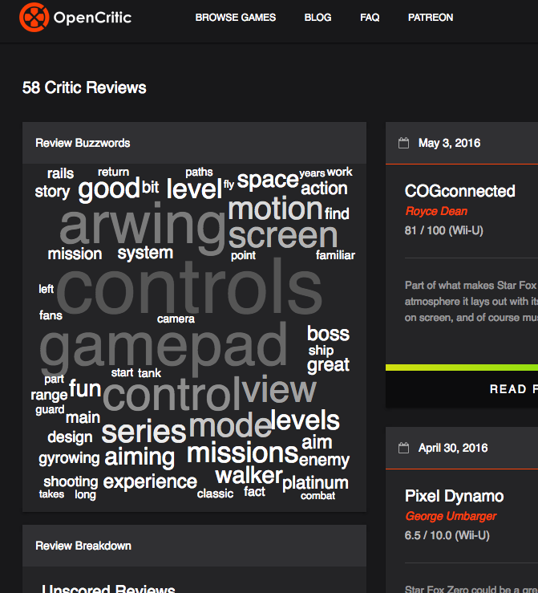
Websites - Open Critic
New Website
“Rotten Tomatoes”
Reviews without a score are excluded

Slide 56
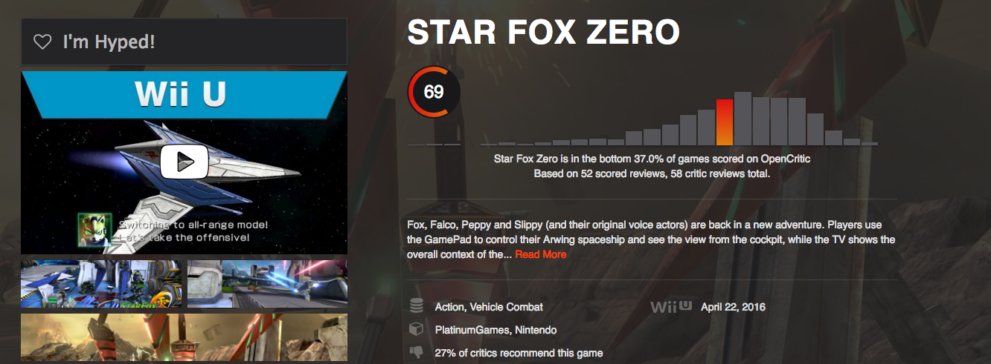
Websites - Open Critic

Slide 57
Librarians!

Slide 58
Librarians- The Video Game Librarian
Pick of the Week
New Release Round-Up
New Game Announcements
News
New Videos

Slide 59
Librarians- Library Journal
Monthly articles
Comprehensive overview of video game genres, styles, and themes
Best Games of the Year List

Slide 60
Librarians- Beyond the Pixels (TSU)
Video Game Reviews
Monthly
Written by multiple librarians

Slide 61
Librarians- Me! (Teen Librarian Toolbox)
Shameless Plug
Weekly column called “Video Games Weekly”
Suggestions for collection development
Video Games 101

Slide 62
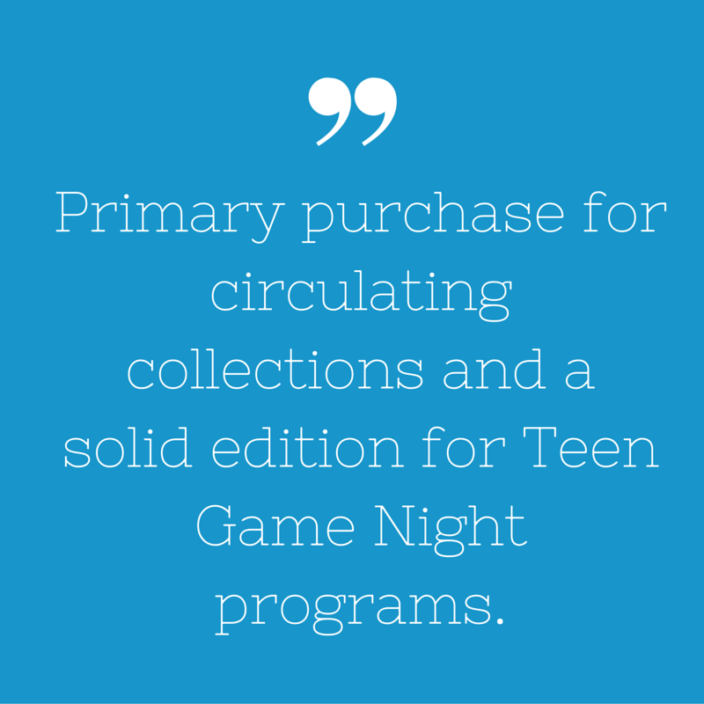
Librarians- Me! (Teen Librarian Toolbox)

Slide 63
Top 3 Picks

Slide 64
Wii U
Super Smash Brothers
Super Mario Maker
Mario Kart 8

Slide 65
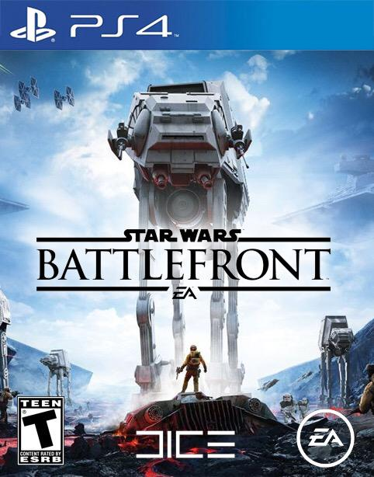
PlayStation 4
Grand Theft Auto 5
Star Wars Battlefront
Call of Duty

Slide 66
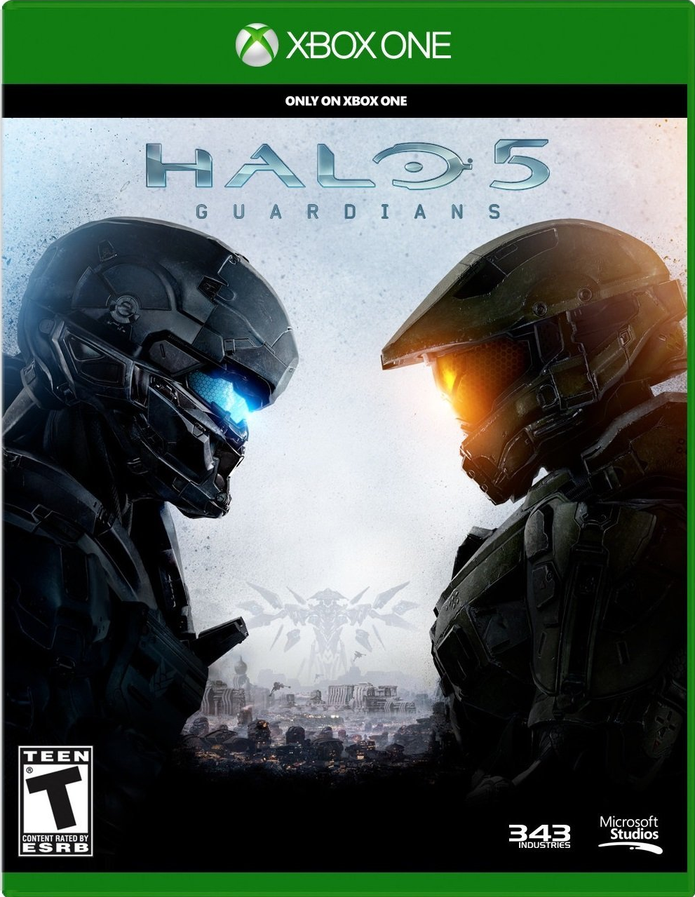
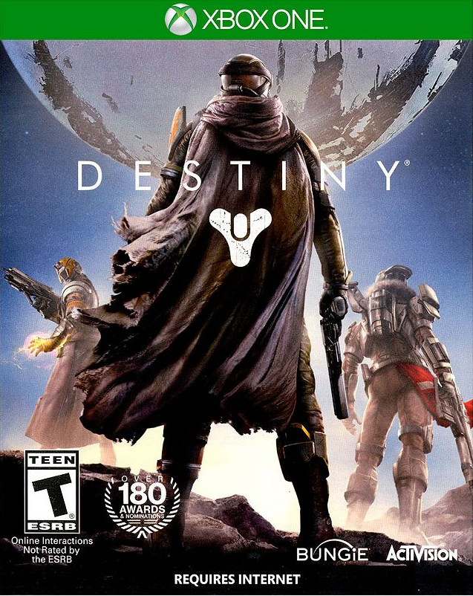
Xbox One
Halo 5
Destiny
Witcher III: Wild Hunt

Slide 67
Collection Development: Board & Card Games

Slide 68
Considerations
Number of players
Age range
Length of play (buy a mix)
Competitive vs. Cooperative
Genres (historical, fantasy, sci fi, humor)
Formats (board, card, app-aided, etc.)

Slide 69
Expenses, Storage, and Maintenance
Games run from $10-100. Average ~$40 each.
On a budget? Stick to card games.
Boxes store easily! Get a bin for small card game boxes. Small ziploc bags for parts will make your life easier.
Consider clear card sleeves for any game that gets a lot of use. Extends the life of your cards.
Include a list of parts taped to the box.
Barcode the boxes to circulate in-house or require a sign out sheet/collateral.

Slide 70
A note about expansions:
Many board game companies come out with expansion packs for their popular titles.
Additional cards, additional board pieces, more characters, etc.
Sometimes optional, sometimes significant game-changers
Consider buying expansions for your most played and loved games

Slide 71
Awards
Golden Geek Award
Awarded by boardgamegeek.com every March
in several categories.
Origin Awards
Presented annually by the Academy of Adventure
Gaming Arts and Design for outstanding games
in the industry.
Dice Tower Awards
Annual community-driven award, with nominees
chosen by bloggers and podcasters.

Slide 72
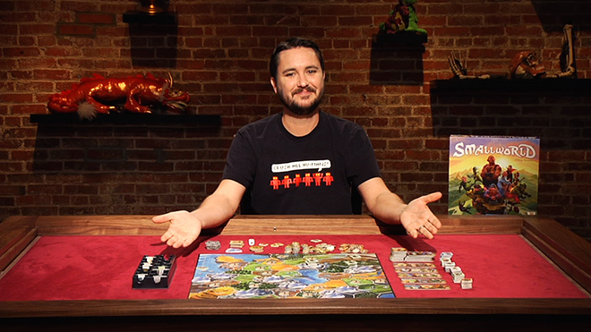
Wil Wheaton’s Tabletop
Geek celebrity guests game together and
show off a wide variety of respected
tabletop games.
All episodes available for free on youtube
and the Geek & Sundry website!
http://geekandsundry.com/shows/tabletop/

Slide 73
Suggested Games
Cooperative
Pandemic
Castle Panic
Sentinels of the Multiverse
Pathfinder Card Game
Eldritch Horror
Battlestar Galactica: TBG
Flash Point: Fire Rescue
Robinson Crusoe: Adventures on the Cursed Island
Hanabi (great for anime clubs)
Competitive
Sushi Go! (great for anime clubs)
Takenoko (great for anime clubs)
Exploding Kittens
Settlers of Catan
King of Tokyo
Gloom
Dominion
7 Wonders
Smallworld
Loveletters

Slide 74
Websites
Boardgamegeek.com
Dicetower.com
...that’s it. That’s all you need.*
* ...unless you have rules disputes, in which case you should go to the website of the game publisher. These websites will often have errata, which are rules clarifications or tweaks to the game rules/mechanics that make the game play better. It’s often a good idea to print out critical bits of errata to keep inside the game box.

Slide 75
Collection Development:
Tabletop RPGs

Slide 76
Considerations
You need someone to run the game!
Must be someone confident making decisions who has the free time to prep the adventure for others.
Must be kind to the players, unless the group decides they want a DM who’s trying to kill them all the time.
Participation is limited
Anything more than about 6 players gets unwieldy for the DM and boring for the players. Larger groups will need multiple DMs to run separate adventures.

Slide 77
Expenses, Storage, and Maintenance
Comparatively cheap: $20-50 for each book
Steep discounts on Amazon, or support your local gaming shop
Typically need at least one player’s handbook and one gamemaster/dungeonmaster handbook
Most games require a set of polyhedral dice: d4, d6, d8, d10, d12, d20. ~$10 per set, or buy bulk
Some games require special dice. Prices vary.
Minimum one set for players, one for gamemaster.

Slide 78
Expenses, Storage, and Maintenance, cont.
Minimal storage needs. May want to hang onto character sheets in between games if your players can’t be trusted to keep track.
New editions every few years
Optional extra books
Purchase published adventures, or let your gamemaster create a ‘homebrew’ adventure.
Add to the gaming experience by purchasing character and monster miniatures, dungeon tiles, and other extras.

Slide 79
Suggested Titles
The major systems are:
Dungeons & Dragons (5th edition)
Pathfinder
Star Wars (Edge of the Empire/Age of Rebellion)
GURPS (4th edition)
Generic Universal RolePlaying System
Super flexible… and complicated because of it.
These are fairly complex, but also the most well-known.

Slide 80
Suggested Titles, cont.
If your players are fandom-oriented or open to trying lesser known systems:
Cortex RPG system
Serenity (Firefly ‘verse) [game of the year 2005]
Supernatural
Battlestar Galactica
Smallville
Mutants & Masterminds (superheros/villains)
Fate Core and Fate: Accelerated Edition (pay what you want)

Slide 81
A note about World of Darkness:
World of Darkness (White Wolf Gaming Studio) used to be one of the biggest RPG settings for both tabletop and live-action roleplay. It’s a bit lost right now after being discontinued, bought by another company, then bought by another company after that.
The future is uncertain, but it’s past popularity means it’s worth having it on your radar. Their line includes three core settings: Vampire, Werewolf, and Mage.

Slide 82
Websites
General news and information:
enworld.org
tribality.com
Specific Systems:
Paizo.com (Pathfinder)
Wizardsofthecoast.com (D&D)
Fantasyflightgames.com (Star Wars)

Slide 83
Free Dungeons & Dragons
Download the basic rule set for Dungeons & Dragons 5th edition for free on the Wizards of the Coast website. All you’ll need is dice.
http://dnd.wizards.com/articles/features/basicrules

Slide 84
Managing
Access to
Gaming Supplies

Slide 85
Considerations
Consider barcoding them for in-house use
Include a laminated list of all the pieces either in the box or taped to the outside
Available all the time vs. available only during programs

Slide 88
Tabletop RPGs
If you choose to circulate copies of the core books, make sure you keep one copy of each book for In-Library Use Only.
Keep the dice behind the desk or in another secure place.

Slide 89
Questions? Comments?

Slide 90
Hands on!

