Slide 1
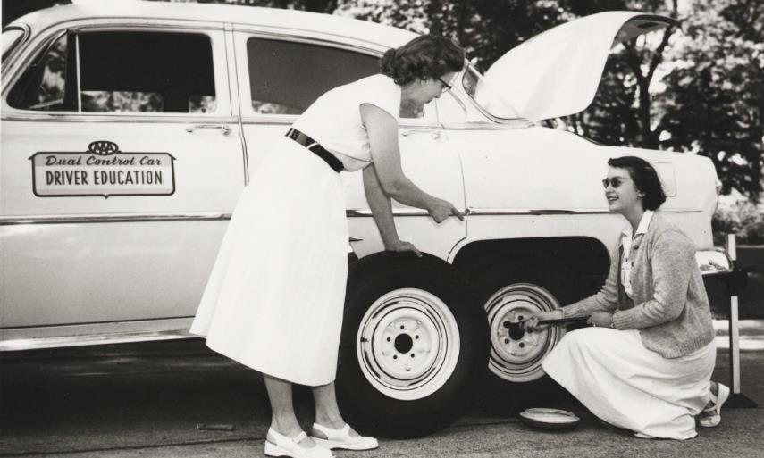
Effective Training
Understanding and Assisting Adult Learners
Karen Vaias, MLIS & Jeff Teichmann, MLIS

Slide 2
Pedagogical

Slide 3
Andragogical

Slide 4
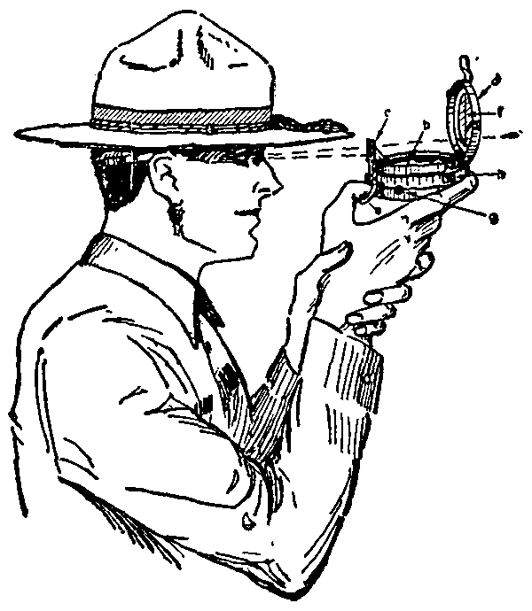
The Adult Learner is…
Self Directed

Slide 5
The Adult Learner is…
Experienced & Knowledgeable

Slide 6
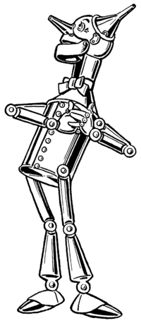
The Adult Learner wants to…
Learn in Order to Succeed

Slide 7
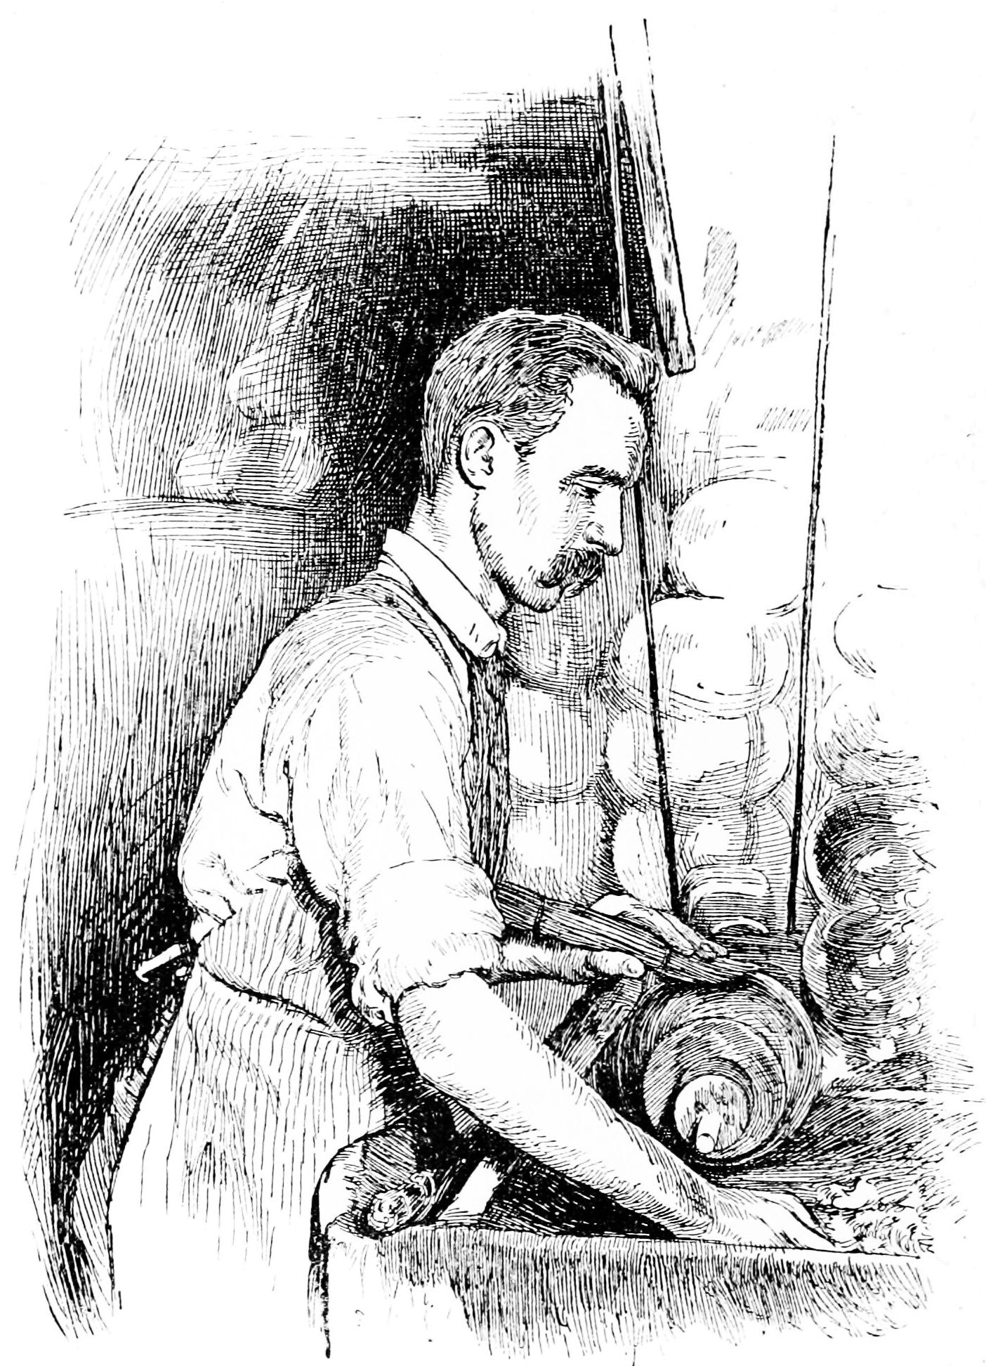
The Adult Learner wants…
Immediate, Real-World Applications

Slide 8
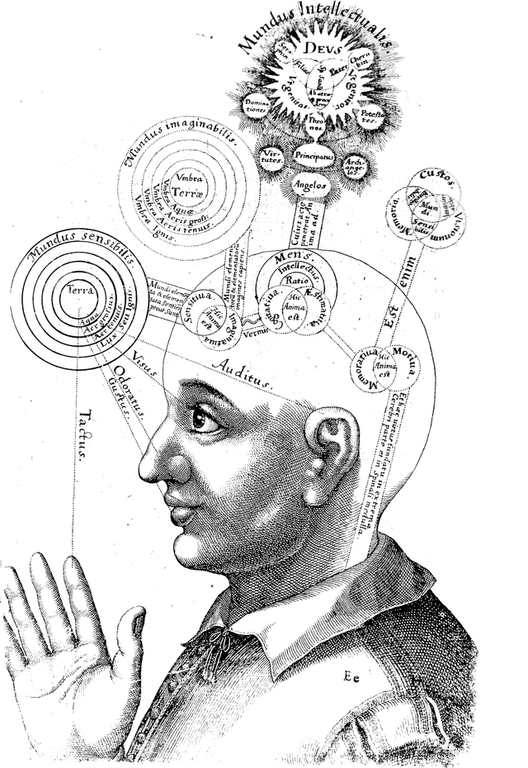
The Adult Learner is…
Influenced by Many Internal Factors

Slide 9
Feelers
Are people-oriented
Focus on feelings
Prefer lack of structure
Share opinions
Notes:
Feelers are people-oriented
They tend to do well in open, unstructured learning environments.
They like group activities
Text message:
Who needs the instructions?
Is it an emergency?
Does our user have any physical limitations that makes texting difficult?

Slide 10
Observers
Watch and listen
Are reserved and quiet
Are on-target with comments
Learn through discovery

Slide 11
Thinkers
Prefer logic and reason
Share ideas and concepts
Analyze and evaluate
Work independently

Slide 12
Doers
Are activity-oriented
Dominate group activities
Prefer real-world applications
Enjoy clear, concise presentations

Slide 13
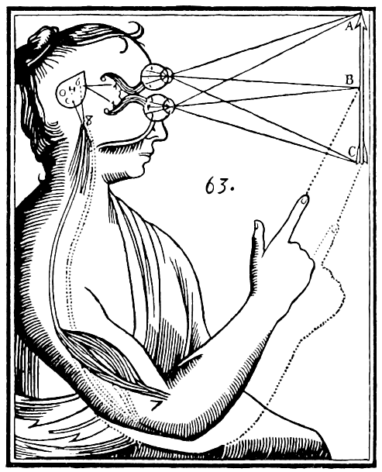
Perceptual Modalities

Slide 14
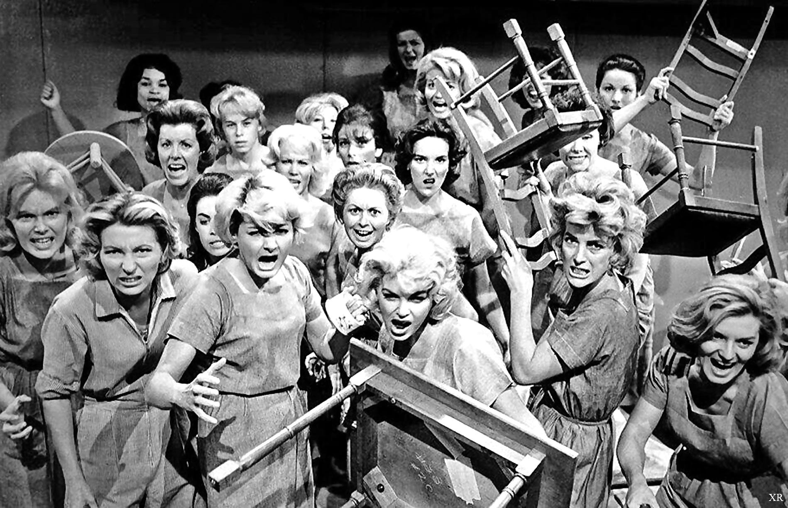
What else affects learning?

Slide 15
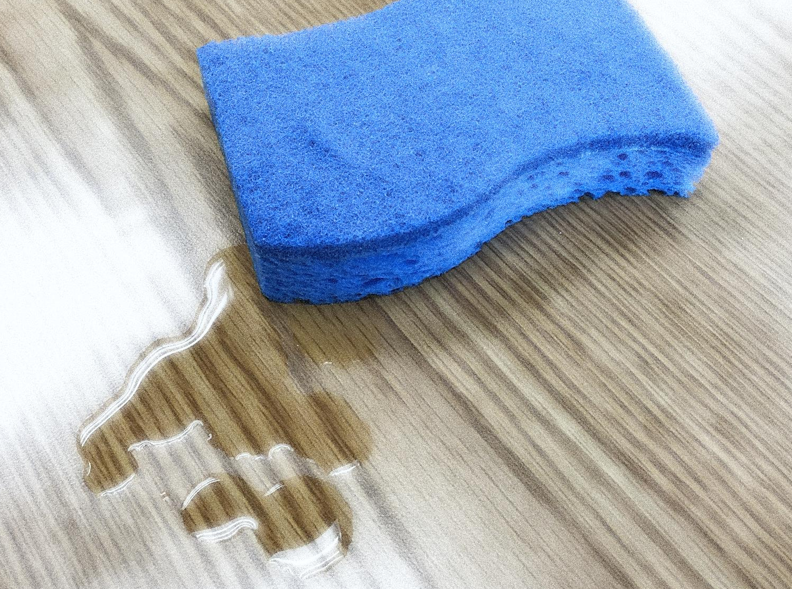
Cognitive Overload
Notes:
Our minds are like sponges
We can absorb a lot, but eventually we become saturated
To avoid overload:
Avoid solid lecture; let visual aids assist you in summarizing; chunk or bundle info.

Slide 16
Origami!

Slide 17
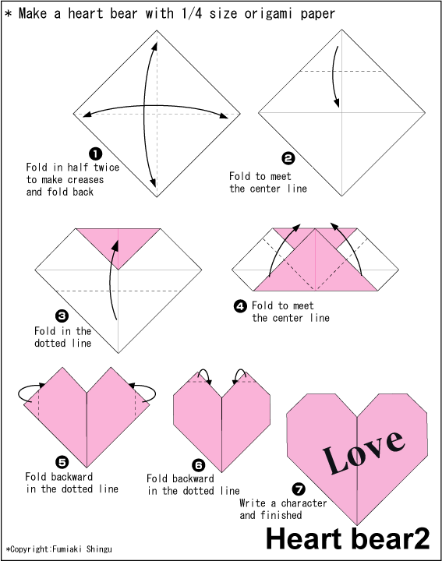

Slide 18
Instructional styles
Factors
Personal Biases
Environment
Content
Preferred style

Slide 19
Personal biases

Slide 20
Environment

Slide 21
Content

Slide 22
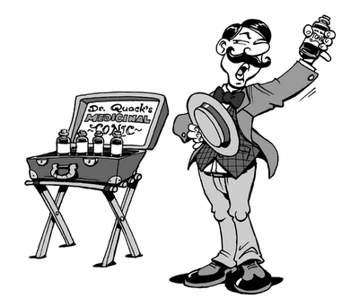
Preferred Style
Seller
Coach
Professor
Entertainer

Slide 23
Preferred Style
Seller
Task oriented
Taskmasters
Main concern = content
Informal & rigid

Slide 24
Preferred Style
Coach
Learner oriented
Facilitators
Main concern = results
Informal & flexible

Slide 25
Preferred Style
Professor
Instructor oriented
Lecturers
Main concern = delivery
Formal & rigid

Slide 26
Preferred Style
Entertainer
Relations oriented
Role Model
Main concern = feelings
Formal & flexible

Slide 27
Preferred Style
Seller
Task oriented
Taskmasters
Main concern = content
Informal & rigid
Coach
Learner oriented
Facilitators
Main concern = results
Informal & flexible
Learners
Content
Learning
Professor
Instructor oriented
Lecturers
Main concern = delivery
Formal & rigid
Entertainer
Relations oriented
Role Model
Main concern = feelings
Formal & flexible
Instructor

Slide 28
Conclusion
Learners
Content
Learning
Instructor

Slide 29
Resources
Lawson, Karen. The Trainer’s Handbook, 2nd ed., 2006. Pfeiffer, San Francisco, CA.
Instructional Style Diagnosis Inventory.
From The Trainer’s Handbook.

Slide 30
Effective Training Understanding and Assisting Adult Learners
Karen Vaias, MLIS
kvaias@bernards.org
Jeff Teichmann, MLIS
jteich@rci.rutgers.edu

