Slide 1
Beacon
Technology
Using beacons to push relevant information to patrons

Slide 2
Beacons
Transmitters that alert nearby smart devices of relevant information, cause the device to perform a specific action.
Example:
One application is an indoor positioning system, which helps smart phones determine their approximate location or context. With the help of an iBeacon, a smartphone's software can approximately find its relative location to an iBeacon in a store. iBeacons can help a phone show notifications of items nearby that are on sale, and it can enable payments at the point of sale (POS) where customers don’t need to remove their wallets or cards to make payments. iBeacon technology works using the Bluetooth Low Energy (BLE)technology, also known as Bluetooth Smart.
Originally going to be made with a Raspberry Pi

Slide 3
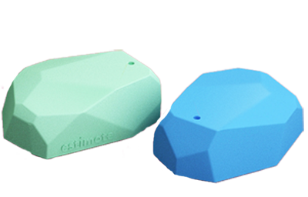
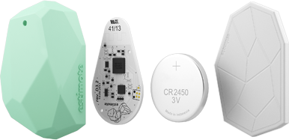
Estimote
Estimote Beacons and Stickers are small wireless sensors that you can attach to any location or object. They broadcast tiny radio signals which your smartphone can receive and interpret, unlocking micro-location and contextual awareness.

Slide 4
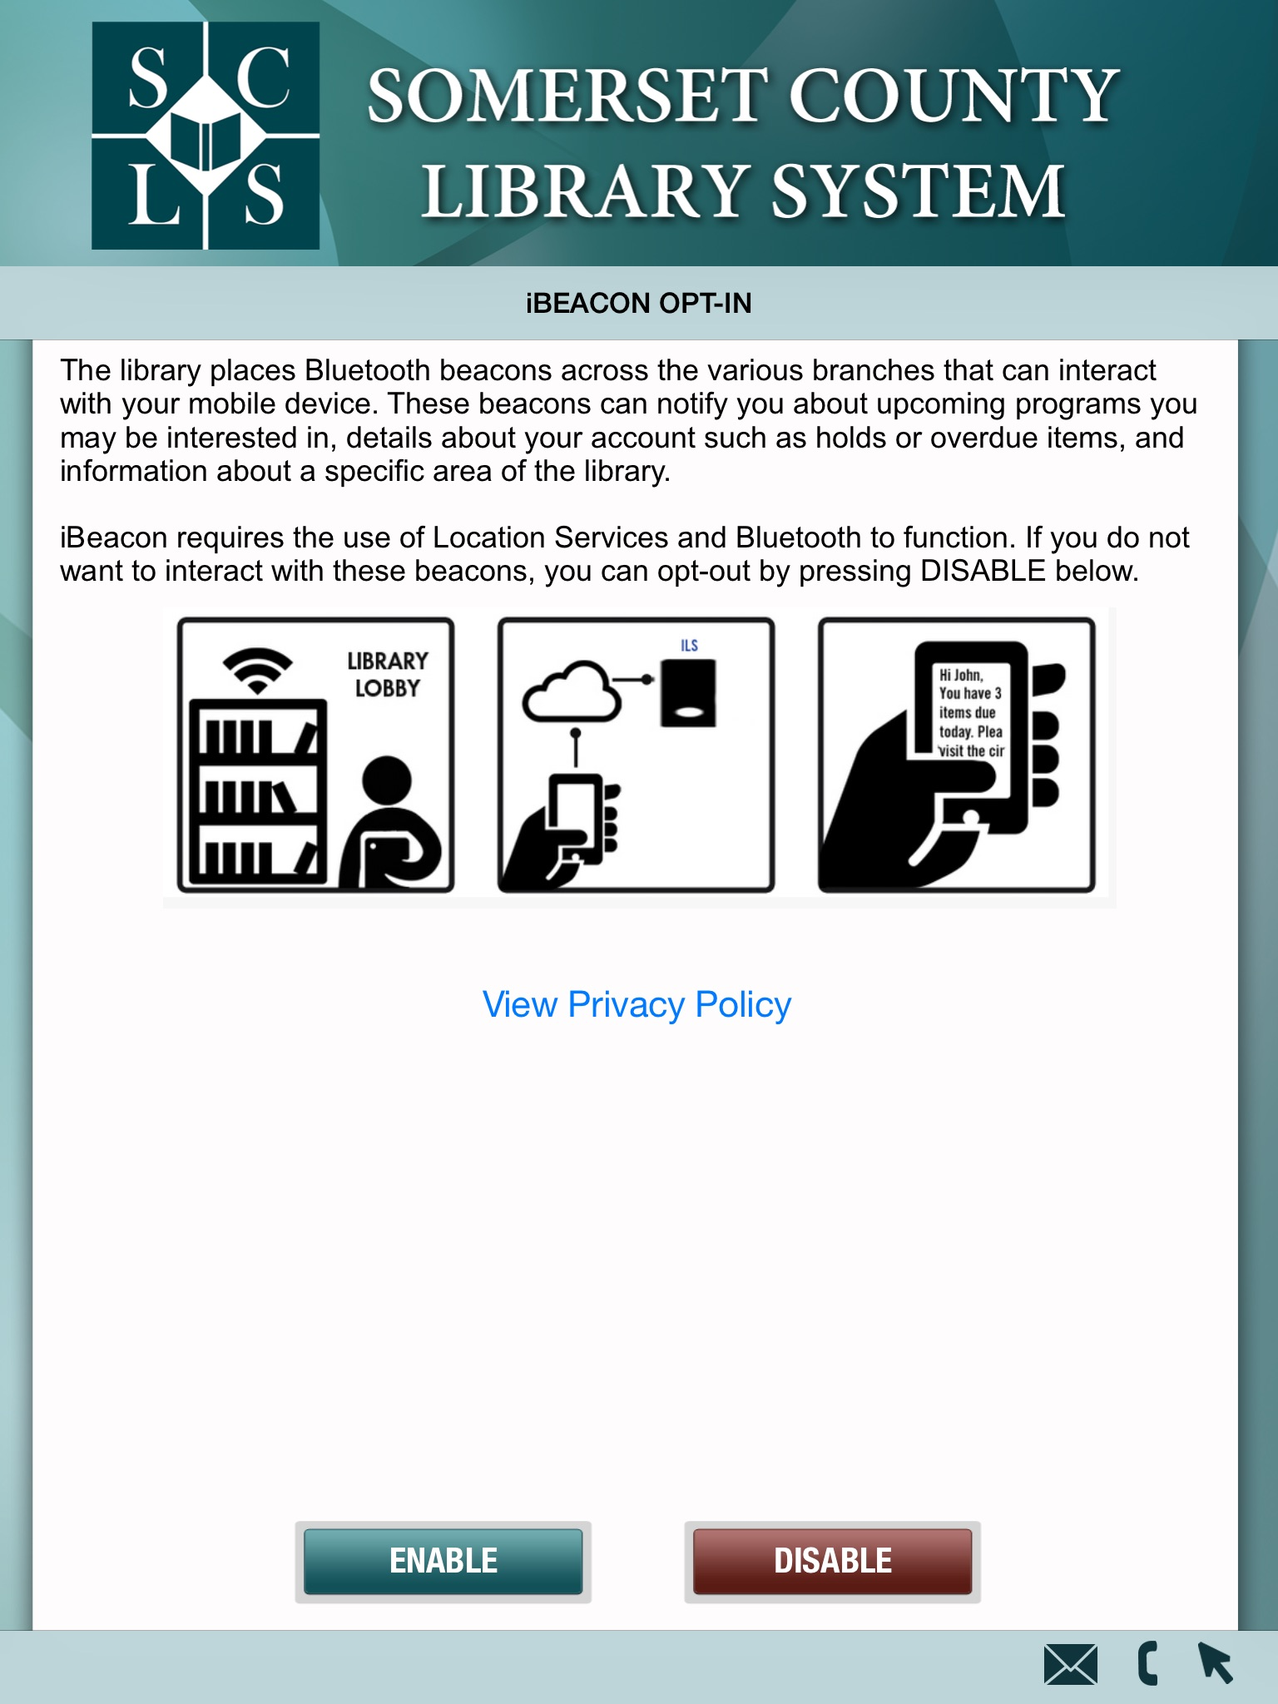
Estimote with Capira Technologies App
Circ Beacon

Slide 5
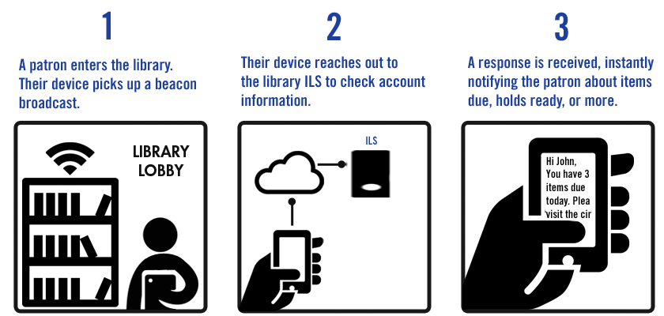
Estimote with Capira Technologies App
Circ Beacon

Slide 6
Estimote with Capira Technologies App
Circ Beacon

Slide 7
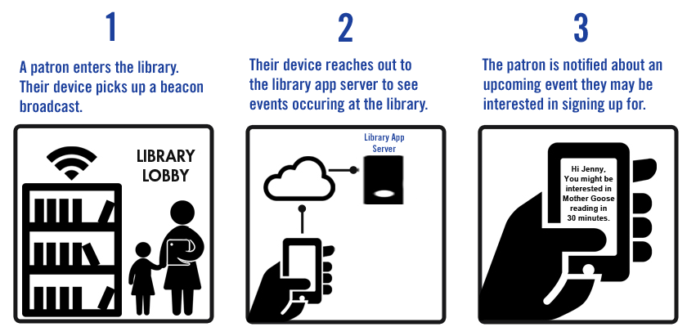
Estimote with Capira Technologies App
Event Beacon

Slide 8
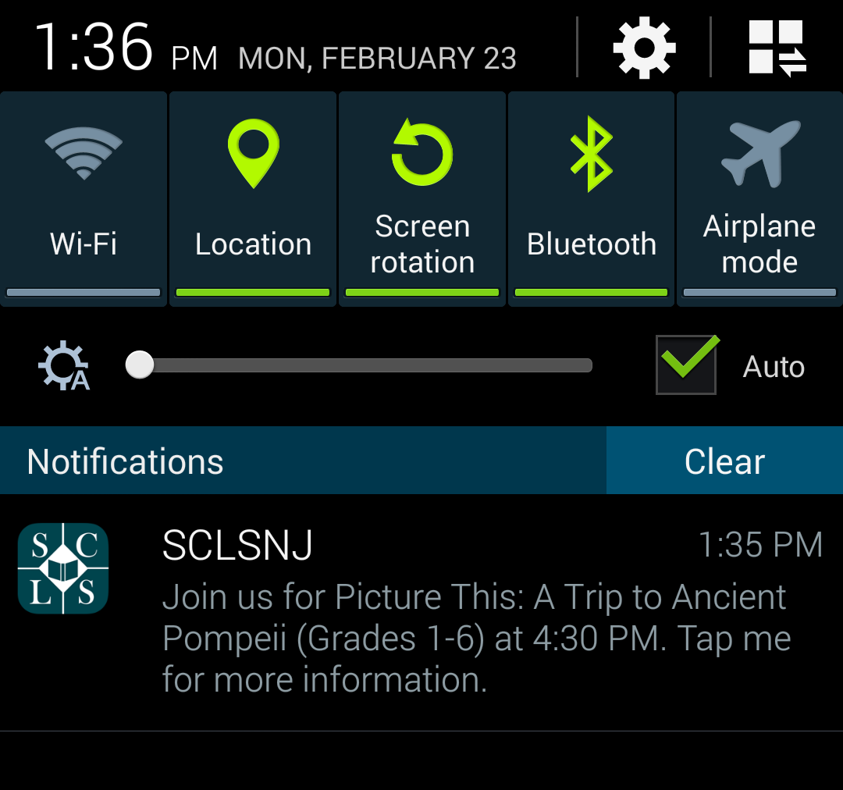
Estimote with Capira Technologies App

Slide 9
Estimote with Capira Technologies App

Slide 10
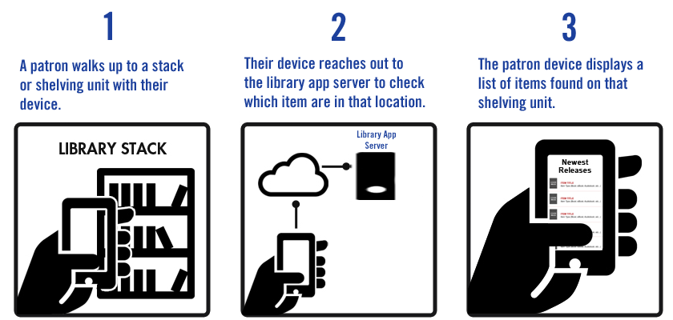
Estimote with Capira Technologies App
Shelf Beacon

Slide 11
RICH LOOMIS
DIGITAL SERVICES MANAGER
SOMERSET COUNTY LIBRARY SYSTEM
☎ (908) 526-4016 x171
✉ rloomis@sclibnj.org

